Slide 1
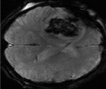
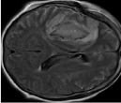
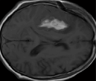
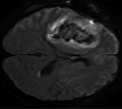

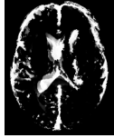

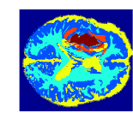
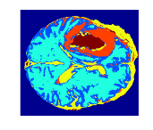
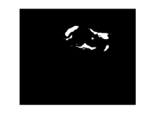


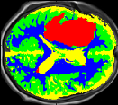




Labeling initialization
SPM segmentation
Multimodal MR dataset
K=1
$$I_{}^{template}$$
$$I_{}^{patient}$$
K=2
Initial ABT guess based on templates outliers
An example of Z-score comparison:
K=3
Initial labeling
K
GMM algorithm
$$I_{T1w}^{template}$$
$$I_{T1w}^{patient}$$
5
Z-scores
4
4
3
Maximal Probability Labeling
0
2
K
-4
1
5
K=4
4
3
Final Labeling*
2
Partition of initial ABT into 2 classes
K=5
1
Incorporation of ABT neighborhood information and final tissue labeling
Supplementary Figure 1. Abnormal brain tissue quantification.

Slide 2
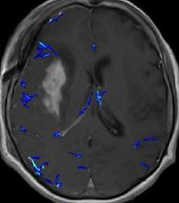
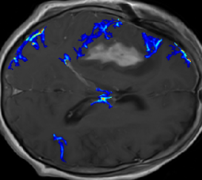
a.
τ₁
τ₂
1
Normalized Distribution
0·5
0
0
100
200
300
Enhancement, %
Normalized Enhancement
b.
c.
1
0·75
0·5
0·25
0
Supplementary Figure 2. Quantitative approach for the assessment of BBB pathology.

Slide 3
a
b
200
200
ABT, ml
BBBD, ml
100
100
0
t1
t2
t3
t4
0
t1
t2
t3
t4
Supplementary Figure 3. Dynamic of ABT and BBBD in a subgroup with all four time points.

