Slide 1
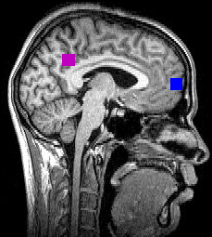



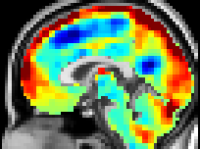


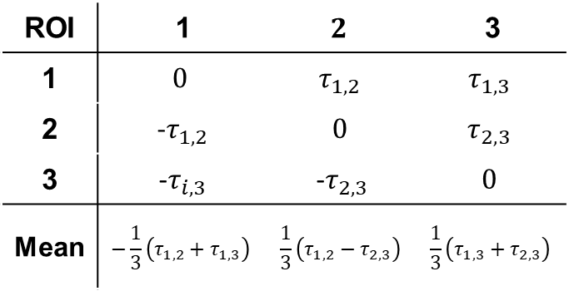
Fig. 1
A
B
$$r_{i,j}$$
Correlation
~200 s
$$τ_{i,j}$$
C
ROI | 1 | $$2$$ | 3
1 | $$0$$ | $$τ_{1,2}$$ | $$τ_{1,3}$$
2 | -$τ_{1,2}$ | $$0$$ | $$τ_{2,3}$$
3 | -$τ_{i,3}$ | -$τ_{2,3}$ | $$0$$
Mean | $$−\frac{1}{3}\left(τ_{1,2}+τ_{1,3}\right)$$ | $$\frac{1}{3}\left(τ_{1,2}−τ_{2,3}\right)$$ | $$\frac{1}{3}\left(τ_{1,3}+τ_{2,3}\right)$$
-6.6
-4.4
-2.2
0
2.2
4.4
6.6
D
Time delay (s)
DAN
VAN
SMN
VIS
E
FPC
LAN
DMN
-0.25 s
+0.25 s
-0.5 s
+0.5 s

Slide 2
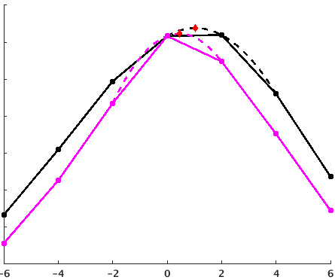



A
Fig. 2
x₁
$τ$ = 1 sec
x₂
temporal
mask
1 1 1 1 1 1 1 1 1 0 1 0 0 0 1 1 1 1 0 0 1 1 1 0 1 1
∆ = 0
N = 19
mask 1
1 1 1 1 1 1 1 1 1 0 1 0 0 0 1 1 1 1 0 0 1 1 1 0 1 1
N = 14
mask 2
1 1 1 1 1 1 1 1 1 0 1 0 0 0 1 1 1 1 0 0 1 1 1 0 1 1
N = 8
∆ = +1
N = 14
mask 1
1 1 1 1 1 1 1 1 1 0 1 0 0 0 1 1 1 1 0 0 1 1 1 0 1 1
N = 12
mask 2
1 1 1 1 1 1 1 1 1 0 1 0 0 0 1 1 1 1 0 0 1 1 1 0 1 1
N = 8
∆ = +2
N = 12
mask 1
1 1 1 1 1 1 1 1 1 0 1 0 0 0 1 1 1 1 0 0 1 1 1 0 1 1
N = 10
mask 2
1 1 1 1 1 1 1 1 1 0 1 0 0 0 1 1 1 1 0 0 1 1 1 0 1 1
N = 8
∆ = +3
N = 11
mask 1
1 1 1 1 1 1 1 1 1 0 1 0 0 0 1 1 1 1 0 0 1 1 1 0 1 1
N = 8
mask 2
1 1 1 1 1 1 1 1 1 0 1 0 0 0 1 1 1 1 0 0 1 1 1 0 1 1
N = 8
∆ = -3
N = 11
mask 1
1 1 1 1 1 1 1 1 1 0 1 0 0 0 1 1 1 1 0 0 1 1 1 0 1 1
1 1 1 1 1 1 1 1 1 0 1 0 0 0 1 1 1 1 0 0 1 1 1 0 1 1
N = 8
mask 2
N = 8
B
$\hat{τ}$ = .45 s
$\hat{τ}$ = 1.04 s
Covariance (a.u.)
Unbiased
Biased
-6
-4
-2
0
2
4
6
∆ (s)

Slide 3
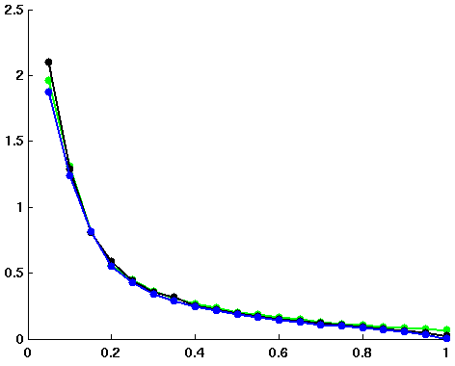
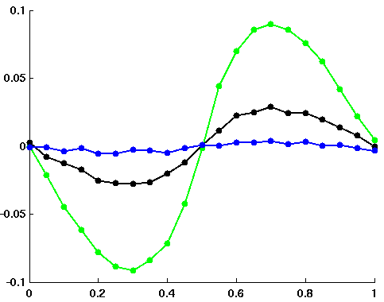
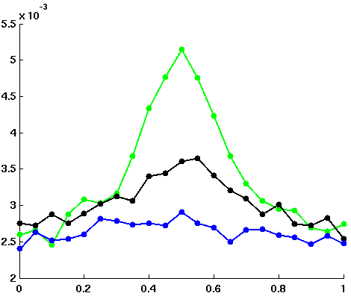



A
B
Fig. 3
TR = 1 s
TR = 2 s
TR = 3 s
TR = 1 s
TR = 2 s
TR = 3 s
RMSE (s)
RMSE (s)
Data quantity (min)
|$r$|
C
TR = 1 s
TR = 2 s
TR = 3 s
Bias (s)
Variance
TR = 1 s
TR = 2 s
TR = 3 s
$τ$ / TR
$τ$ / TR
TR = 1 s
TR = 2 s
TR = 3 s
RMSE (s)
$τ$ / TR

Slide 4
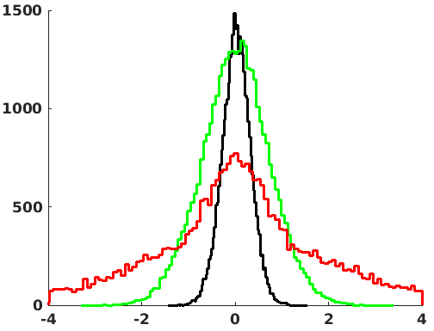
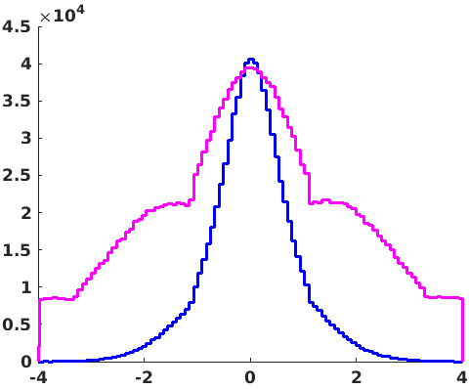



Fig. 4
A
B
Session (30 min)
Subject (300 min)
Group (3000 min)
$$\left|\hat{r}\right|<0.2$$
$$\left|\hat{r}\right|≥0.2$$
# of ROI pairs
# of ROI pairs
$\hat{τ}$ (s)
$\hat{τ}$ (s)

Slide 5












A
TD matrix
|FC| matrix
Fig. 5
DAN
$$\hat{τ}$$
$$\left|\hat{r}\right|$$
VAN
+0.75 s
.7
SMN
VIS
FPC
LAN
DMN
-0.75 s
0
B
C
TD matrix
$$D_{0}$$
TD submatrix
|FC| matrix
$$D_{−1}$$
Mean |FC| submatrix
$$D_{−2}$$
$$D_{2}$$
$$D_{1}$$
$$\frac{1}{9}\sum_{i=1}^{3}{\sum_{j=1}^{3}{\left|r_{i,j}\right|}}$$
“Error” matrix
Mean |FC| matrix
$$\sqrt{\frac{1}{9}\sum_{i=1}^{3}{\sum_{j=1}^{3}{{(τ_{i,j}−\overline{τ_{D_{j−i}}})}^{2}}}}$$
D
“Error” matrix
Mean |FC| matrix
E
DAN
error
$$\left|\hat{r}\right|$$
Session
Subject
Group
VAN
0.7
.7
SMN
VIS
Error
r = -.87****
FPC
LAN
DMN
0.3
0
r = -.81****
r = .26
$$\left|\hat{r}\right|$$

Slide 6
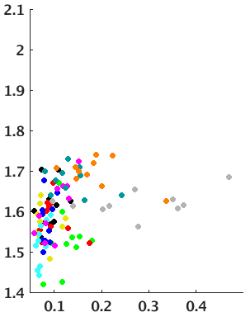
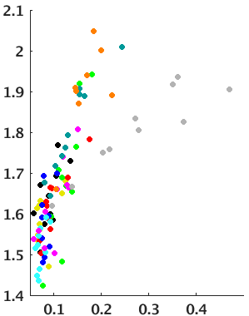
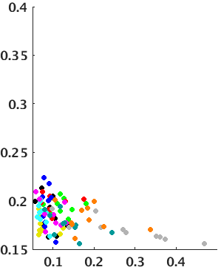
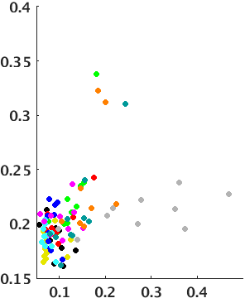
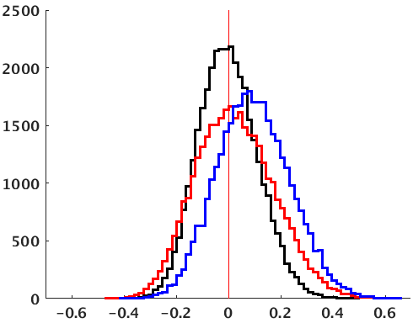
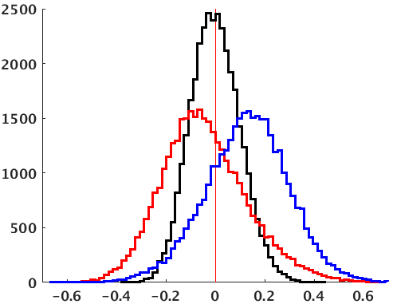
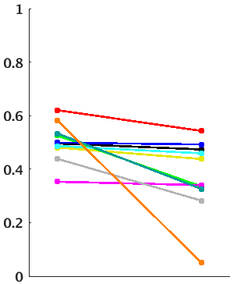
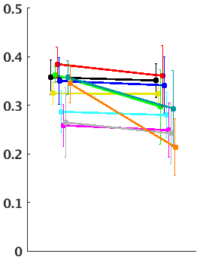
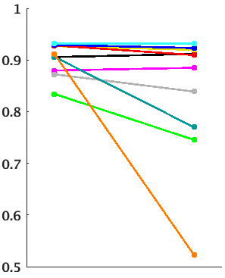
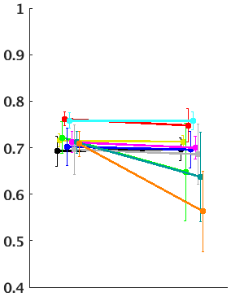


A
B
Fig. 6
TD
FC
Pre-censoring
Post-censoring
Pre-censoring
Post-censoring
MSC01
r = -.44
r = .43
MSC02
MSC03
$$σ_{TD}$$
MSC04
$$σ_{FC}$$
MSC05
MSC06
MSC07
MSC08
MSC09
r = .32
r = .72
MSC10
FD (mm)
FD (mm)
C
QC:|TD|
D
QC:|FC|
Medians
Medians
-0.004
0.019
0.107
Null
Pre-censoring
Post-censoring
-0.004
-0.056
0.133
# of ROI pairs
# of ROI pairs
r
r
E
TD
F
FC
Low:High motion correspondence
Group correspondence
Low:High motion correspondence
Group correspondence
∗
∗∗∗
∗∗∗
ρ
r
Pre-
censoring
Post-
censoring
Pre-
censoring
Post-
censoring
Pre-
censoring
Post-
censoring
Pre-
censoring
Post-
censoring

Slide 7
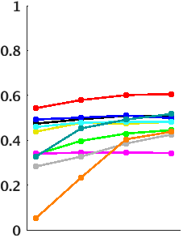
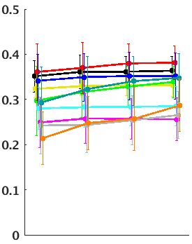
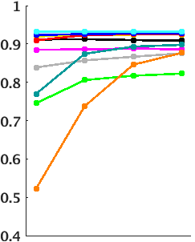
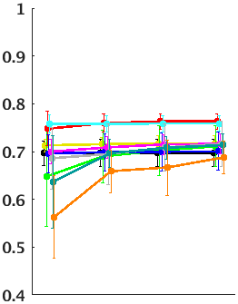
A
B
Fig. 7
TD
FC
Low:High motion correspondence
Group correspondence
Low:High motion correspondence
Group correspondence
∗∗
∗
∗∗∗
∗∗∗
∗∗∗
MSC01
∗
∗∗∗
∗∗∗
∗∗∗
MSC02
MSC03
MSC04
ρ
MSC05
r
MSC06
MSC07
MSC08
MSC09
MSC10
60
30
15
min
60
30
15
min
Minimum block duration (s)
Minimum block duration (s)

Slide 8
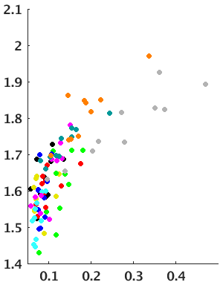
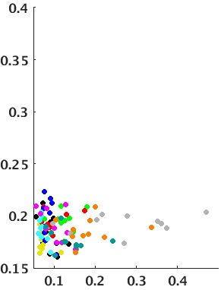
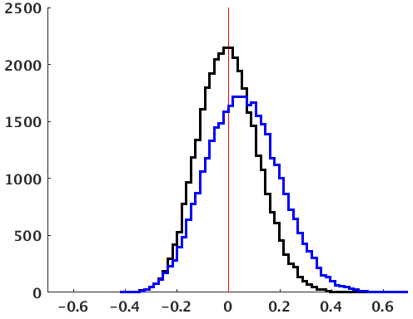
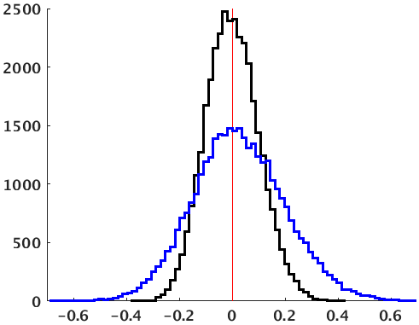


A
Fig. 8
TD
FC
MSC01
MSC02
MSC03
$$σ_{TD}$$
$$σ_{FC}$$
MSC04
MSC05
MSC06
r = .75
r = .04
MSC07
MSC08
MSC09
MSC10
B
FD (mm)
FD (mm)
QC:|TD|
QC:|FC|
Medians
Medians
-0.005
0.090
-0.004
0.022
Null
Post-censoring
r
r

Slide 9
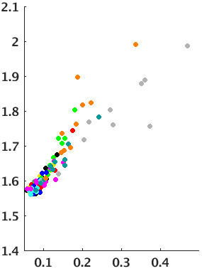
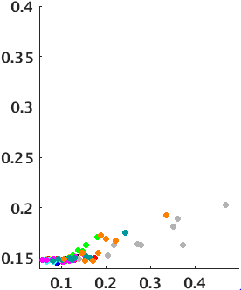
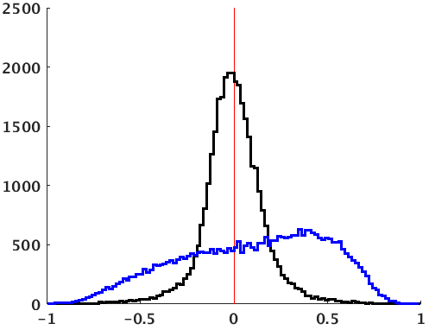
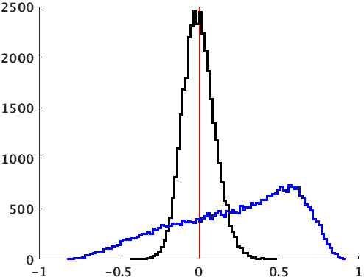


A
Fig. 9
Surrogate TD
Surrogate FC
MSC01
MSC02
MSC03
MSC04
MSC05
Surrogate $σ_{TD}$
Surrogate $σ_{FC}$
MSC06
r = .92
r = .88
MSC07
MSC08
MSC09
MSC10
B
FD (mm)
FD (mm)
QC:Surrogate |TD|
QC:Surrogate |FC|
Medians
Medians
-0.005
0.141
-0.005
0.287
Null
Post-censoring
r
r

Slide 10
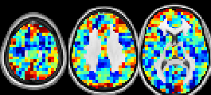
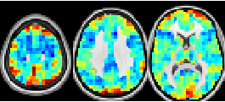
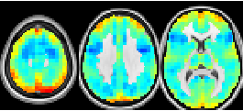
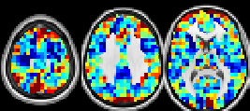
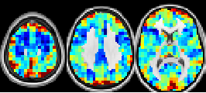
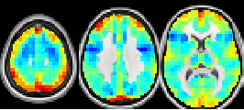
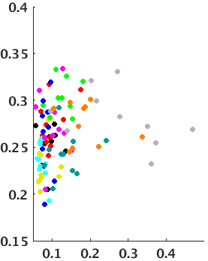
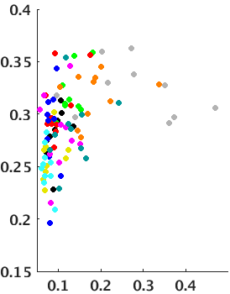
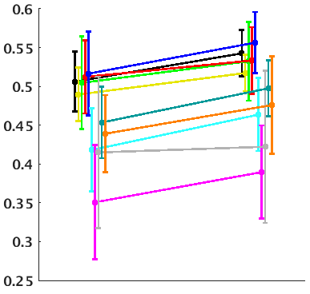





A
Fig. 10
*
TR = 1 s
TR = 2 s
TR = 3 s
= 10 minutes
= 100 minutes
= 1000 minutes
.
+
RMSE (s)
$$β= .2789, R^{2}= .7970$$
$$β= .1455, R^{2}= .9982$$
$$β= .0464, R^{2}= .9983$$
B
|$r$|
Session
Subject
Group
+0.5 s
Unweighted
Weighted
-0.5 s
C
Unweighted
Weighted
D
Correspondence with unweighted group lag projection
∗∗∗
$$σ_{{TD}_{P}}$$
ρ
r = .21
r = .42
FD (mm)
MSC01
MSC03
MSC05
MSC07
MSC09
Unweighted
Weighted
MSC02
MSC04
MSC06
MSC08
MSC10

Slide 11
Supplementary figures

