Slide 1



A
Fig. S1
$$|r|= .2$$
$|r|= .$4
TR = 1 s
TR = 2 s
TR = 3 s
RMSE (s)
Data quantity (min)
Data quantity (min)
B
10 minutes
250 minutes
TR = 1 s
TR = 2 s
TR = 3 s
TR = 1 s
TR = 2 s
TR = 3 s
RMSE (s)
|$r$|
|$r$|

Slide 2


A
B
Fig. S2
TR = 1 s
TR = 2 s
TR = 3 s
TR = 1 s
TR = 2 s
TR = 3 s
$z(\hat{r})$ RMSE
$z(\hat{r})$ RMSE
Data quantity (min)
|$r$|

Slide 3
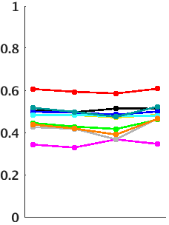
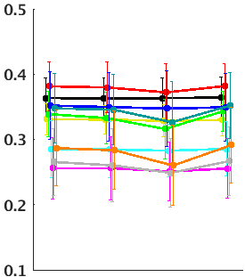
Fig. S3
TD
Low:High motion correspondence
Group correspondence
n.s.
n.s.
∗
∗∗∗
∗∗∗
∗∗
ρ
Unbiased
Biased
Equal
All
Unbiased
Biased
Equal
All
MSC01
MSC03
MSC05
MSC07
MSC09
MSC02
MSC04
MSC06
MSC08
MSC10

Slide 4
Fig. S4
Group correspondence
TD
FC
∗
∗∗
∗
∆ρ
∆ r
orig
orig
interp
interp
orig
orig
orig
interp
orig
interp
interp
orig
interp
interp
orig
interp
1
2
3
4
1
2
3
4
Frames replaced
Frames replaced
MSC01
MSC03
MSC05
MSC07
MSC09
MSC02
MSC04
MSC06
MSC08
MSC10

Slide 5
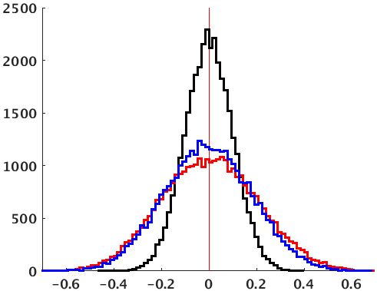
Fig. S5
QC:FC
Medians
Null
Pre-censoring
Post-censoring
-0.001
0.004
-0.003
r

