Slide 1
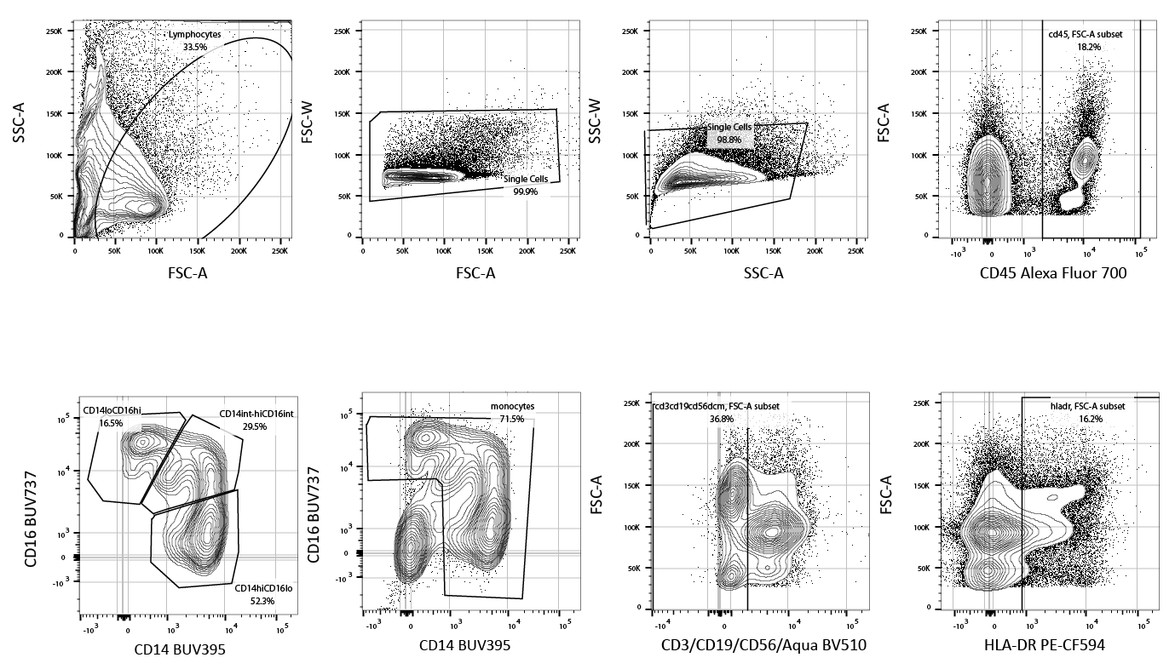
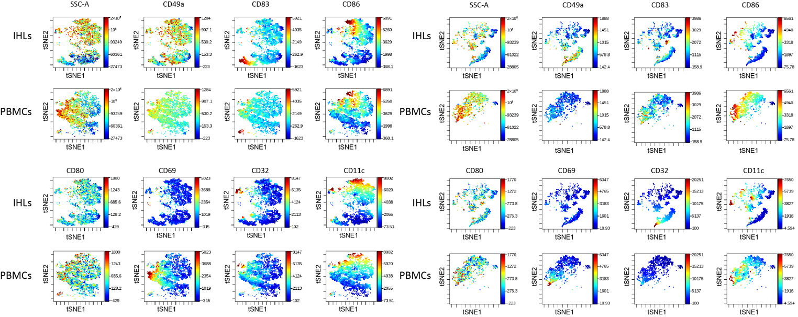
Supplementary Figure 1
A
leukocytes
single cells
single cells
CD45+
MOs/Mϕ subsets
MOs/Mϕ
CD3⁻CD19⁻CD56⁻LD⁻
HLA-DR+
B
C
D
Supplementary Figure 1: Gating strategy for ihMφ and MOs derived from liver (A) and peripheral blood (B) respectively. MOs were defined as single, CD45⁺, HLA-DR⁺, CD3⁻/CD19⁻/CD56⁻/zombie Aqua⁻ cells and then CD14/CD16 markers defined classical/non-classical/intermediate MOs subsets. (C and D) t-SNE analyses of two additional samples showing expression of CD49a, CD83, CD86, CD80, CD69, CD32 and CD11c.

Slide 2
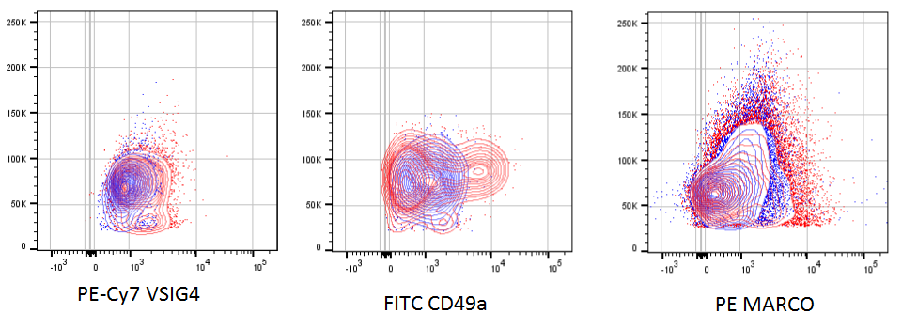
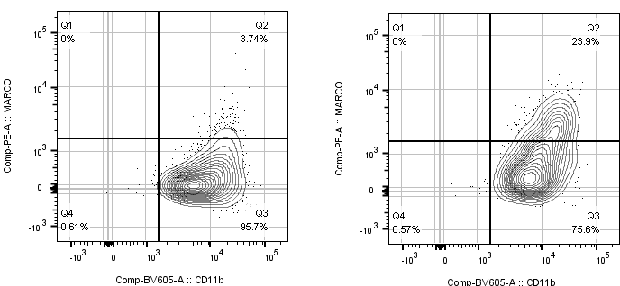
Supplementary Figure 2
A
B
Supplementary Figure 2: (A) Representative flow cytometry plots of VSIG4, CD49a and MARCO staining (red) and their corresponding isotype controls gated on ihMϕ. (B) Validation staining of MARCO in unstimulated PBMCs (left) and 48h-IL-10 stimulated PBMCs (right) gated on monocytes.

Slide 3
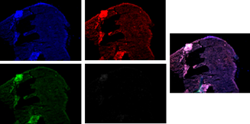
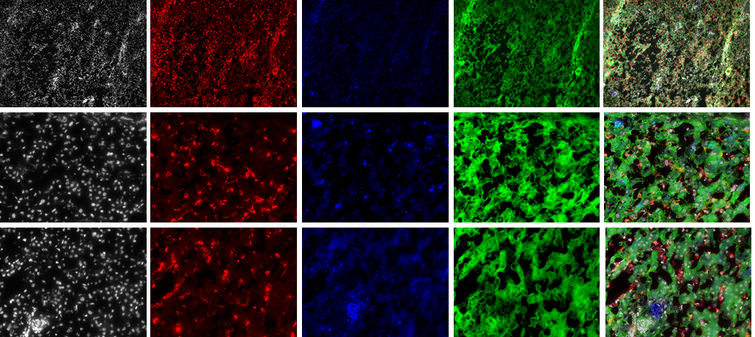
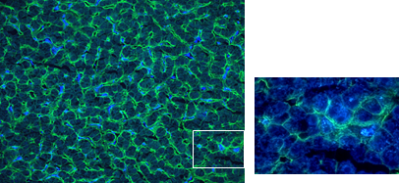
Supplementary Figure 3
A
B
Hoescht
CD68
VSIG4
CD49a
merge
VSIG4
x10
x40
x40
C
Supplementary Figure 3: (A) Representative Controls of liver tissue auto fluorescence for all 4 channels and merge (right). (B) Immunofluorescence staining of Hoechst, CD68, VSIG4 and CD49a at a x10 (top) and x40 (lower pictures) magnification. (C) Staining of human healthy donor tissue slides (12µm thick) for CD68 (blue) and CD49 (green); 20x magnification (left) and 60x magnification (right).

Slide 4
Supplementary Figure 4
Supplementary Figure 4: Scatter plots showing the calculated intensity on stained tissue slides of CD49a on CD49a^{+/-} signals (left) (n=291 for CD49a⁻ and n=270 for CD49a⁺), VSIG4 on VSIG4^{+/-} signals (middle) (n=209 for VSIG4⁻ and n=352 for VSIG4⁺) and MARCO on MARCO^{+/-} signal (left) (n=247 for MARCO⁻ and n=314 for MARCO⁺ ).

