Slide 1
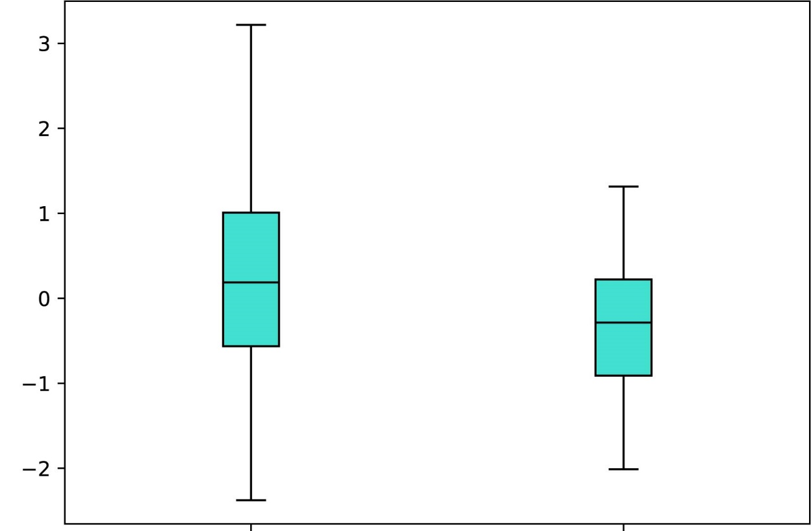
Kim
Sjodahl
Lindgren
p < 2.7 x 10⁻⁴
p < 2.5 x 10⁻⁷
p < 2.8 x 10⁻¹³
CPT1B z-score
CPT1B z-score
CPT1B z-score
Low
Grade
High
Grade
Low
Grade
High
Grade
Low
Grade
High
Grade
Supplementary Figure 7

