Slide 1
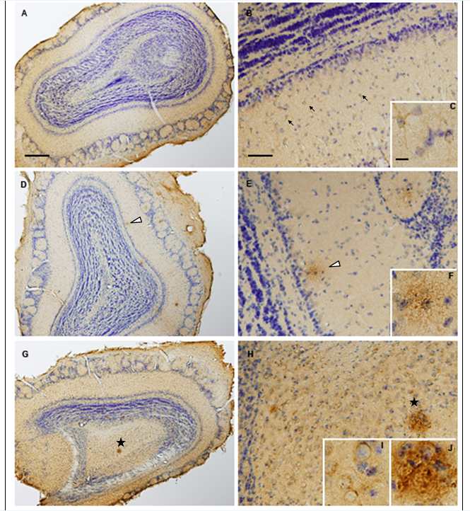
GL
EPL
ML
AON
GrL
GL
GrL
EPL
ML
AON
ML
EPL
AON
GrL
GL
GL: glomerular layer
EPL: external plexiform layer
MC: mitral layer
GrL: granular layer
AON: anterior olfactory nucleus
Supp. Figure 1

Slide 2

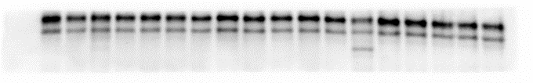
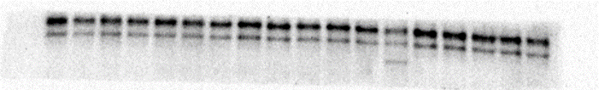
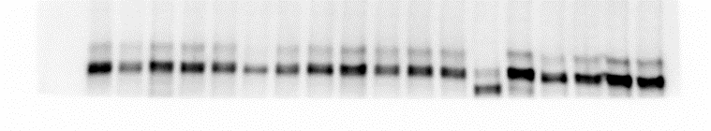
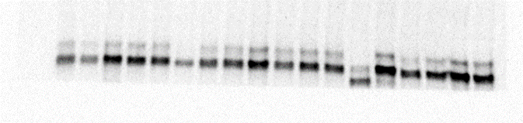
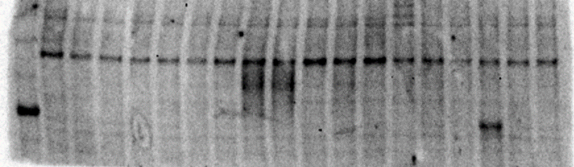
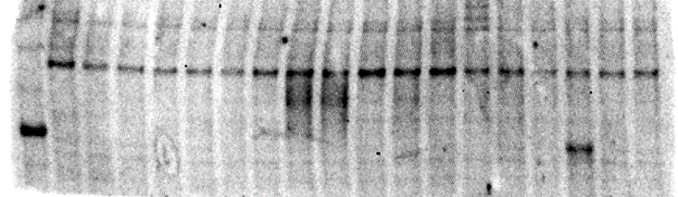
A
6 months
PP5
WT
Tg2576
**
**
Expression (a.u)
2m
6m
WT
Tg2576
B
WT
2m
Tg2576
2m
WT
6m
Tg2576
6m
WT
2m
Tg2576
2m
WT
6m
Tg2576
6m
pPDK1
PDK1
WT
WT
Tg2576
Tg2576
Expression (a.u)
Expression (a.u)
2m
6m
2m
6m
WT
2m
Tg2576
2m
WT
6m
Tg2576
6m
WT
2m
Tg2576
2m
WT
6m
Tg2576
6m
pPKC
PKC
WT
WT
Expression (a.u)
Expression (a.u)
Tg2576
Tg2576
2m
6m
2m
6m
WT
2m
Tg2576
2m
WT
6m
Tg2576
6m
pFAK
WT
Expression (a.u)
Tg2576
2m
6m
Supp. Figure 2

Slide 3
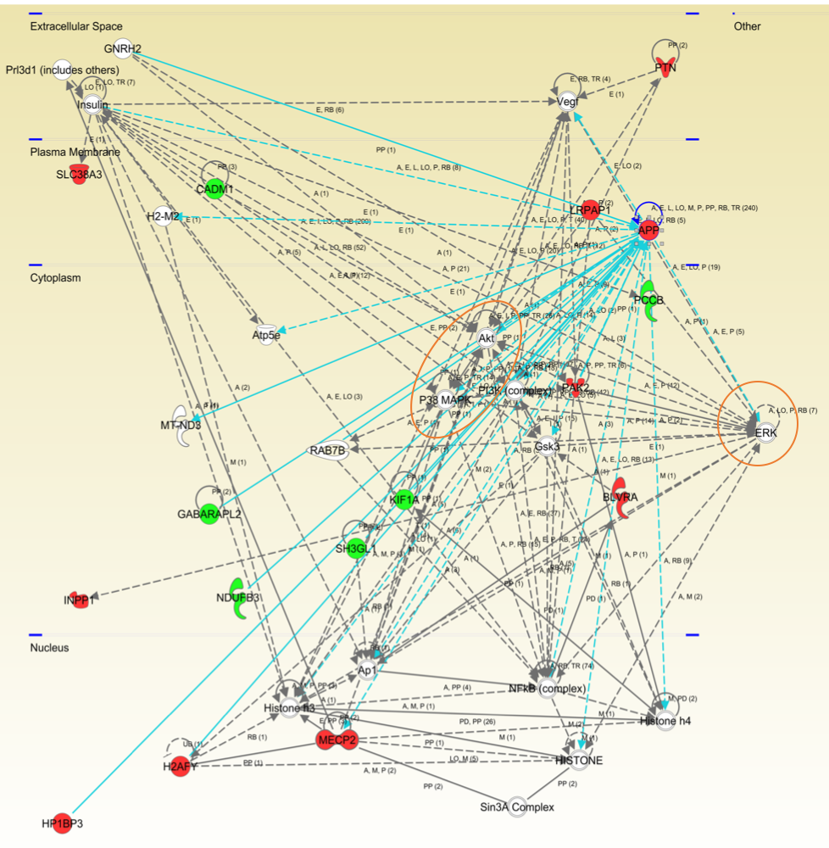
Supp. Figure 3

Slide 4
Supp. Figure 4

