Slide 1


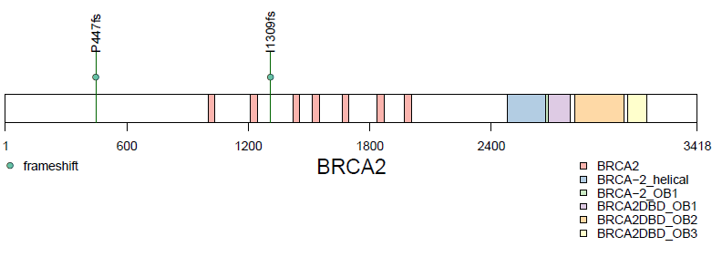

Figure S1
A
B
C
D

