Slide 1
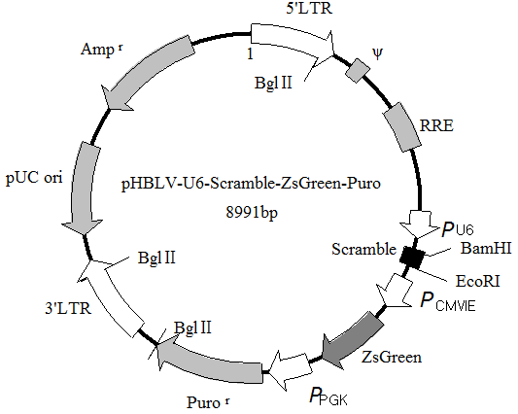
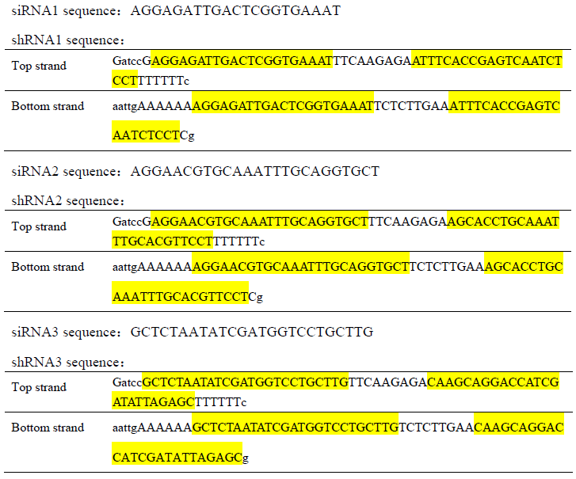
A B
Supplemental Figure 1. The sketch map of the plasmid (A) and the sequences of shRNA (B) used for RAC2 knock-down.

Slide 2
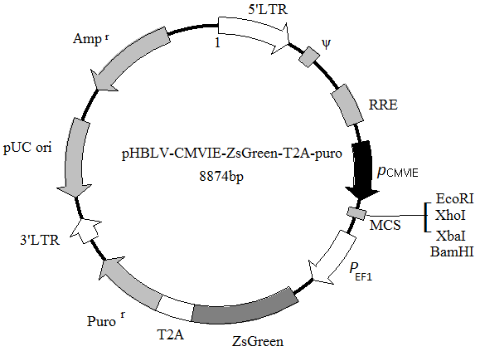
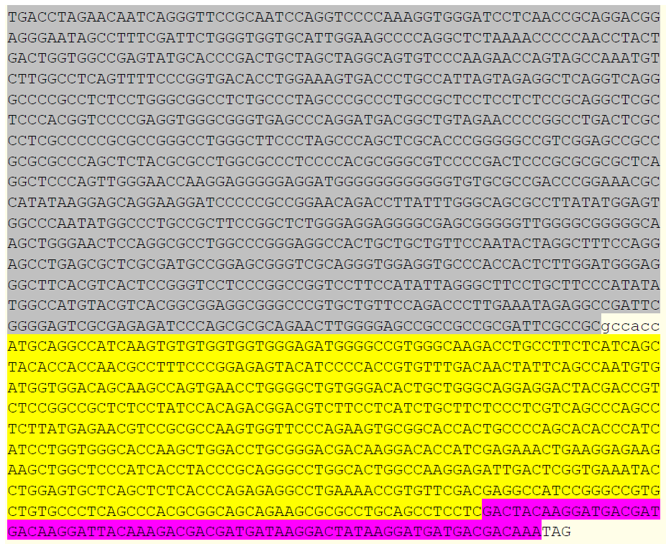
A B
Supplemental Figure 2. The sketch map of the plasmid (A) and the sequence of Egr1-RAC2 (B) used for RAC2 overexpression, in which the Egr1 sequence was shown in gray, RAC2 in yellow while Flag in purple.

Slide 3
Flag
GAPDH
Ctrl 0.25 0.5 1 2 4 8 24
Hours post-irradiation
Supplemental Figure 3. Overexpression of RAC2 in OCM-RAC2 cells post-irradiation was verified by Western-blot analysis of Flag at indicated time points.

Slide 4
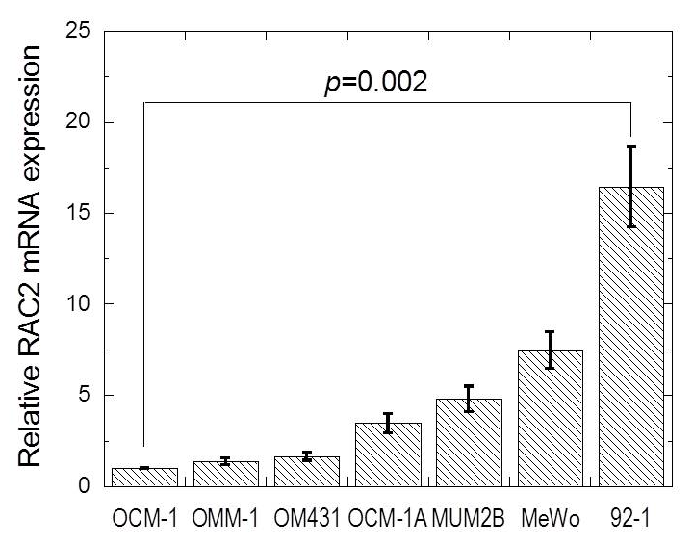
Supplemental Figure 4. Relative RAC2 expressions in several melanoma cell lines.

Slide 5
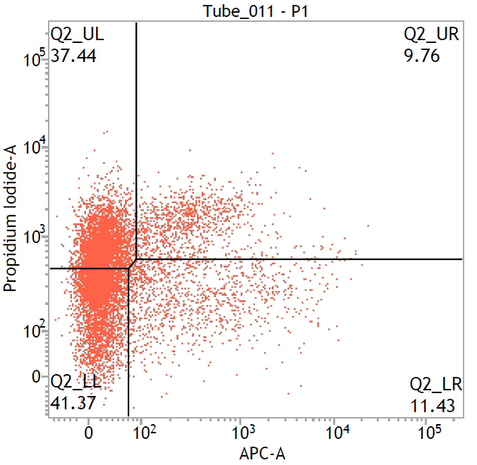
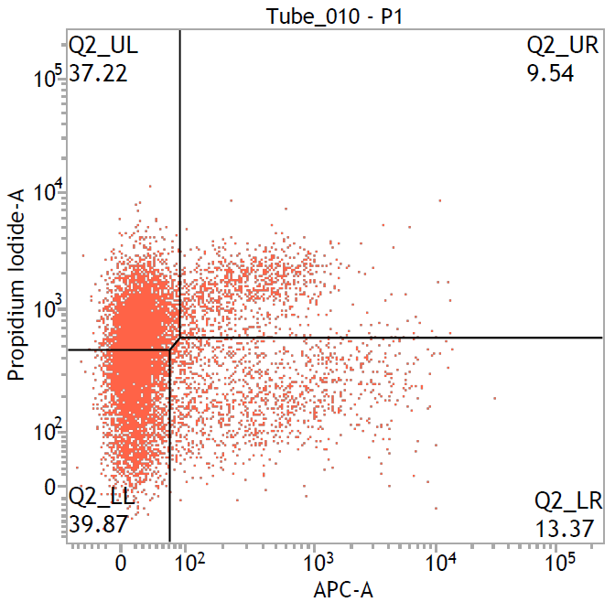
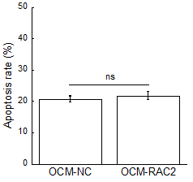
A
B
PI
Annexin V-APC
DPI+IR
Supplemental Figure 5. Inhibition of NADPH oxidase activity by 10 μM DPI abolished the radiosensitizing effect induced by RAC2 overexpression.

Slide 6
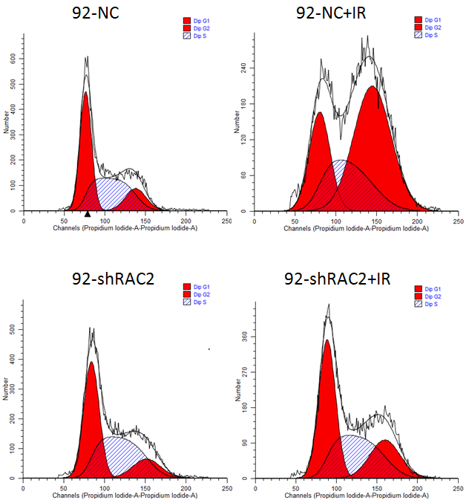
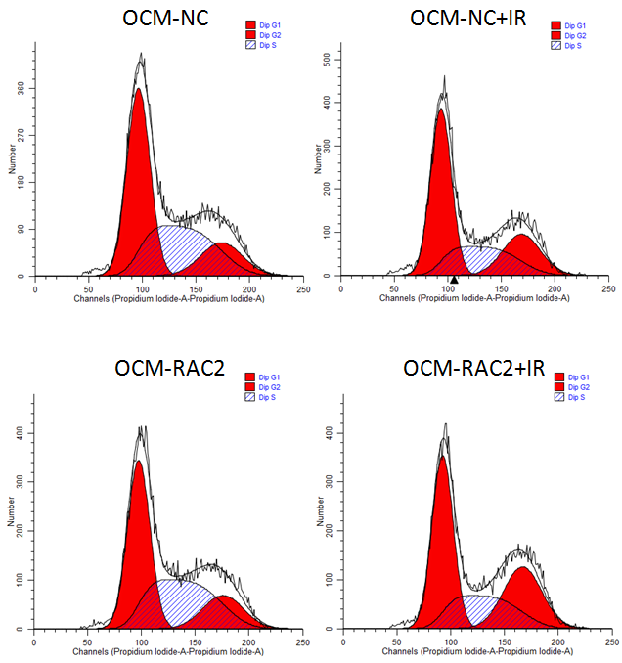
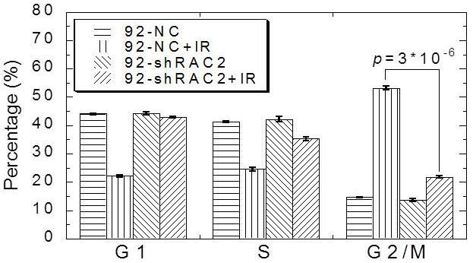
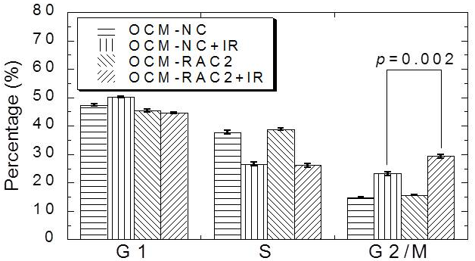
A B
C D
Supplemental Figure 6. Cell cycle distribution of the 4 cell lines exposed to 2 Gy X-rays irradiation.

