Slide 1
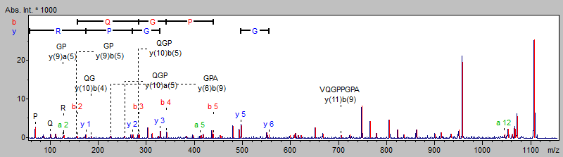
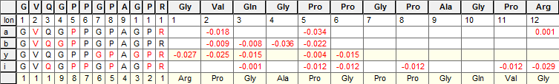
Supplementary figure 1. MS/MS of m/z 1105.6 from mouse intestine samples
Collagen alpha-1 (I) chain (CO1A1_Mou)
Observed M+H | Mr (expt) | Mr (calc) | ppm | Miss | Mascot Score | Sequence
1105.575 | 1104.493 | 1104.568 | -67.801 | 0 | 50 | GVQGPPGPAGPR (oxidation P)
Fragment Ion Mass Error (Da)

Slide 2
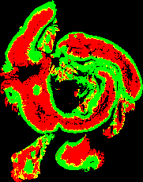

Supplementary figure 2. FFPE mouse intestine samples prepared with a wetted paper towel to maintain humidity.
A
B
C
Notes:
Supplementary figure 1 – Digest with paper towel
Scale bars 1000um

Slide 3
Supplementary figure 3. Inter- site observation – QC parameters

Slide 4
Supplementary figure 4. Inter- site observation – peptides

Slide 5
Supplementary figure 4. Inter- site observation – peptides (cont.)

Slide 6
Supplementary figure 5. Inter- site observation – trypsin autolytic peptides
m/z 842.50: [108-115] VATVSLPR
m/z 906.50: [201-208] NKPGVYTK
m/z 952.39: [1-8] FPTDDDDK
m/z 1006.48: [148-157]APVLSDSSCK
m/z 1045.56: [ 98-107] LSSPATLNSR
m/z 1469.73: [134-147] SSGSSYPSLLQCLK
m/z 1713.81: [58-72] LGEHNIDVLEGNEQF
Coefficient of Variance

Slide 7
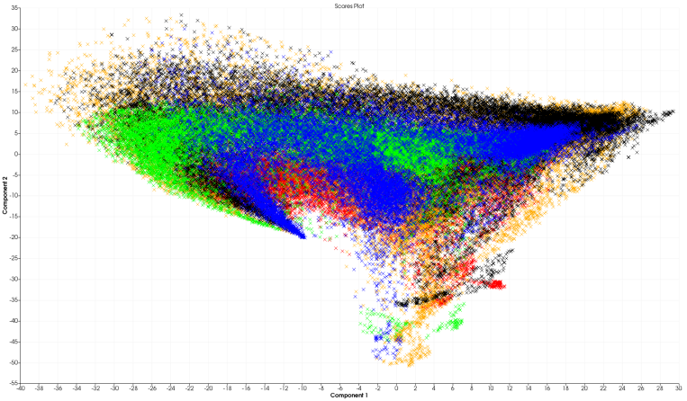
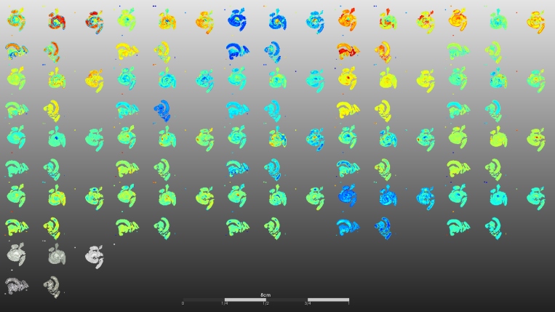
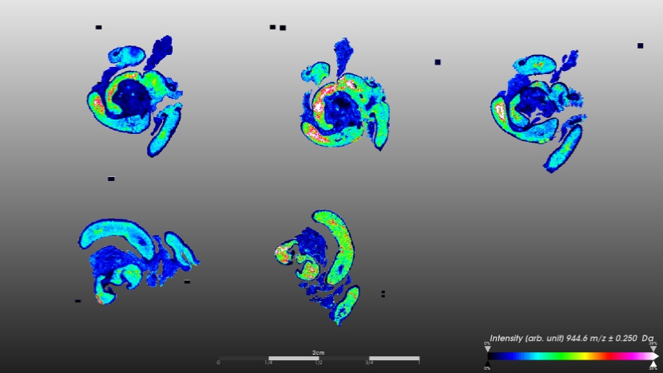
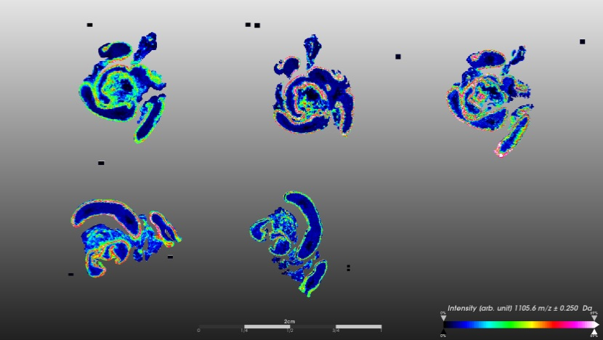
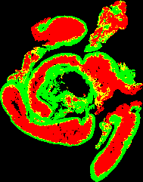




Supplementary figure 6. Multi-centre study
A
B
Site 1
Site 2
Site 3
Site 4
Site 5
C
D
E
Site | Spatial resolution score (%)
1 | 11.594
2 | 8.831
3 | 10.744
4 | 9.828
5 | 12.160
Mean ± S.D | 10.63 ± 1.338
F
Notes:
Supplementary figure 7 – Mouse ring test PCA

