Slide 1
Supplemental Figure 1.
Videos of 3D CT reconstructions of skulls from a control litter. Although there is some variability in the skull dimension, they are similar in size.

Slide 2
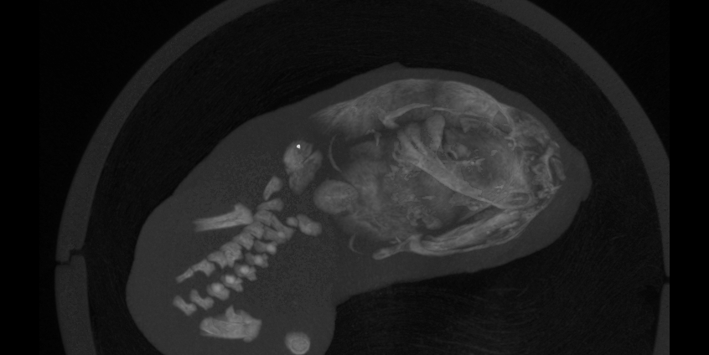
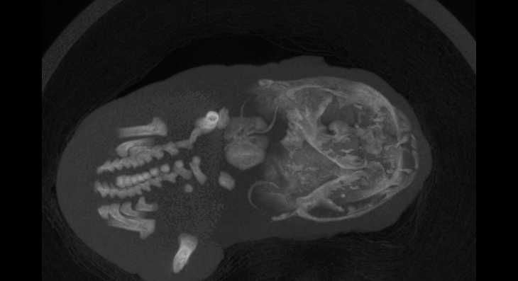
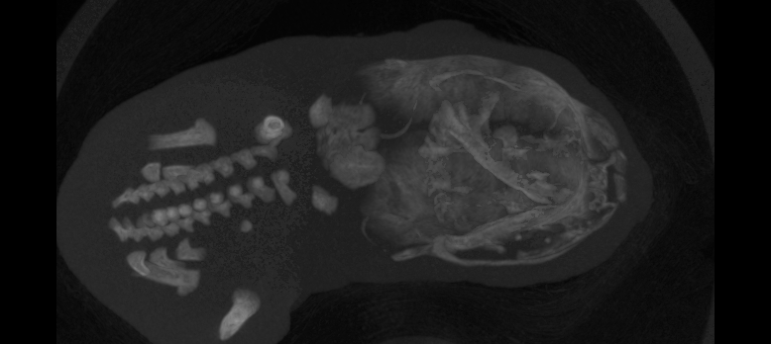
Figure 1.
Control
2
3
4

