Slide 1
Supplemental Figure 2.
Videos of 3D CT reconstructions of skulls from a litter that received an infection with Zika virus. Substantial variability can be seen in the dimension of the skulls. Those indicated with an asterisk were smaller than the others.

Slide 2
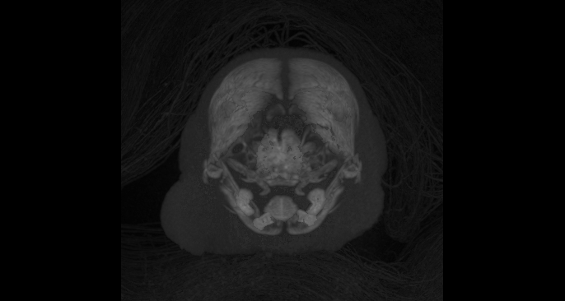
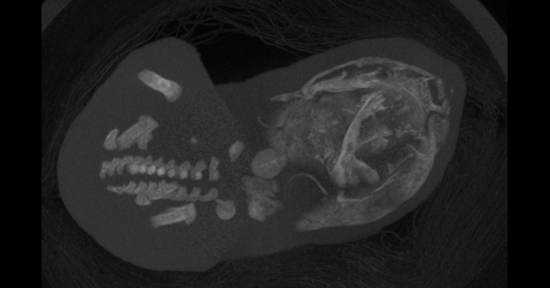
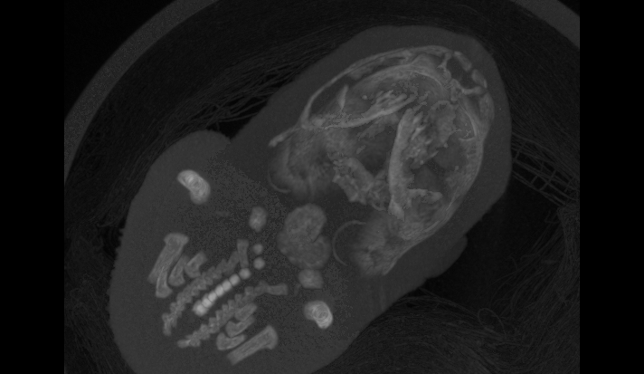
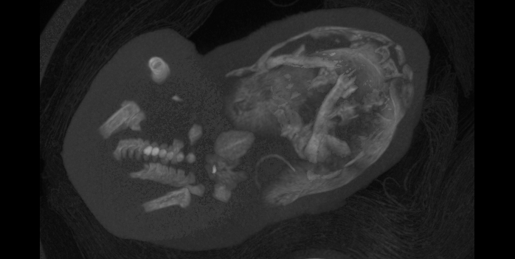
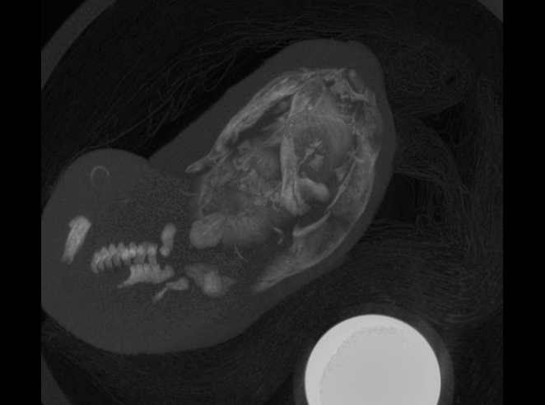
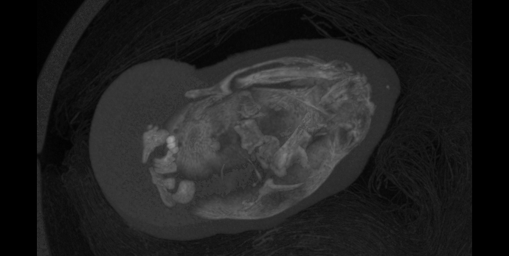
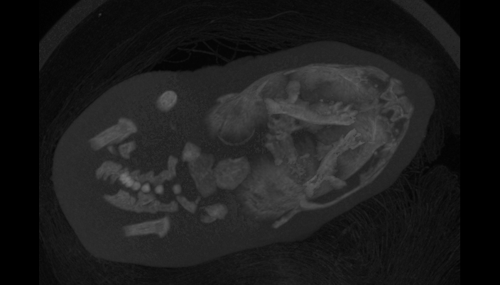
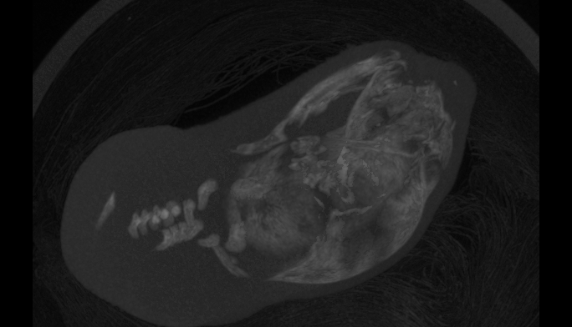
Figure 2.
Zika Infected
1
3
*
4
5
6
8
*
*
10
12
13

