Slide 1
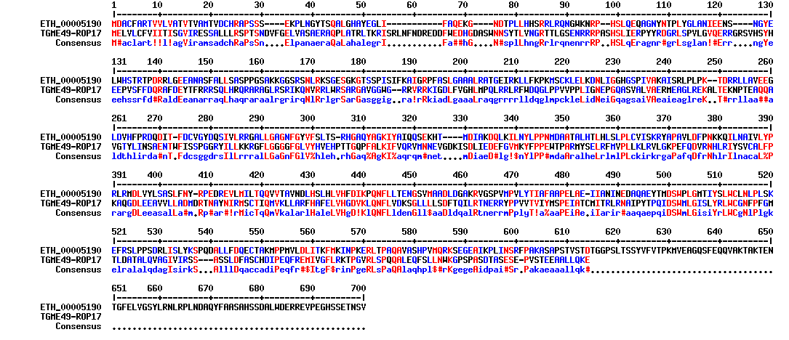

Slide 3
A
a
a
a
a
b
Caspase Activity (%)
eGFP ROP1-wt ROP1-Dead ROP1-ΔNter ROP1-Δ151-257
B
Bax/Bcl₂ mRNA expression
eGFP ROP1-wt ROP1-Dead ROP1-ΔNter ROP1-Δ151-257

Slide 4
A
b
b
a
a
c
c
c
d
d,e
c
d,e
e
B
C
***
b
b
P21 relative expression
a
P21 relative expression
a
a
eGFP ROP1-wt ROP1-Dead ROP1-ΔNter ROP1-Δ151-257
Non Infected
Infected

