Slide 1
Detection of unexpected ischemia due to left main disease during tele-rehabilitation using 12-lead ECG monitoring: Case report.
September 2018
EHJ-CR-D-18-00262

Slide 2
Introduction
Cardiac rehabilitation (CR) has been shown to reduce mortality following acute coronary syndromes (1). Participation in CR remains low, partially due to the need to perform in the hospital setting (2).
Several studies have examined feasibility of home-based tele monitoring, however only single or three lead ECG channels have been used, limiting sensitivity to detect ischemic changes (3).
Our CR program utilizes a proprietary Master Caution garment (MCG, HealthWatch) worn by the subject during exercise which enables 12-lead ECG monitoring in real-time.
In this report, we describe detection of unexpected left main coronary disease in a patient wearing our unique 12-lead ECG monitoring system.

Slide 3
Case presentation-history
The patient is a 68 y.o. male who underwent PCI to the obtuse marginal following ACS. Several months later he developed recurrent chest pain. Repeat cath showed a borderline lesion in the left main not felt to be clinically significant (Figure 1).
He was referred to our CR program and randomized into our study using the Master Caution garment. While exercising, the ECG technician noted ST-depressions in leads 1,L, V2-5 (Figure 2) which were asymptomatic.

Slide 4
Investigations
Figure 1
Initial coronary angiogram showing minimal lesion in the left main.

Slide 5
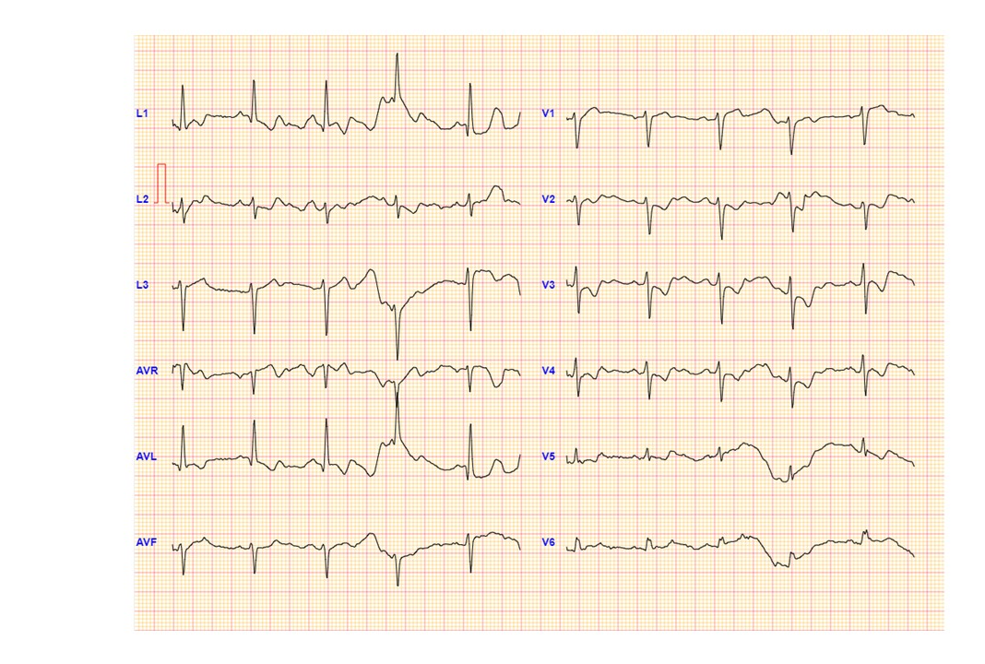
Investigations
Figure 2
ST depression in leads 1,L V2-V5.
The patient was asymptomatic at the time the ST depressions were noted. Detected using MCD monitoring technique.

Slide 6
Management
The patient underwent stress echocardiography which revealed severe ischemia of the anterior wall. Repeat angiography revealed significant worsening of the left main lesion to 70-90% (Figure 3). The progression was felt to be due to poor compliance with medical therapy.
The patient was referred for revascularization.

Slide 7
Figure 3
Repeat angiography after ST-depression noted showing progression of the ostial left main lesion.

Slide 8
Discussion
In conclusion, significant ischemia due to clinically unexpected, rapidly progressive left main disease was detected during tele-monitored cardiac rehabilitation using a 12-lead ECG device. This life-threatening diagnosis could easily have been missed using conventional ECG monitoring and our case demonstrates the potential clinical utility of 12-lead digital home ECG monitoring using the MCD device.

Slide 9
Learning Points
1. In this report, we describe detection of unexpected, significant left main coronary disease.
2. It was detected during tele-monitored cardiac rehabilitation using the MCD 12-lead ECG device.
3. This life-threatening diagnosis could easily have been missed using conventional ECG monitoring
4. Our case demonstrates the potential clinical utility of 12-lead digital home ECG monitoring using the MCD device.

Slide 10
References
1. De Vrie H, Kemps HM, van Engen-Verheul MM, Kraaijenhagen RA, Peek N. Cardiac rehabilitation and survival in a large representative community cohort of Dutch patients. Eur Heart J 2015; 36:1-10.
2. De Vos C, Li X, Van Vlaenderen I, Sako O, Dendale P, Eyssen M, Paulus D. Participating or not in a cardiac rehabilitation programme: factors influencing a patient's decision. Eur J Prev Cardiol 2013; 20: 341-348.
3. Kraal JJ, Peek N, Van den Akker-Van Marle ME, Kemps HM. Effects of home-based training with tele-monitoring guidance in low to moderate risk patients entering cardiac rehabilitation: short term results of the FIT@Home study. Eur J Prev Cardiol 2014; 21:26-31.

