Slide 1
Functional assessment of tandem coronary artery stenosis by intracoronary optical coherence tomography-derived virtual fractional flow reserve: a case series
February 2019
EHJ-CR-D-18-00446

Slide 2
Introduction
Functional assessment of coronary stenosis by FFR improves clinical outcomes and reduces unnecessary revascularizations.
OCT provides high-resolution images of coronary structures with excellent reproducibility.
On the other hand, the use of both modalities in daily clinical practice is challenging.
The OCT-derived FFR – considering the lumen area, length of the stenosis, and fluid dynamics – has been reported to strongly correlate with the wire-based FFR.
However, the applicability of the OCT-derived FFR in the assessment of tandem lesions is currently unclear.
We present two cases with tandem lesions assessed by the OCT-derived FFR, showing excellent correlation with the wire-based FFR.

Slide 3
Characteristisc of Cases
Case 1：
A 63-year-old male patient with a history of hypertension, dyslipidemia, and diabetes mellitus was admitted to the hospital due to angina with Canadian Cardiovascular Society (CCS) class III symptoms, despite treatment with maximal doses of a beta-blocker and nitrates. Exercise electrocardiography demonstrated ischemic ST segment depression.
Case 2
A 71-year-old male patient with a history of hypertension was admitted to the hospital due to CCS class III angina symptoms, despite treatment with maximal doses of a beta-blocker and nitrates. Exercise electrocardiography showed ischemic ST segment depression.

Slide 4
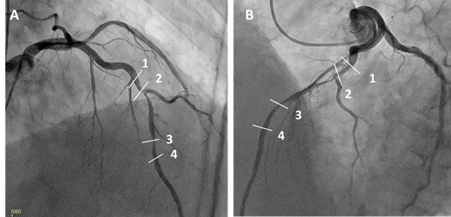
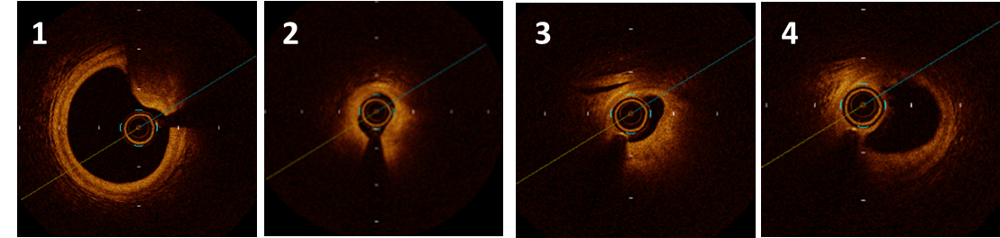
Case 1
OCT was performed and showed a minimal lumen area (MLA) of 0.83 mm² at the proximal lesion(2) and 1.02 mm² at the distal lesion (3) in the mid LAD.
The OCT-derived FFR was calculated yielding a value of 0.64. In the absence of stenosis at the proximal lesion in the mid LAD artery (i.e., successful stenting at the proximal tandem lesion), the OCT-derived FFR yielded a value of 0.79.
Coronary angiography of 30 right anterior oblique (RAO) 30 cranial (CRA) view (A) and 45 left anterior oblique (LAO) 20 CRA view (B) showing the presence of a tandem lesion in the mid segment of the left anterior descending (LAD) artery.
Optical coherence tomography (OCT) images correlation to regions shown on angiograms (1-4)

Slide 5
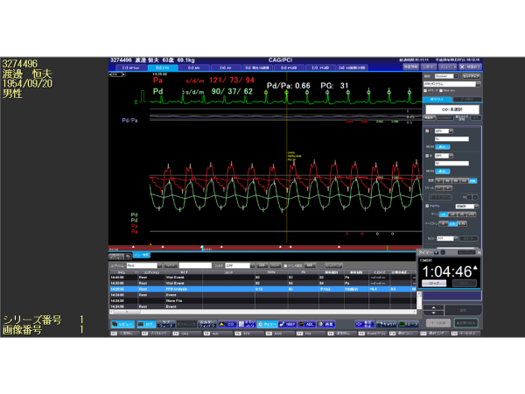
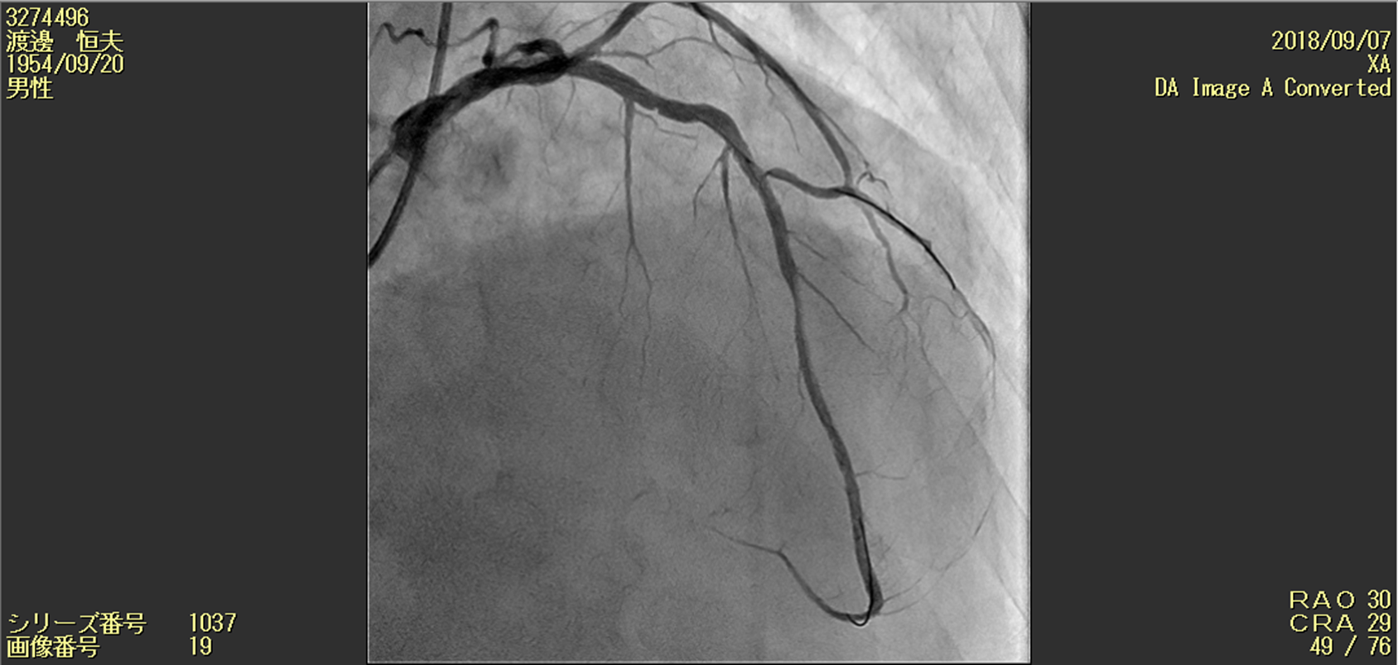
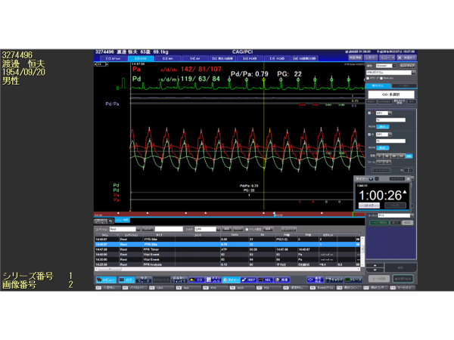
Case 1
C
The wire-based FFR was performed, yielding a value of 0.66 (C).
A 3.0 mm×18 mm DES was implanted in the proximal lesion, followed by post-dilation (D). The wire-based FFR was repeated, yielding a value of 0.79 (E), which was the same to that obtained from the OCT-derived FFR.
D
E

Slide 6
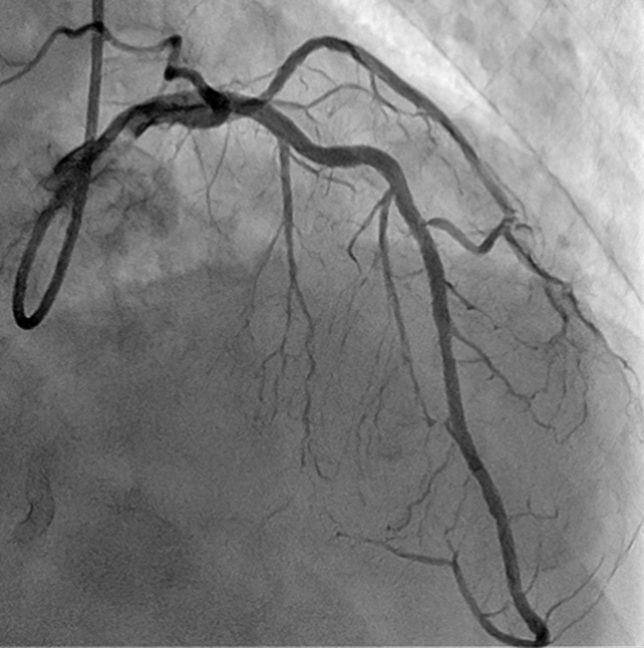
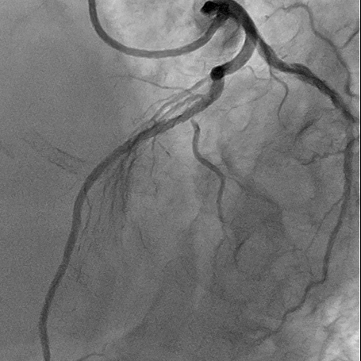
Case 1: Angiogram of 30 RAO 30 CRA view (F) and
45 LAO 20 CRA view (G) after additional stenting at the distal lesion
F
G

Slide 7
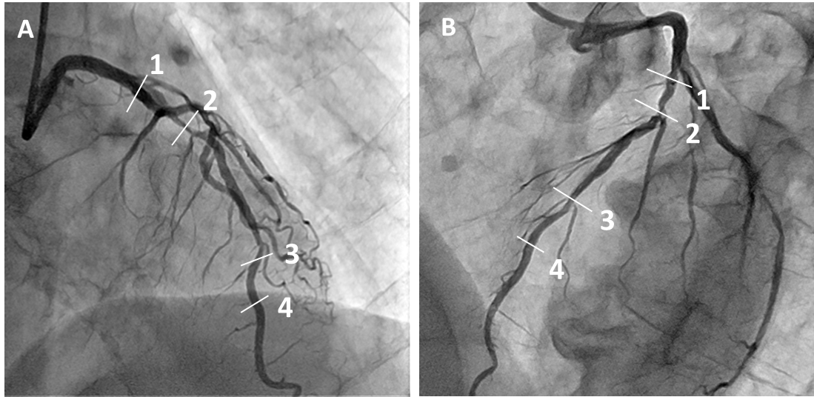
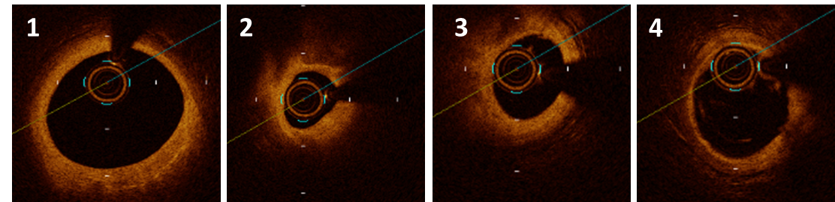
Case 2
OCT was performed and showed a minimal lumen area (MLA) of 1.07 mm² at the proximal lesion(2) and 1.82 mm² at the distal lesion (3) in the mid LAD.
The OCT-derived FFR was calculated yielding a value of 0.76. In the absence of stenosis at the proximal lesion in the mid LAD artery (i.e., successful stenting at the proximal tandem lesion), the OCT-derived FFR yielded a value of 0.88.
Coronary angiography of 30 right anterior oblique (RAO) 30 cranial (CRA) view (A) and 45 left anterior oblique (LAO) 20 CRA view (B) showing the presence of a tandem lesion in the mid segment of the left anterior descending (LAD) artery.
Optical coherence tomography (OCT) images correlation to regions shown on angiograms (1-4)

Slide 8
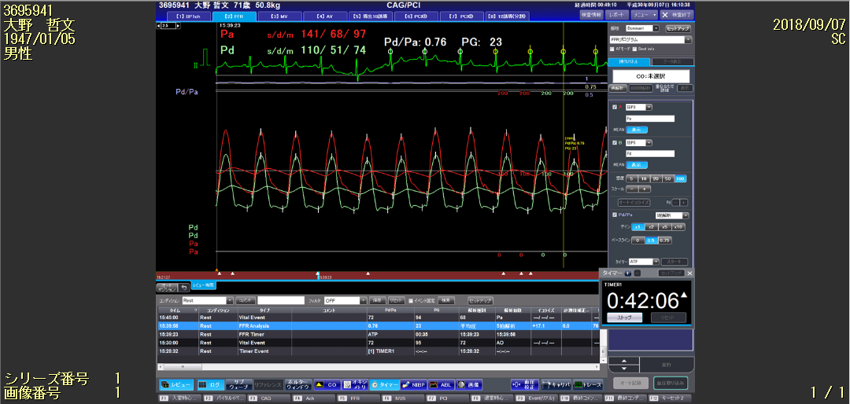
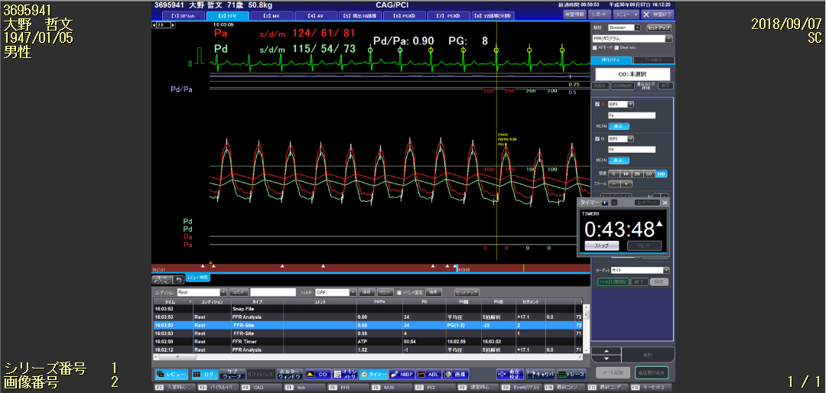
Case 2
C
The wire-based FFR was performed, yielding a value of 0.76 (C).
After coronary stenting in the proximal lesion, the wire-based FFR yielded a value of 0.90 (F).
Therefore, additional intervention to the distal lesion was deferred.
D
F

Slide 9
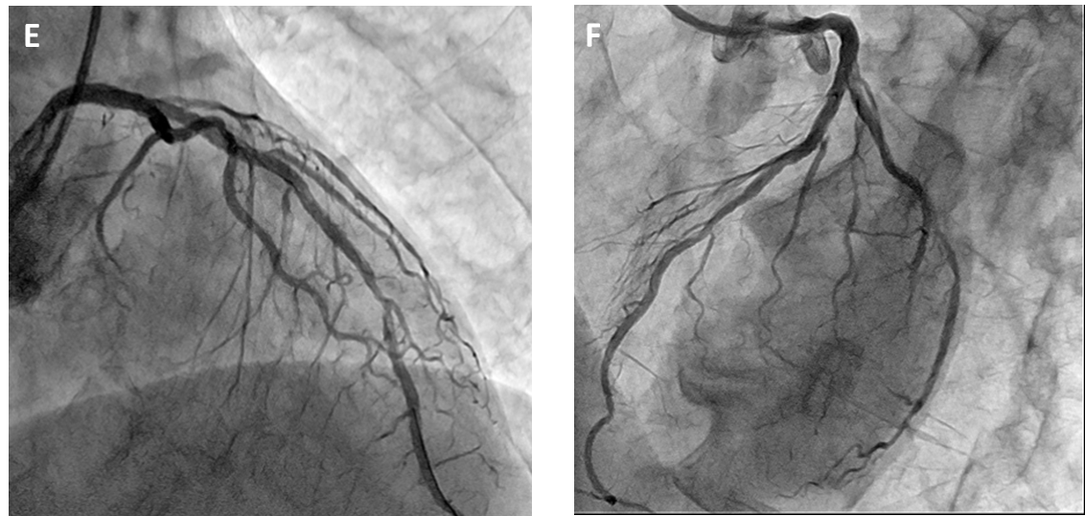
Case 2: Final Angiogram of 30 RAO 30 CRA view (E) and
45 LAO 20 CRA view (F)

Slide 10
Case Summary
 |  | Before stenting | After stenting at the proximal lesion
Case1 | Wire based FFR | 0.66 | 0.79
 | OCT-derived FFR | 0.64 | 0.79
Case2 | Wire based FFR | 0.76 | 0.90
 | OCT-derived FFR | 0.76 | 0.88
Additional stenting at the distal lesion
Deffered

Slide 11
Discussion
The FFR method is currently the gold standard for the physiological assessment of intermediate coronary lesions, identifying ischemia-inducible stenosis which requires revascularization.¹
Nevertheless, the use of both modalities in daily clinical practice is challenging. In addition, simple FFR measurements are unable to predict the actual functional severity of each individual stenosis in tandem lesions due to the mutual flow volume interaction between the stenoses.²

Slide 12
Discussion
The OCT-derived FFR – considering the MLA, percentage of the area of stenosis, length of the stenosis, and fluid dynamics – has been reported to strongly correlate with the wire-based FFR versus conventional measurements.³
The present cases indicated that the OCT-derived FFR is able to estimate the wire-based FFR and the severity of each individual lesion in patients with tandem lesions.

Slide 13
Learning Points
The OCT-derived FFR was very useful in assessing the functional severity of coronary tandem lesions.
This approach enables us to evaluate the severity of each lesion and pressure loss, unaffected by another stenosis.
Thus, the OCT-derived FFR may be useful for the assessment of the functional severity of tandem lesions.

Slide 14
References
Pijls NH, Van Gelder B, Van der Voort P, Peels K, Bracke FA, Bonnier HJ, et al. Fractional flow reserve. A useful index to evaluate the influence of an epicardial coronary stenosis on myocardial blood flow. Circulation 1995; 92: 3183-3193.
Pijls NH. Fractional flow reserve to guide coronary revascularization. Circ J 2013; 77: 561-569.
Seike F, Uetani T, Nishimura K, Kawakami H, Higashi H, Aono J, et al. Intracoronary Optical Coherence Tomography-Derived Virtual Fractional Flow Reserve for the Assessment of Coronary Artery Disease. Am J Cardiol 2017; 120: 1772-1779.

