Slide 1
Supplementary Material
Hypoplastic posterior mitral valve leaflet diagnosed in adulthood

Slide 2
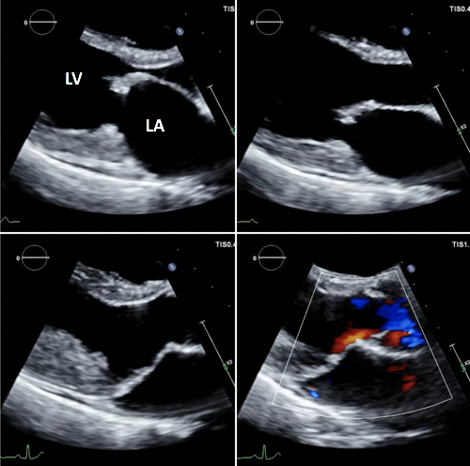
Figure 3

Slide 3

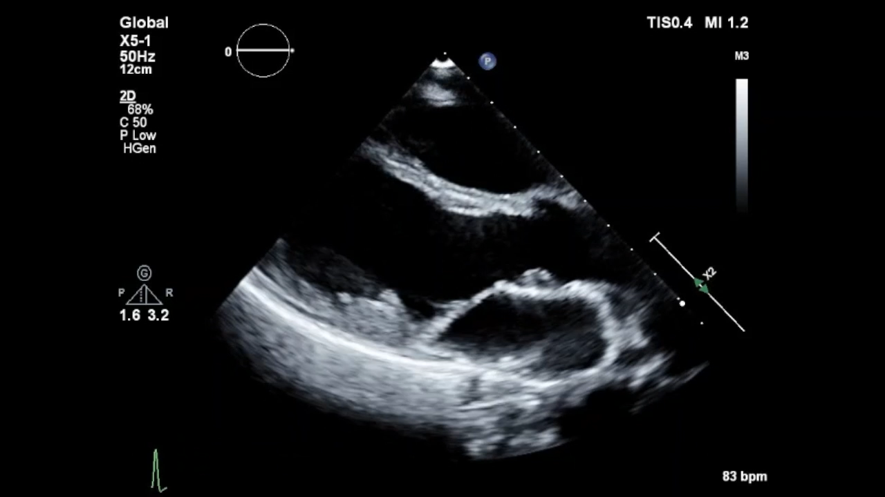
Figure 4 (a)
Notes:
F

Slide 4
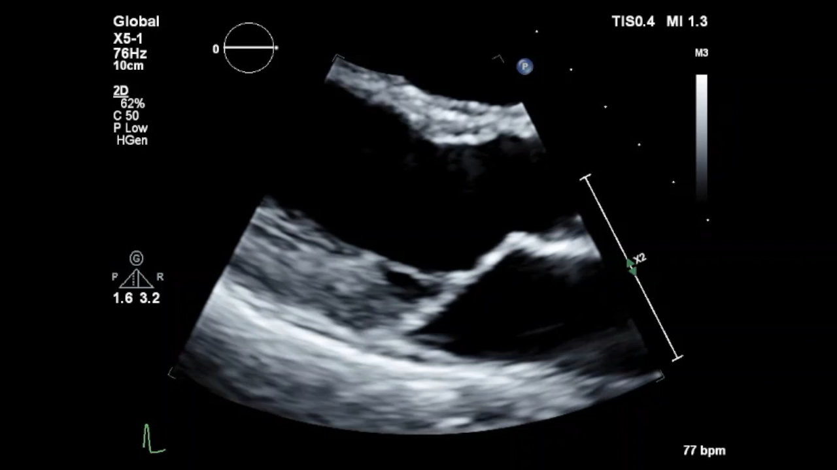
Figure 4 (b)

Slide 5
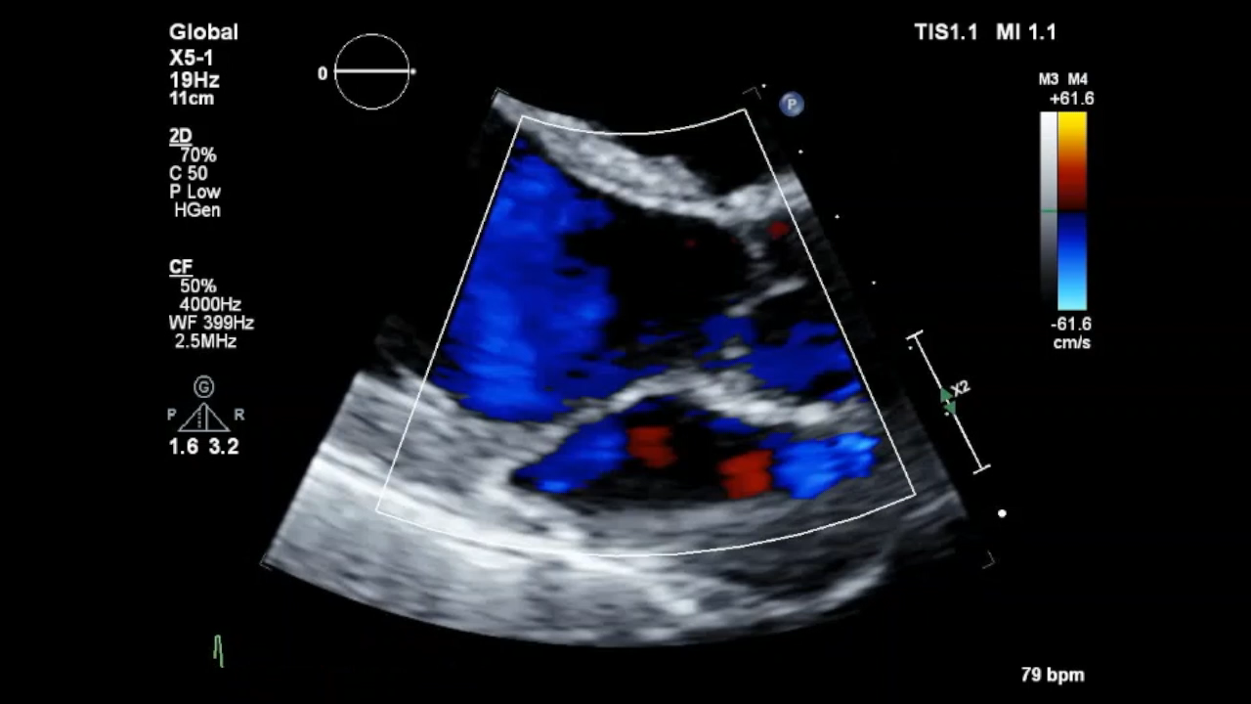
Figure 5

