Slide 1
Subcutaneous implantable Cardioverter Defibrillators in Patients with
Left Ventricular Assist Devices: Case Report and Comprehensive Review
María López-Gil MD, Adolfo Fontenla MD, PhD, Juan F. Delgado MD, PhD, Daniel Rodríguez-Muñoz MD PhD .
March 2018
EHJ-CR-D-18-00456

Slide 2
Introduction
Most patients candidates for a LVAD implant have a previously implanted ICD.
The interaction between both devices adds complexity to the management of this population
S-ICD is sought to avoid lead-related (infectious, vascular, fracture) complications.
Guidelines for Sudden Cardiac Death recommend S-ICD in patients in whom pacing for bradycardia or tachycardia termination is not anticipated.
However, the special features of S-ICD increase the risk of sensing pitfalls

Slide 3
Case Presentation
History and Examination Findings
20-year-old man with idiopathic dilated cardiomyopathy (EF 15%) and advanced heart failure was included on the cardiac transplant waiting list
Negative genetic study (Dilated Cardiomyopathy NGS panel)
Sustained, self-limiting ventricular tachycardias. Referred for ICD implant.
Due to the echocardiographic finding of both right and left ventricular thrombus an EMBLEM MRI S-ICD™ (Boston Scientific) was implanted following successful ECG screening
Progressive worsening of heart failure status prompted HeartMate 3TM (Left Ventricular Assist System, Abbott) implantation

Slide 4
Case Presentation
Timeline
Date | Event
2014 | Heart Failure. Idiopathic Cardiomyopathy diagnosis
January 2017 (During hospitalization) | Heart Failure, sustained self-limiting ventricular tachycardia, right and left ventricular thrombus. Negative gene study
February 2017 | EMBLEM MRI S-ICD™ implantation
January 2018 | Refractory heart failure, inotropic dependence
March 2018 (During hospitalization) | HeartMate 3TM implantation. S-ICD deactivated before surgery. After surgery, S-ICD shows inappropriate sensing. ICD deactivation.
June 2018 (Hospital discharge) | Pre-discharge S-ICD checked again: inappropriate sensing. Remained deactivated
September 2018 | Heart transplant. S-ICD explantation

Slide 5
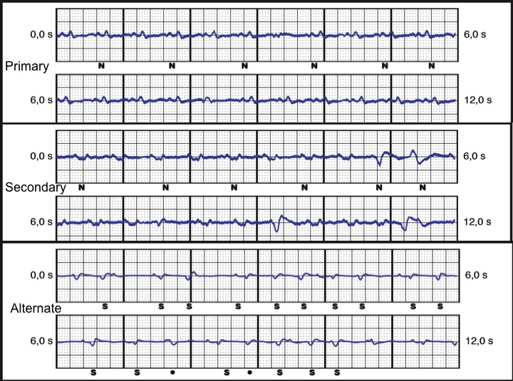
Case Presentation Ventricular detection test
During S-ICD implantation
After LVAD implantation
Ventricular sensing is correct in primary and alternate vectors, while secondary vector shows P wave-instead of QRS- detection due to low QRS amplitude.
Primary vector was selected for sensing.
Primary and secondary vectors show EMI and cardiac signals are detected as noise (N).
QRS amplitude in primary and alternate vectors is lower than before LVAD implant.
Alternate vector does not show EMI, but low QRS amplitude causes undersensing

Slide 6
Case Presentation
Detection vectors displayed on RX with both devices implanted
EMI detection depends on the proximity of the source (LVAD) to the vectors
Primary and secondary vectors involve the S-ICD can (located next to LVAD), showing EMI
Alternate vector does not involve S-ICD can, and EMI is not visible

Slide 7
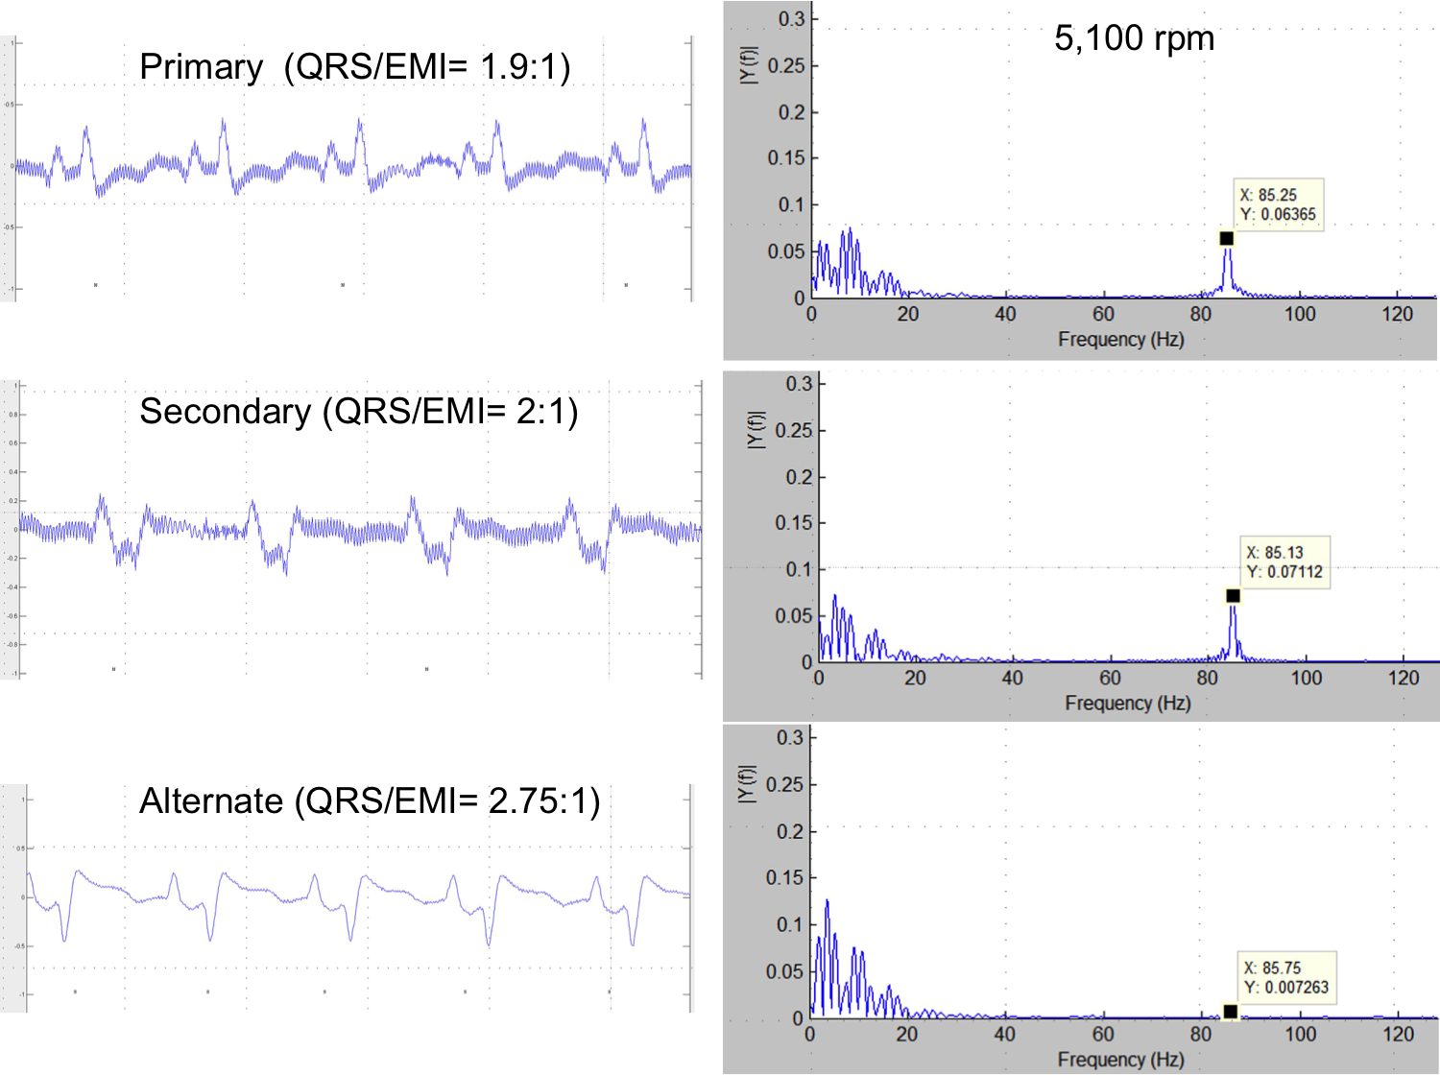
Case Presentation
S-ECG high resolution capture and Fast-Fourier transform plot
EMI amplitude is higher in primary and secondary vectors due to a closer proximity between LVAD and S-ICD can
QRS/EMI amplitude ratio is higher in alternate vector, making EMI detection less likely
5100 rpm refers to LVAD pump operating rate

Slide 8
Literature review
NA: non-available. ( )*operating rate range of the specific LVAD when not specified in the report. (references number as in the text)
Pump location and/or LVAD operating rates are related with EMI detection

Slide 9
Discussion
S-ICD sensing is based on subcutaneous cardiac signals (S-ECG) recorded from the best of 3 possible vectors
Special algorithms and filtering are intended to avoid T wave oversensing and EMI detection in the S-ICD
Dedicated S-ICD notch and band-pass filters do not avoid EMI detection:
- when the source (LVAD pump) is located near the S-ICD can
- when the pump runs at lower operating rates.
Furthermore, QRS signal attenuation in S-ECG after LVAD implantation compromises an adequate detection

Slide 10
Learning Points
Subcutaneous ICD (S-ICD) sensing may be compromised after Left Ventricular Assist Device (LVAD) implantation due to electromagnetic interference (EMI) and changes in QRS voltage.
1.
2.
3.
S-ICD implantation in LVAD potential candidates should be avoided until further data can prove its safety and efficacy.
When a LVAD is implanted in a S-ICD recipient, detection and therapy should be withheld until re-evaluation of sensing vectors demonstrates appropriate detection.

Slide 11
References
1.-Al-Khatib SM, Stevenson WG, Ackerman MJ, Bryant WJ, Callans DJ, Curtis AB, et al. 2017 AHA/ACC/HRS Guideline For Management of Patients With Ventricular Arrhythmias and the Prevention of Sudden Cardiac Death. Heart Rhythm 2018; 15: e73-e189.
2.-Saeed D, Albert A, Westenfeld R, Maxhera B, Gramsch-Zabel H, O´Connor S, et al. Left ventricular assist device in a patient with a concomitant subcutaneous implantable cardioverter defibrillator. Circ Arrhythmia Electrophysiol. 2013; 6: e32-e33.
3.-Gupta A, Subzposh F, Hankins SR, Kutalek SP. Subcutaneous implantable cardioverter-defibrillator implantation in a patient with a left ventricular assist device already in place. Tex Heart Inst J 2015; 42: 140-143.
4.-Raman AS, Shabari FR, Kar B, Loyalka P, Hariharan R. No Electromagnetic Interference Occurred in a Patient with a HeartMate II Left Ventricular Assist System and a Subcutaneous Implantable Cardioverter-Defibrillator. Tex Heart Inst J 2016; 43: 183-185.
5.-Pfeffer TJ, König T, Duncker D, Michalski R, Hohmann S, Oswald H, et al. Subcutaneous implantable cardioverter-defibrillator shocks after left ventricular assist device implantation. Circ Arrhythmia Electrophysiol 2016; 9: 1-3.
6.-Migliore F, Leoni L, Bottio T, Siciliano M, Ferretto F, Gerosa G, et al. Subcutaneous Implantable Cardioverter-Defibrillator and Left Ventricular Assist Device: A Safe and Effective Approach for Refractory Heart Failure. JACC Clin Electrophysiol. 2016; 2: 246-247.

