Slide 1
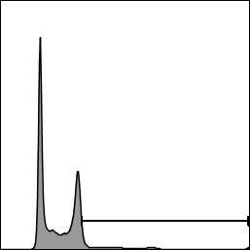
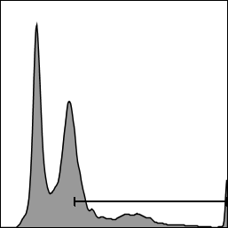
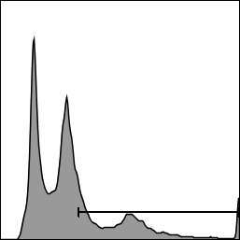
A
1000
200
B
ns
UT
200
2 Gy X 4
8 Gy
500
100
100
PGCC
PGCC
PGCC
count
0
0
0
Pi
Supplemental Figure S1. 8 Gy radiation bolus treatment has the same effect as fractionated 8 Gy. PPC1 cells were treated with a single dose of 8 Gy radiation or with four sequential daily doses of 2 Gy. After 8 Gy of exposure, cells were given three days to generate PGCC and then fixed for cell cycle analysis. Both methods of delivering radiation resulted in accumulation of G2+ cells.

