Slide 1
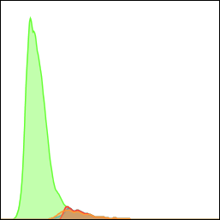
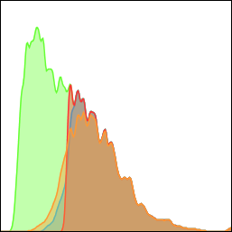
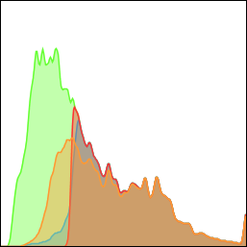
A
350
90
100
high Pi (polyploid)
high SCC
175
45
50
high scatter
whole population
count
0
0
0
SCC
Untreated PPC1 Docetaxel Radiation
Supplemental Figure S2. PGCC are characterized by high propidium iodide and high SCC/FSC by flow cytometry. (A) Untreated and docetaxel- or radiation- treated PPC1 cells were analyzed to compare the size and ploidy characteristics of PGCC. The untreated population had a small group of G2+ cells, which were also high SCC/FSC cells. High SCC alone (a measure of cellular topological complexity) was sufficient to capture this population. These three parameters also overlapped for the much more abundant subpopulation of PGCC in docetaxel-treated PPC1 cells. The parameters largely overlapped for radiation-induced PGCC, with a small number of G2+ cells mapping just outside of the high-SCC gate. (B) High-SCC PGCC were quantified for the indicated treatment groups.
B
***
***
PGCC by SCC

