Slide 1
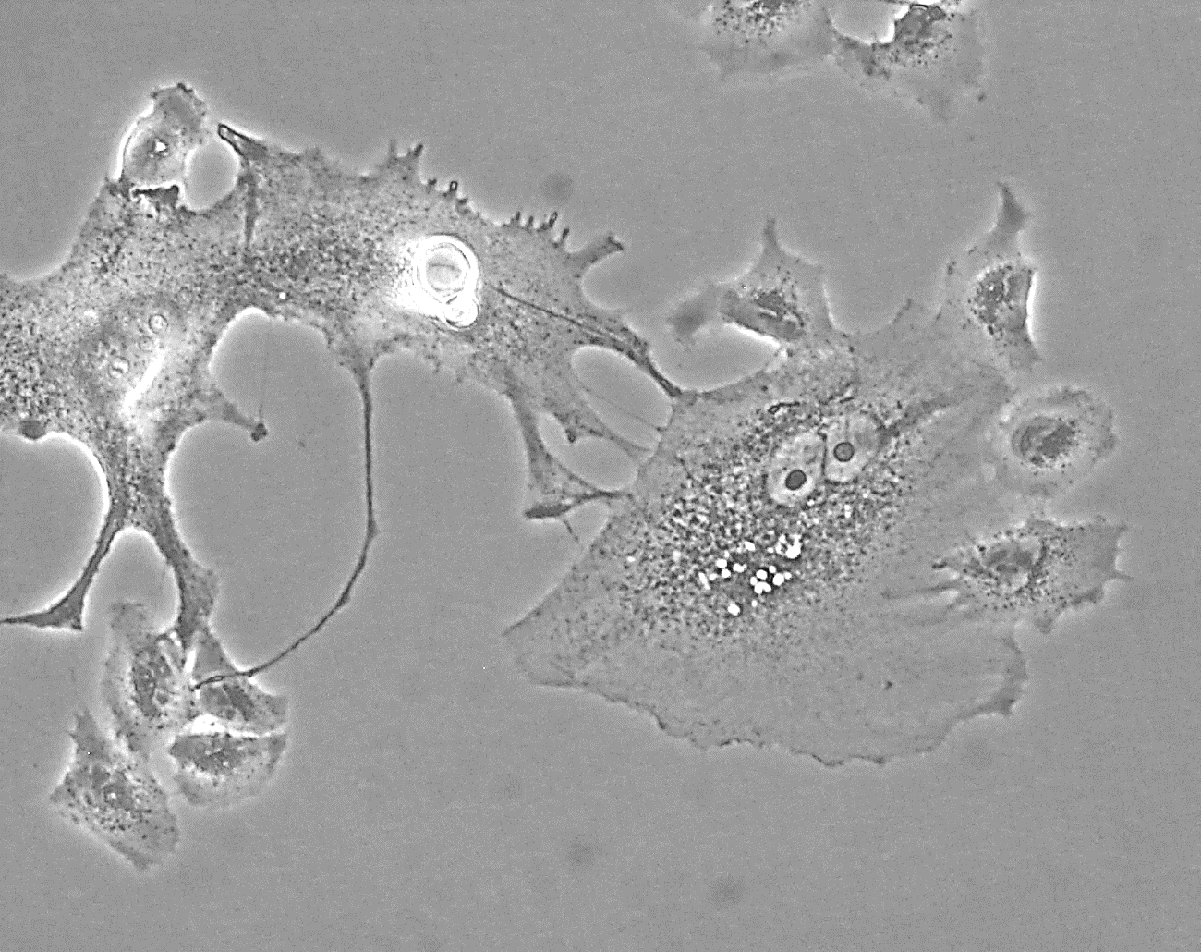
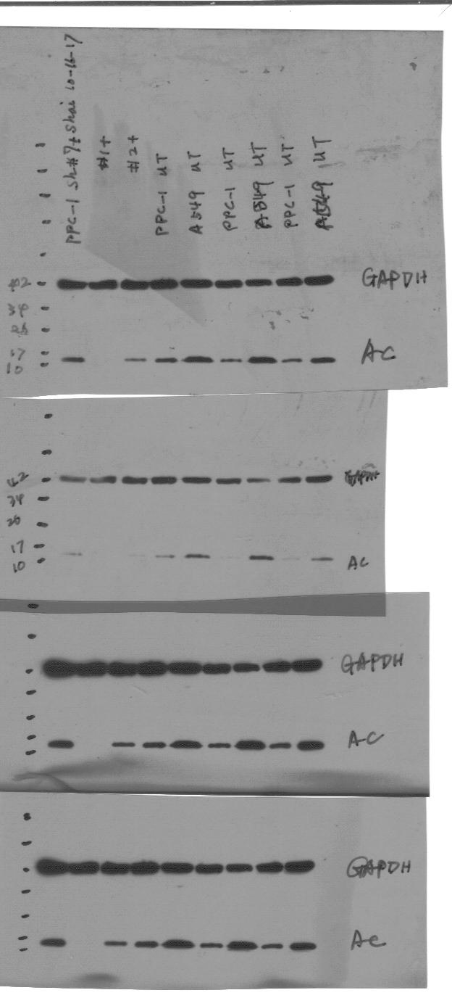
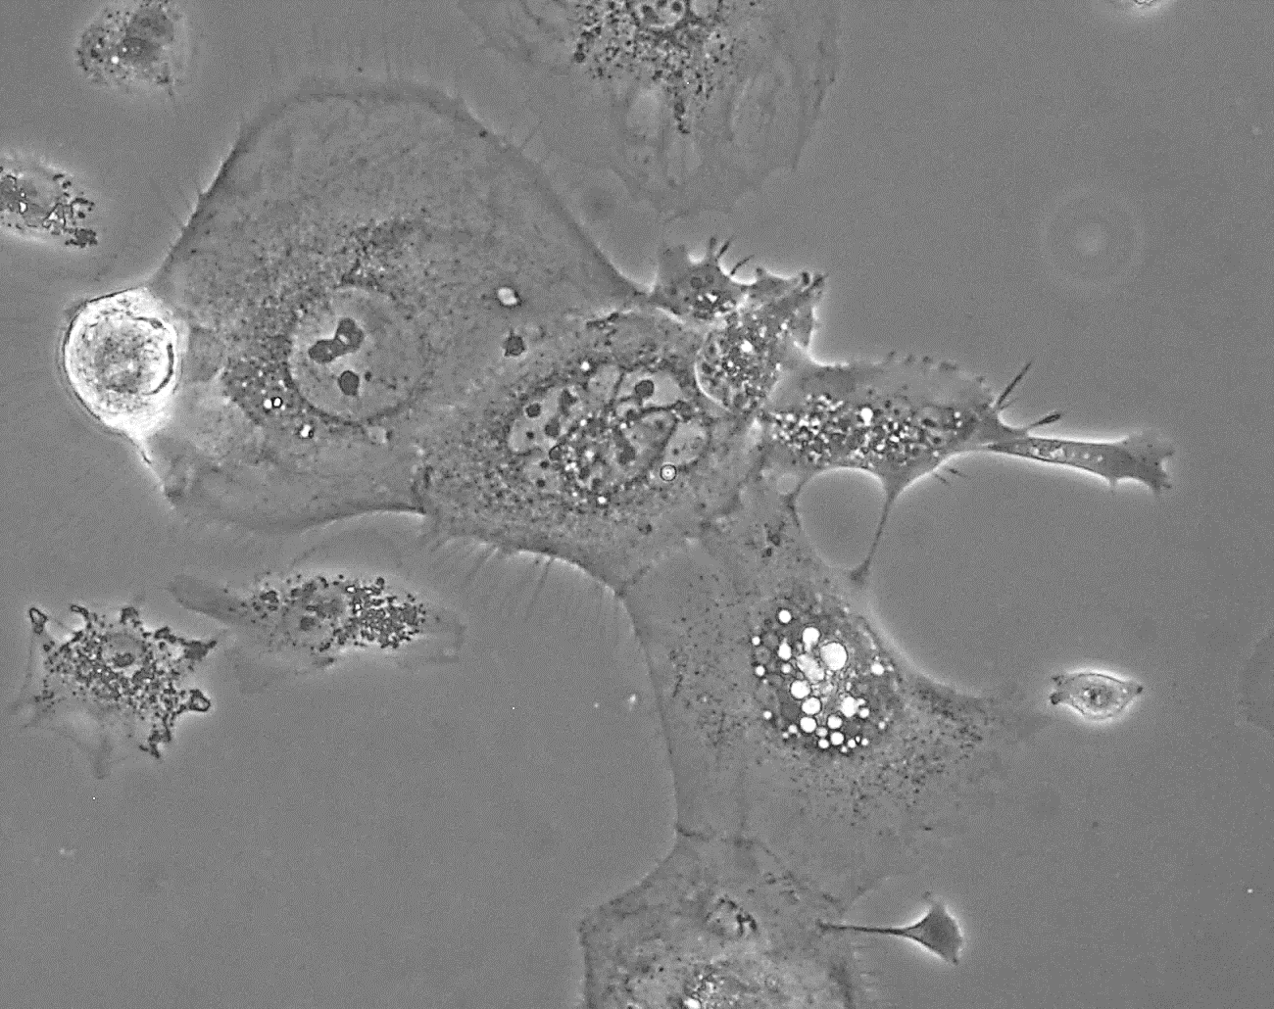
Supplemental Figure S5. A549 NSCLC cells express ASAH1, accumulate ceramide upon LCL-521 exposure, and are capable of neosis after treatment stress. (A) Western blot analysis comparing ASAH1 expression in PPC1 cells and A549 cells, GAPDH serves as a loading control. (B) Crystal violet viability assay performed as described in materials and methods, with A549 cells exposed to 10 µM LCL-521 for 72 hours, n=2 in triplicate. (C,D) Lipidomics analysis of ceramide and sphingosine levels in A549 cells after incubation with 10 µM LCL-521 for five hours, n=3. (E,F) Images of A549 PGCC formed in response to 30 µM cisplatin (E) or 10 Gy radiation exposure (F). Arrows indicate where PGCC appear to be generating small offspring via the budding-like process of neosis.
A
B
ns
E
PPC1 A549
ASAH1
Crystal violet signal,
percent of untreated
GAPDH
0 10 µM
LCL-521
C
D
***
*
F
Total ceramide (pm/1 million cells)
Sphingosine (pm/1 million cells)
0 5 hr
0 5 hr
10 µM LCL-521
10 µM LCL-521

