Slide 1
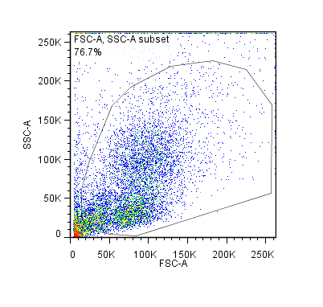
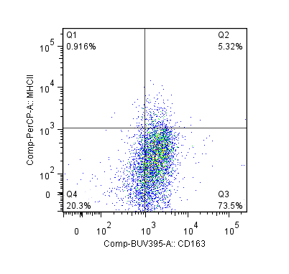
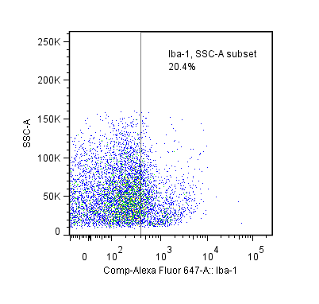
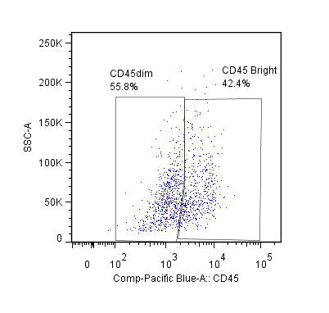
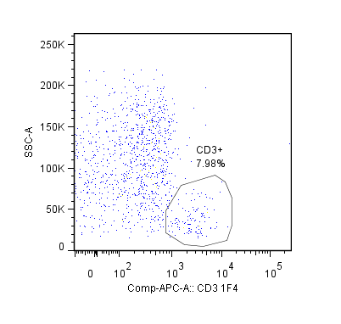
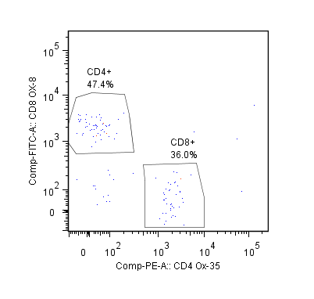
A
B
C
D
E
F
G
H
I
S4 Fig. Gating strategy for brain samples. Representative brain sample from AERO-infected rat at 7 dpi. General gating strategy begins with (A) vital brain gate, (B) live/dead gating and (C) singlet inclusion. Myeloid cells were gated as follows: (D) Peripheral macrophages as CD163+, (E) neutrophils as RP-1+ CD11b+, and (F) microglia as Iba-1+. (G) Iba1+ microglia can be further characterized based on level of CD45 expression. T-cells were gated as (H) CD3+ and then categorized as either (I) CD8+ or CD4+.

