Slide 1
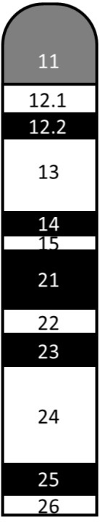
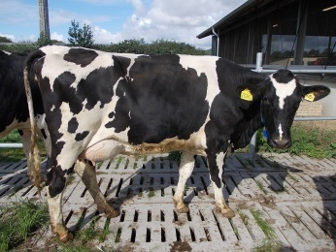
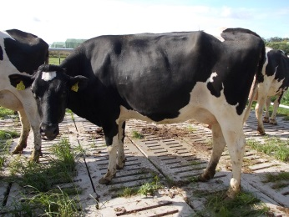
BTA18
Q/q sires (n=6):
Two haplotypes within each sire
Σa_{SNP-A} - Σa_{SNP-B}
> 2 SD_{all sires} (Σ a_{SNP-A} - Σa_{SNP-B})
Legend:
Σa_{SNP-Q} : sum of all SNP allele effects in haplotype A
Σa_{SNP-q} : sum of all SNP allele effects in haplotype B
SD: standard deviation
Q: favorable haplotype
q: unfavorable haplotype
Σ a_{SNP-A}
Σ a_{SNP-B}
Q daughters: n=21
q daughters: n=21
BTA18 according to ISCNDB 2000
(kindly provided by Dr. T. Goldammer, FBN)

