Slide 1
Supplementary figures

Slide 2
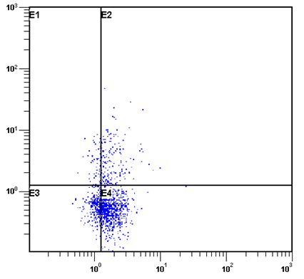
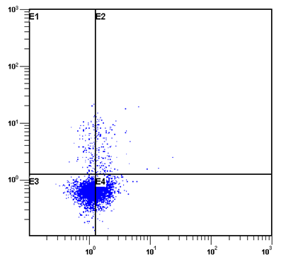
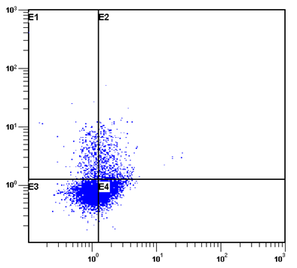
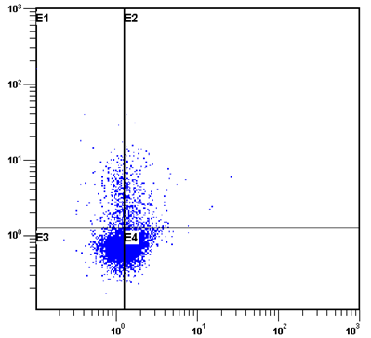
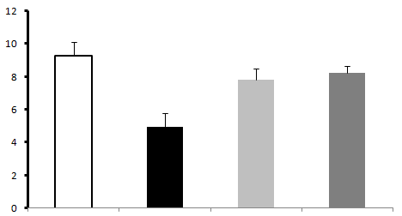

Control
Model
Electro-Acupuncture
Moxibustion
CD25+ PE
Foxp3+ PerCP-Cy5.5
*
*
*
CD4+CD25+FOXP3+Treg Cells(%)
Control
Model
Electro-
acupuncture
Moxibustion
Supplement figure 1: The percentage of CD⁴⁺CD²⁵⁺Foxp³⁺Treg cells among CD4⁺T cells
in each group. Treg cells mainly distributed in the right-upper quadrant(n=8).

Slide 3
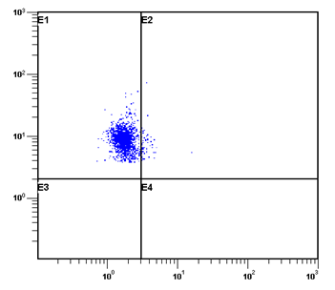
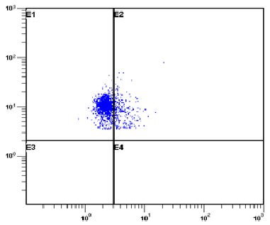
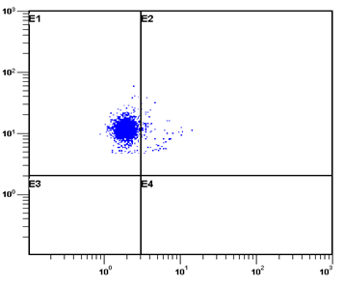
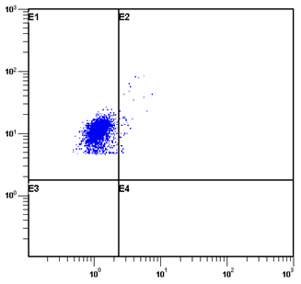
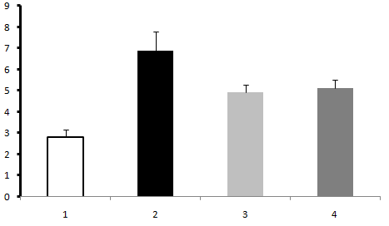
Control
Model
Electro-Acupuncture
Moxibustion
CD8+ PE
IL-17 PerCP-Cy5.5
*
*
*
CD3+CD8+IL17+Th17 Cells(%)
Control
Model
Electro-
acupuncture
Moxibustion
Supplement figure 2: The percentage of CD³⁺CD⁸⁺IL-17⁺Th17 cells among CD4⁺T cells
in each group. Th17 cells mainly distributed in the right-upper quadrant.(n=8)

