Slide 1
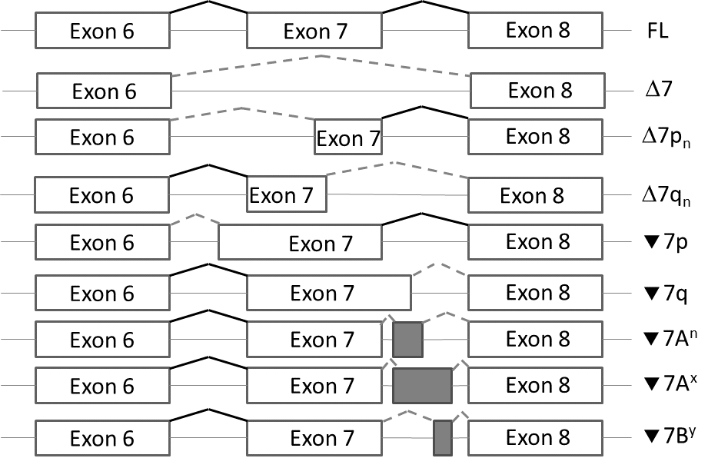
Supplementary figure 1 – Annotation used for description of splicing events. Here we illustrate hypothetical events occurring in the region of exon 7 compared to a full-length (FL) reference transcript that contains exon 7. Splicing events are shown with solid black lines, whereas alternative splicing events are represented with dashed grey lines and cassette insertion events are represented in grey boxes.

Slide 2
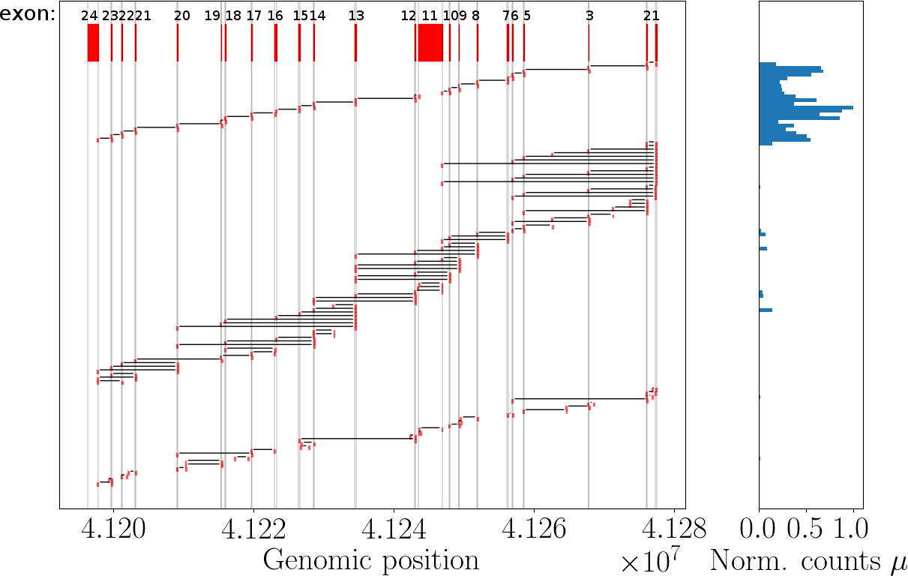
Reference
Previously described
Exons
New events (>25 reads)
Supplementary figure 2 – Schematic representation of the events found in BRCA1. Exon order provided from 5´ to 3’ as this gene is on the reverse strand. On top we show the reference-transcript boundaries, followed by events that have been previously described and, in the bottom, events that were not previously described and that were observed at least 25 times in at least one of the four samples.
Normalized counts (norm.counts) = occurrence_i/max(occurrence_i), i.e. is the ratio of the each read count to the maximum read count.

Slide 3
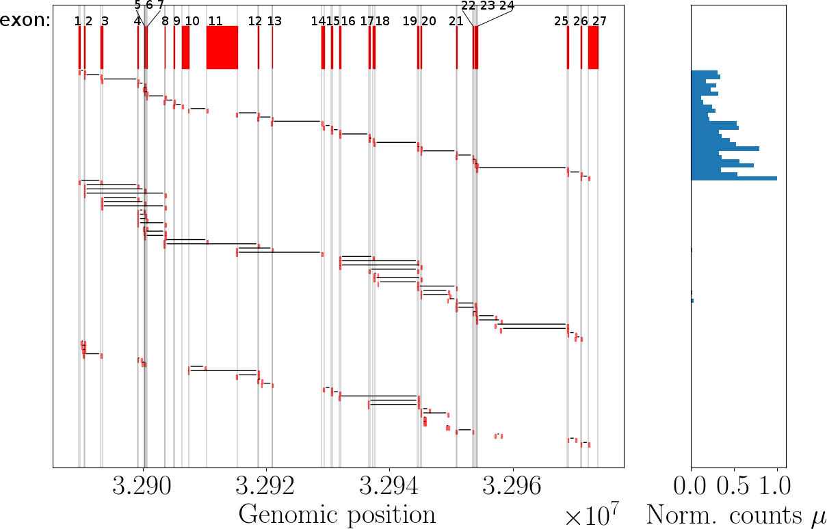
Reference
Exons
Previously described
New events
Supplementary figure 3 – Schematic representation of the events found in BRCA2. On top we show the reference-transcript boundaries, followed by events that have been previously described and, in the bottom, events that were not previously described and that were observed at least 25 times in at least one of the four samples.
Normalized counts (norm.counts) = occurrence_i/max(occurrence_i), i.e. is the ratio of the i-th occurrence to the maximum occurrence.

Slide 4
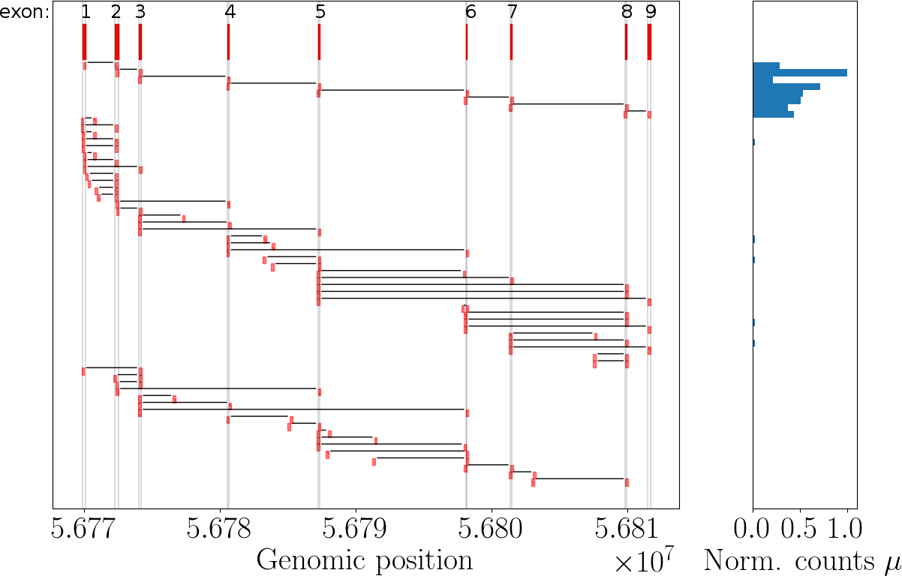
Reference
Previously described
Exons
New events
Supplementary figure 4 – Schematic representation of the events found in RAD51C. On top we show the reference-transcript boundaries, followed by events that have been previously described and, in the bottom, events that were not previously described and that were observed at least 25 times in at least one of the four samples.
Normalized counts (norm.counts) = occurrence_i/max(occurrence_i), i.e. is the ratio of the i-th occurrence to the maximum occurrence.

Slide 5
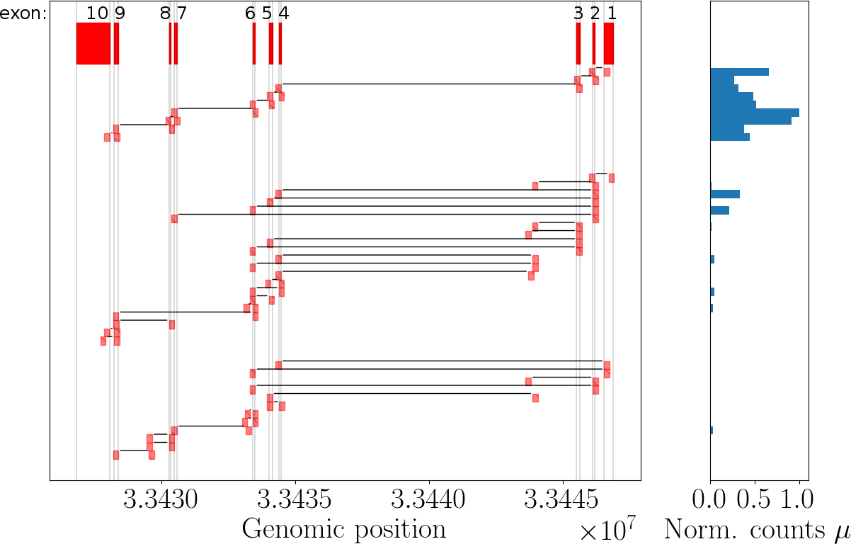
Reference
Exons
Previously described
New events
Supplementary figure 5 – Schematic representation of the events found in RAD51D. Exon order provided from 5´ to 3’ as this gene is on the reverse strand. On top we show the reference-transcript boundaries, followed by events that have been previously described and, in the bottom, events that were not previously described and that were observed at least 25 times in at least one of the four samples.
Normalized counts (norm.counts) = occurrence_i/max(occurrence_i), i.e. is the ratio of the i-th occurrence to the maximum occurrence.

