Slide 1
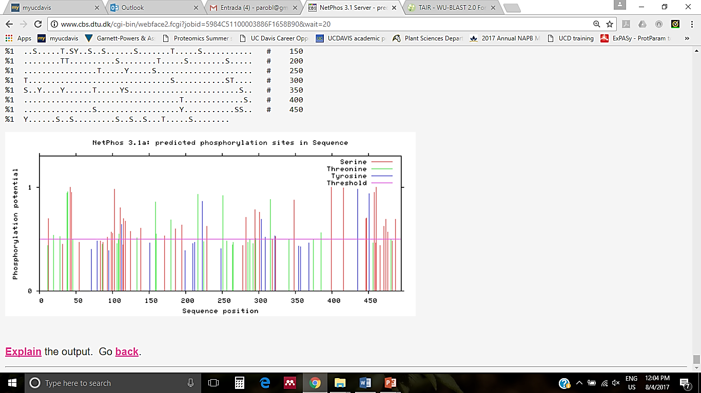
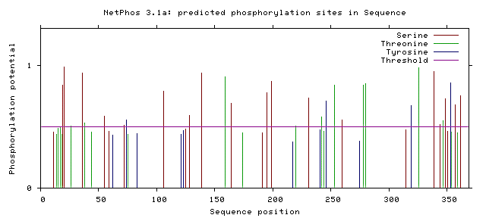
A
Malectin domains
TM domain
Kinase domain
FERONIA
COK-4
*************
FER 401 LNGVEIFKMNTSDGNLAGTNPIPGPQVTADPSKVLRPTTRKSKSNTAIIAGAASGAVVLALIIGFCVFGAYRRRKRGDYQPASDATSGWLPLSLYGNSHS
COK-4 1 -----------------------------------------------------------------------------------------MFLNCVGMCCS
FER 501 AGSAKTNTTGSYASSLPSNLCRHFSFAEIKAATKNFDESRVLGVGGFGKVYRGEIDGGTTKVAIKRGNPMSEQGVHEFQTEIEMLSKLRHRHLVSLIGYC
COK-4 12 KPTTNTTSSQRQFPTLIEELCHQFSLTDLRKATNNFDQKRVIGSGLFSEVYKGCLQHDGASDYTVAIKRFDYQGWAAFNKEIELLCQLRHPRCVSLIGFC
FER 601 EENCEMILVYDYMAHGTMREHLYKTQNPSLPWKQRLEICIGAARGLHYLHTGAKHTIIHRDVKTTNILLDEKWVAKVSDFGLSKTGPTLDHTHVST----
COK-4 112 NHENEKILVYEYMSNGSLDKHLQEGQ---LSWKKRLEICIGVARGLHFLHTGAKRSIFHCILGPGTVLLDDQMEPKLAGFDASEQGSRFMSKQKQINVIV
FER 697 -------------------------VVKGSFGYLDPEYFRRQQLTEKSDVYSFGVVLFEALCARPALNPTLAKEQVSLAEWAPYCYKKGMLDQIVDPYLK
COK-4 209 FWVIFVLLYELTHCHDFLWIKLSLLFVIGCRGYTATDYLMDGIITAKWDVFSFGFLLLEVVCRRMFYLITLTKKEC----------LENPVEERIDPIIK
FER 772 GKITPECFKKFAETAMKCVLDQGIERPSMGDVLWNLEFALQLQESAEENGKGVCGDMDMDEIKYDDGNCKGKNDKSSDVYEGNVTDSRSSGIDMSIGGRS
COK-4 299 GKIAPDCWQVFVDMMVSCLKYEPDERPTIGEVEVQLEHALSMQE-------------------------------QSDITNSNSEYTLLSKTIISLGVKK
FER 872 LASEDSDGLTPSAVFSQIMNPKGR
COK-4 367 C
***
***********************
*
***********
***
*******************
****************
***********
********************
B
Figure S1.
FER kinase domain
COK-4

