Slide 1
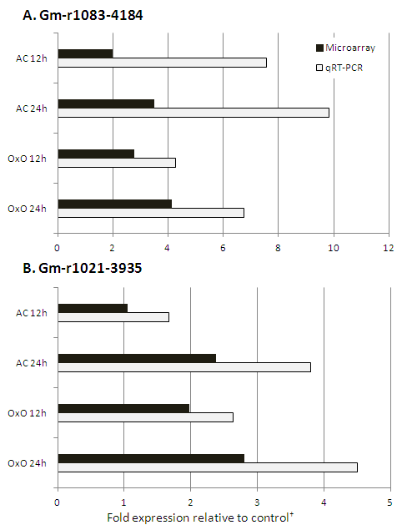
Supplemental Figure S2. Comparison of qRT-PCR results and microarray in two cDNAs coding for PR-5 protein in two lines: the parent AC-Colibri and the transgenic OxO expressing oxalate oxidase enzyme, at two time points 12 and 24 h.
†All fold expressions are relative to time zero control of the same line.

