Slide 1
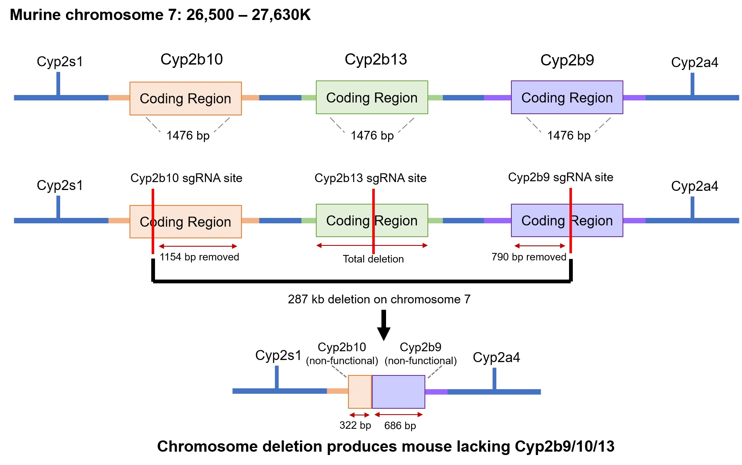
Supplemental Material 1: Crispr/Cas9-mediated partial chromosome deletion was used to produce a Cyp2b9/10/13-null mouse.

Slide 2
0 2 4 5 6 8 9 10
WEEKS
Glucose
Tolerance
Test (GTT)
Glucose
Tolerance
Test (GTT)
Insulin
Tolerance
Test (ITT)
Mice euthanized, weighted, tissues excised; weighted
Supplemental Material 2: Timeline of the different procedures performed during a 10-week treatment of 9-10 week old WT and Cyp2b-null mice with either a normal diet (ND) or a high-fat diet (HFD).

Slide 3
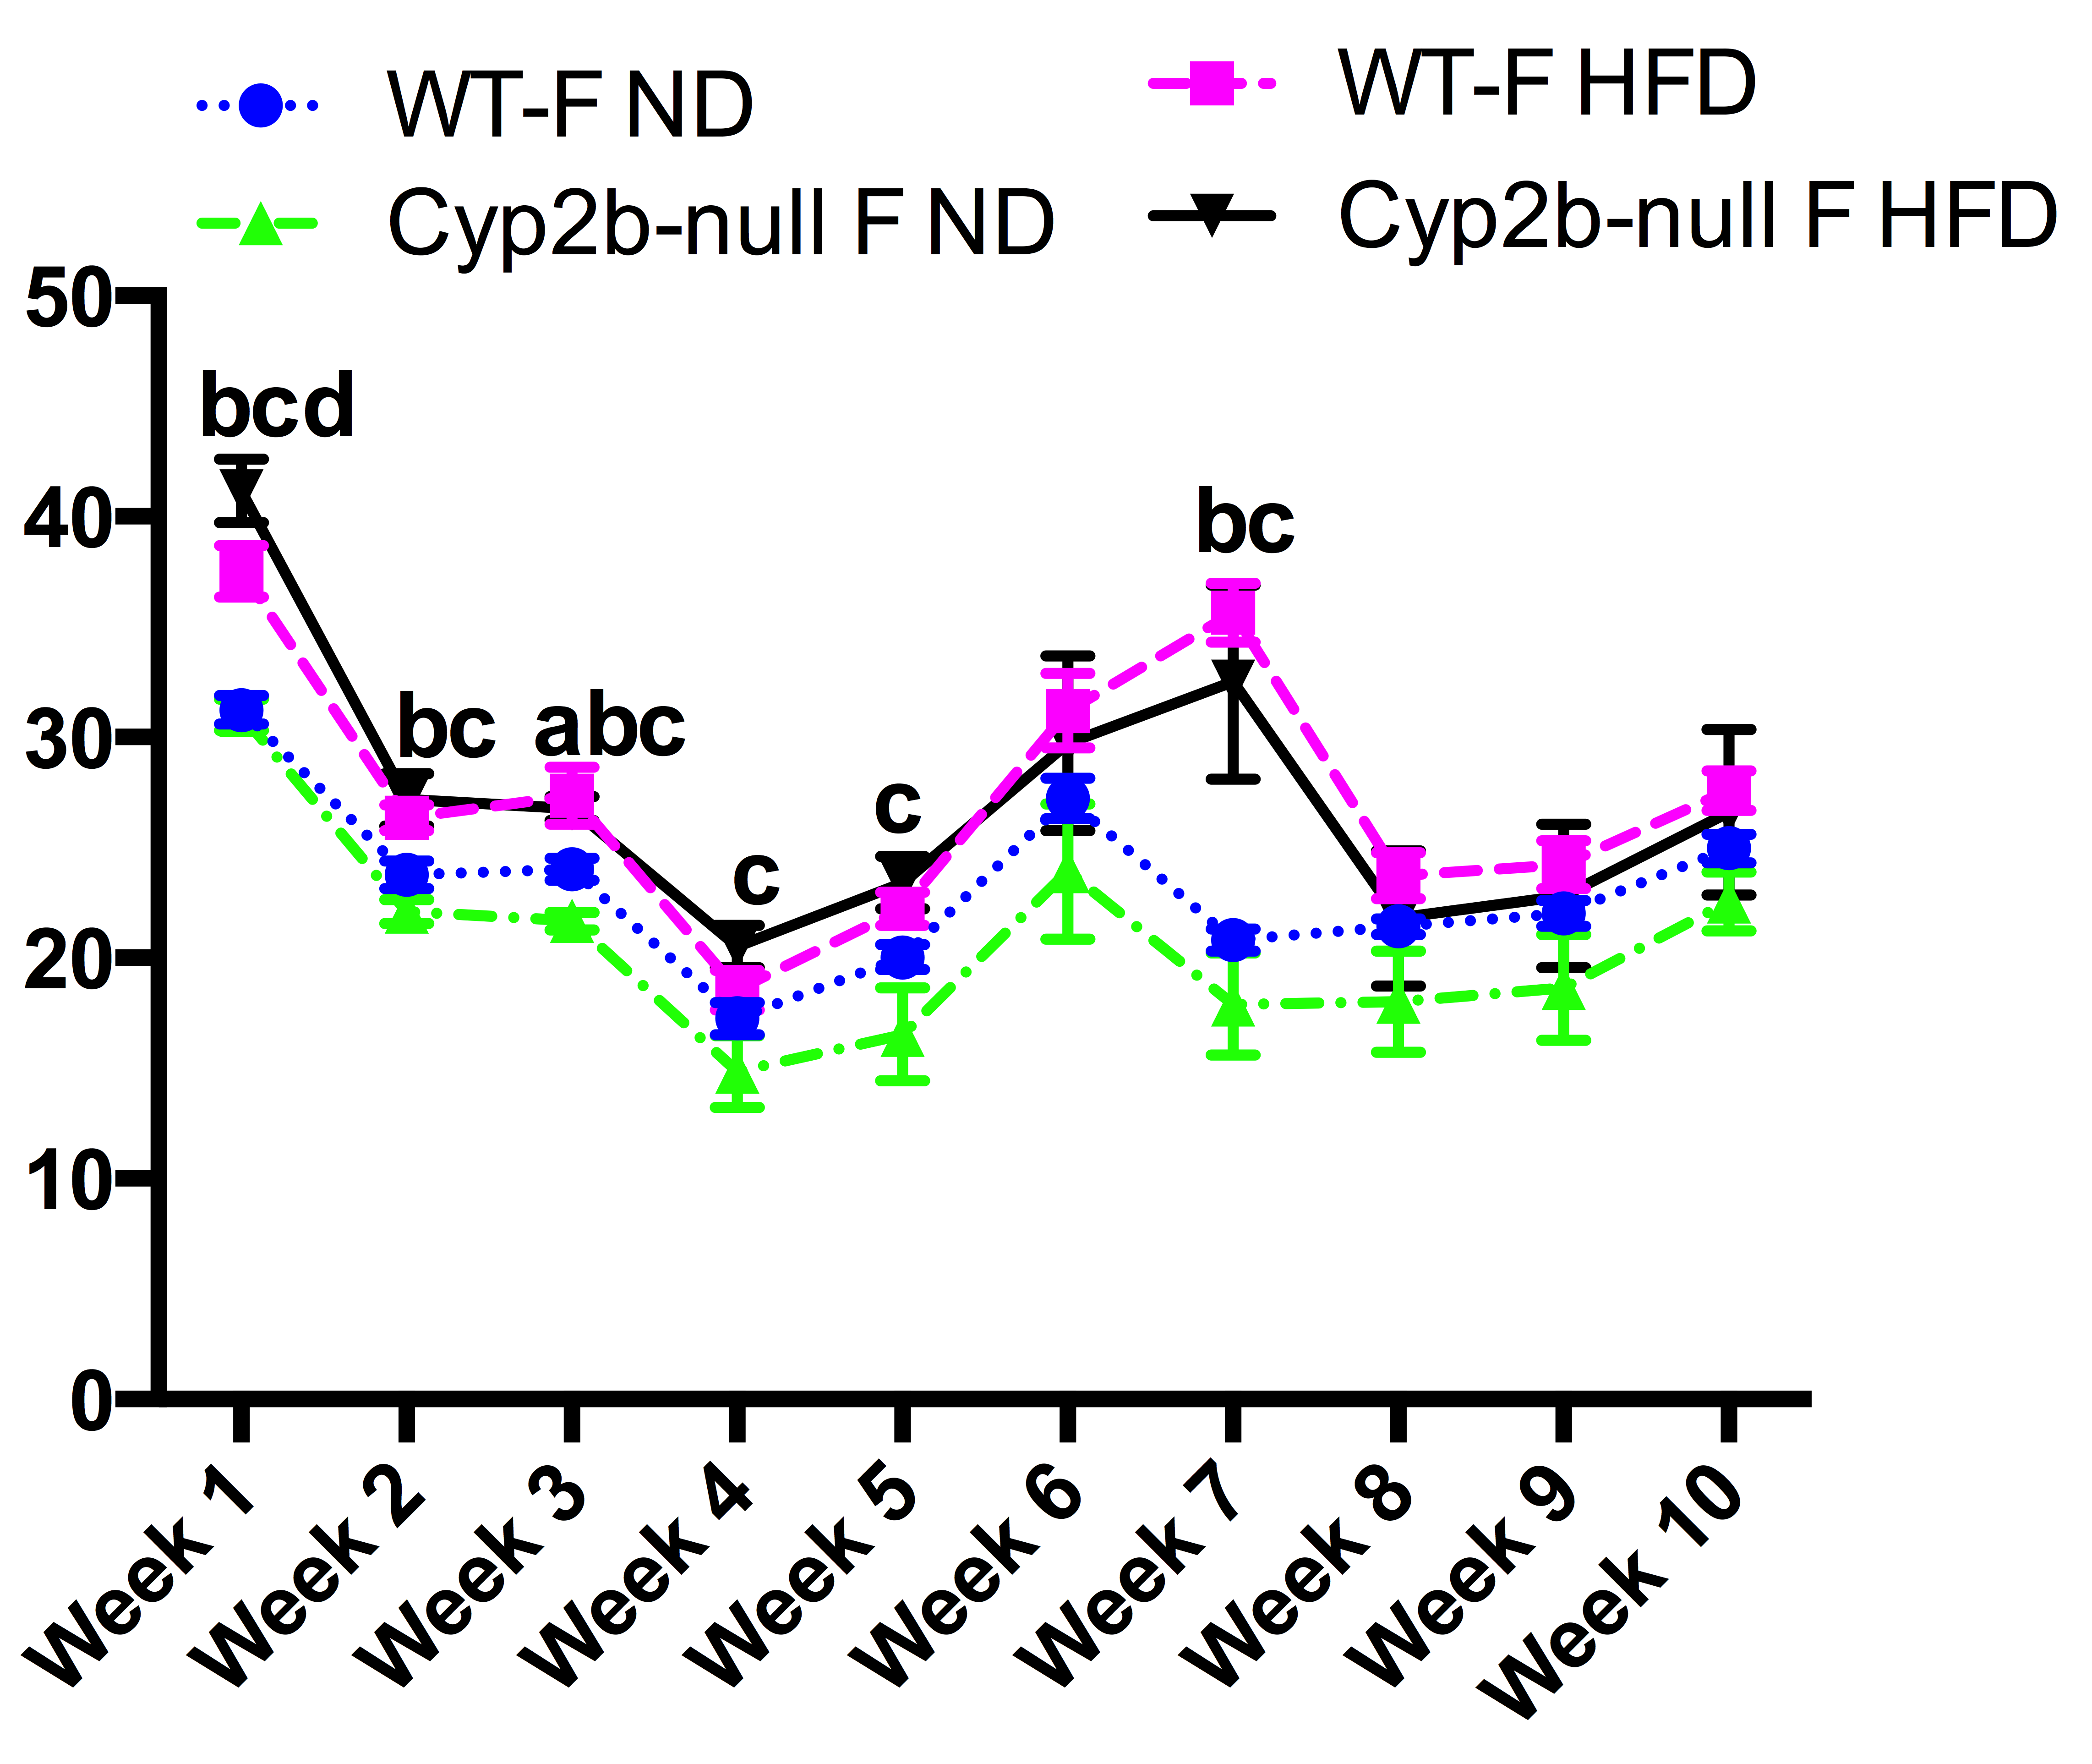
A
B
Week
Supplemental Material 3: Feed consumption (Kcal) determined in WT and Cyp2b9/10/13-null mice during the 10-weeks of dietary treatment
Data are presented as mean + SEM. Statistical significance was determined by one-way ANOVA followed by Fisher’s LSD as post-hoc test (n= 8-9).‘a’ indicates WT ND are different than Cyp2b9/10/13-null ND, ‘b’ indicates WT ND are different than WT HFD, ‘c’ indicates Cyp2b9/10/13-null ND are different than Cyp2b9/10/13-null HFD, ‘d’ indicates WT HFD different than Cyp2b9/10/13-null HFD. In general, most differences in caloric consumption were between ND-fed and HFD-fed mice.

Slide 4
A
Week 5
Fasting blood glucose (mg/dl)
Female
B
Male
Week 8
Male
Female
Supplemental Material 4: Fasting blood glucose levels were determined during weeks 5 and 8. Mice were fasted 4-5 hr and fasting plasma glucose levels were determined using a glucometer after tail bleeding. Data are presented as mean blood plasma + SEM. Statistical significance was determined by one-way ANOVA followed by Fisher’s LSD as the post-hoc test (n= 8-9). *Indicates a p-value < 0.05.‘a’ indicates WT-ND are different than Cyp2b-null-ND, ‘c’ indicates Cyp2b-null-ND are different than Cyp2b-null-HFD.

Slide 5
Supplemental Material 5. Insulin tolerance test performed on week 9 does not indicate changes in insulin tolerance in Cyp2b-null mice. Insulin tolerance was compared between WT and Cyp2b-null mice fed a ND because only Cyp2b-null ND-fed mice appeared to show putative changes in glucose tolerance compared to its similarly treated WT counterparts. Insulin tolerance tests were performed following a 4-5 hour fast. At time 0, 0.75 Units of insulin (Novolin N, Nova Nordisk, Bagsvaerd, DK) per gram of body weight was injected into each mouse intraperitoneally followed by blood glucose measurements
every 30 min for 1 h. Data are presented as mean blood glucose level + SEM. Statistical significance was determined by Student’s t-test (n = 9). No significant differences were detected.

Slide 6
Males
Females
Males
Females
Brca1
Maff
Wee1
Dbp
E230016M11Rik
Per3
Bcl2l11
Gpcpd1
Cpsf4l
Cyp2a4
Gys2
Nceh1
Nmrk1
Npc1
Cyp2b10
Arntl
Sdf2l1 Acnat2
Hyou1 Chka
Ppp1r3b Hexim1
Gm5844 Clpx
Tubb2a Tjp3
Creld2 Gldc
Hn1l Hspa5
Bag3
Gfpt1
Slc30a10
491
50
245
54
Up-regulated
Down-regulated
Supplemental File 10: Venn Diagram showing shared differentially expressed genes between male and female Cyp2b-null ND mice compared to WT-ND mice.

Slide 7
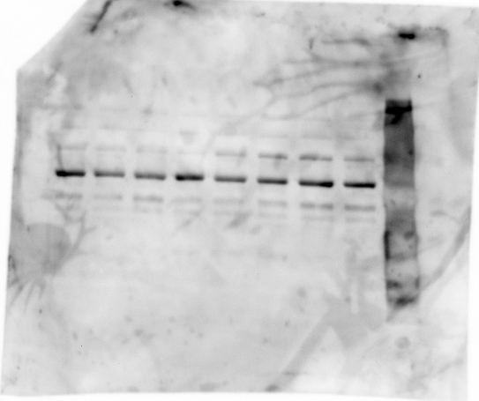
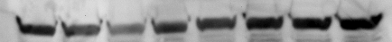
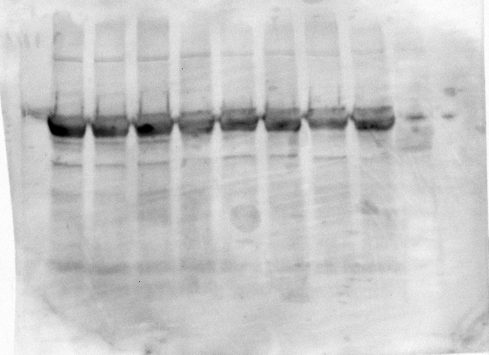
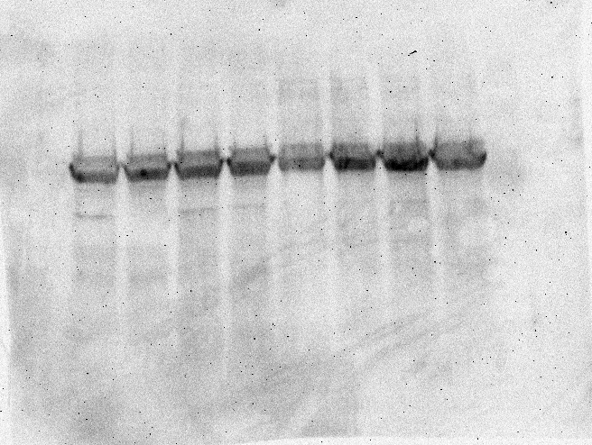
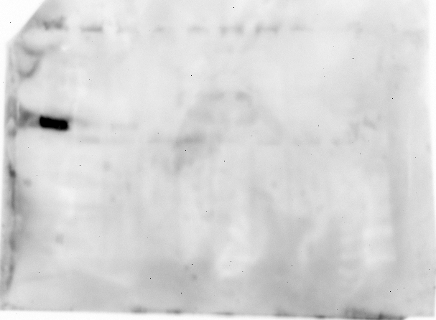
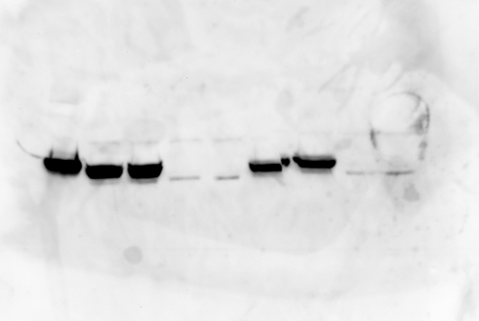
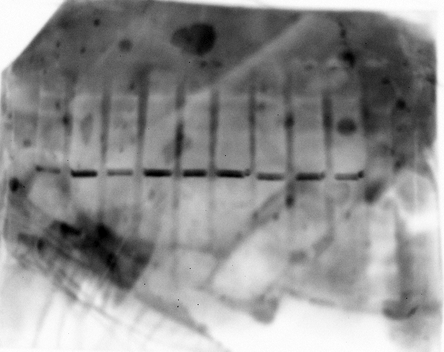
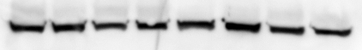
Supplemental Material 11: Western blots show changes in Cyp2b protein expression between WT and Cyp2b9/10/13-null mice. Microsomes were prepared by homogenizing frozen livers followed by differential centrifugation as described previously (77). Protein concentrations were determined using Bradford reagent (Bio-Rad). Immunoblots were performed using 30 μg of microsomal protein separated on 12% SDS-polyacrylamide gels (BioRad). Protein was transferred onto 0.2μm polyvinylidene difluoride (PVDF) membrane and were recognized using polyclonal antibodies to Cyp2a (Invitrogen, Carlsbad, CA USA), Cyp3a (Chemicon International, Temecula CA USA), Cyp2b (previously developed in house to a section of Cyp2b10)(40,41), Cyp4a (Thermofisher Scientific, Rockford IL USA). β-actin (Sigma Aldrich, St.Louis MO USA) was used as the reference protein. Chemiluminescent western blot detection was done using alkaline phosphatase conjugated secondary antibodies, where in anti-mouse IgG (Immunostar, Bio-Rad) was used to visualize β-actin and anti-rabbit IgG (Immunostar, Bio-Rad) was used to visualize CYPs. Protein was quantified by densitometry (Quality One, BioRad, Hercules, CA). Relative density is shown as the average of two samples using b-actin as the reference gene. Data represents relative mean of WT compared to Cyp2b-null mice of the same gender and dietary teatment. Statistical differences were determined by Student’s t-tests (n = 2) (* p < 0.05 ** p < 0.01).
1.0 1.1 1.0 1.0
1.0 1.4 1.0 2.9
1.0 1.0 1.0 3.7
Cyp2a
1.0 0.9 1.0 1.6
1.0 0.7 1.0 1.3 ^{c*}
Cyp3a
1.0 0.8 1.0 0.9
1.0 1.1 1.0 1.2
Cyp4a
0.0 0.0 0.0 0.0
1.0 0.0^{b}**** 1.0 0.0^{b}****
Cyp2b
β-actin
WT-ND
Cyp2b-null ND
WT-HFD
Cyp2b-null HFD
WT-ND
Cyp2b-null ND
WT-HFD
Cyp2b-null HFD
Males
Females

