Slide 1
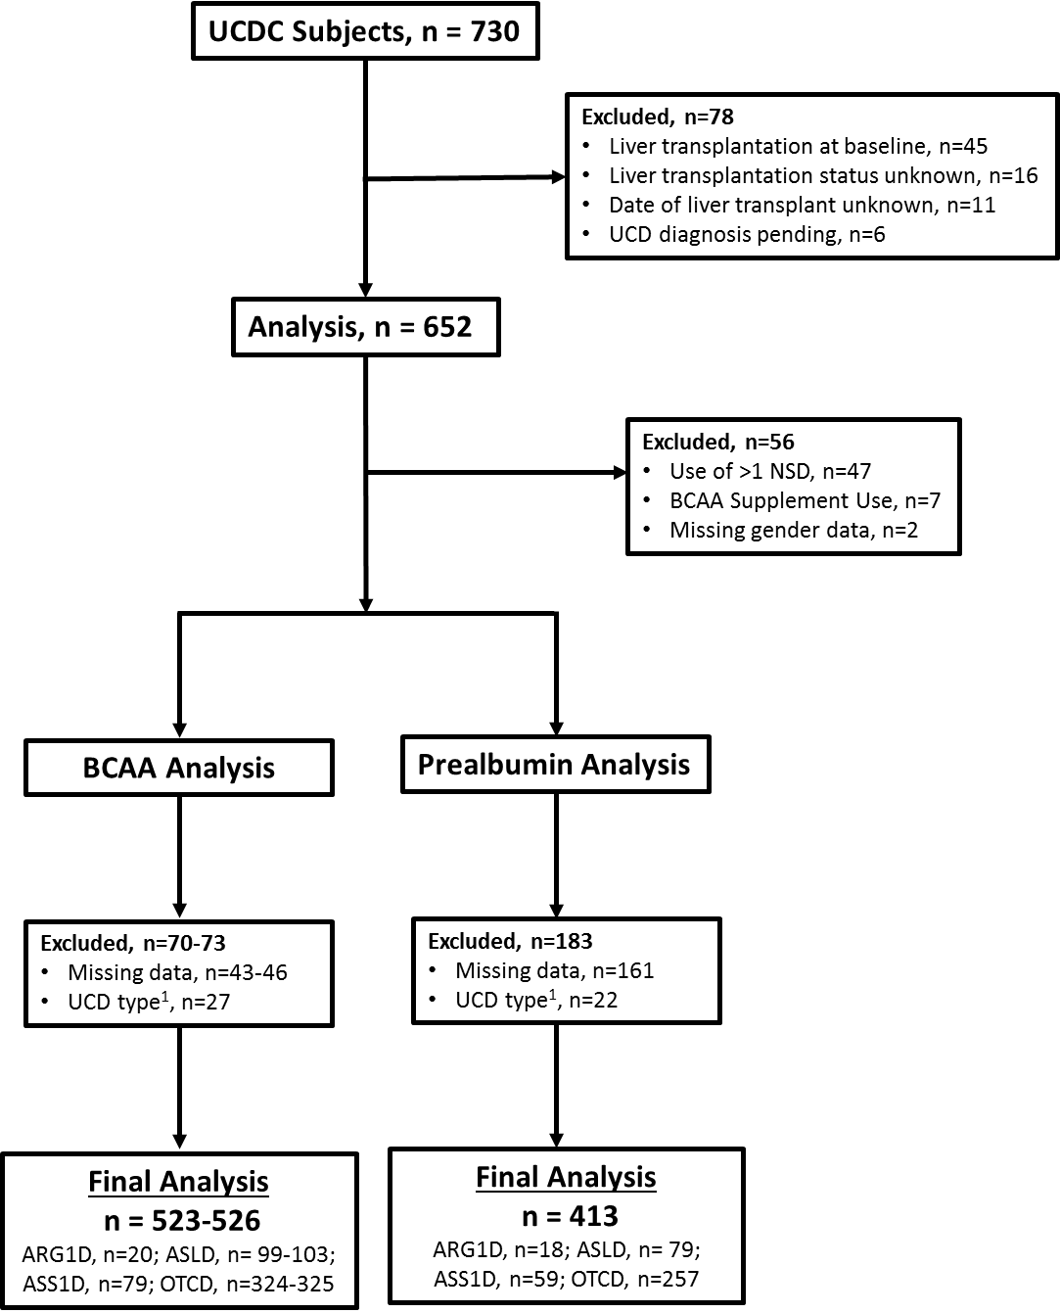
Figure S1
Notes:
Corrected spelling.

Slide 2
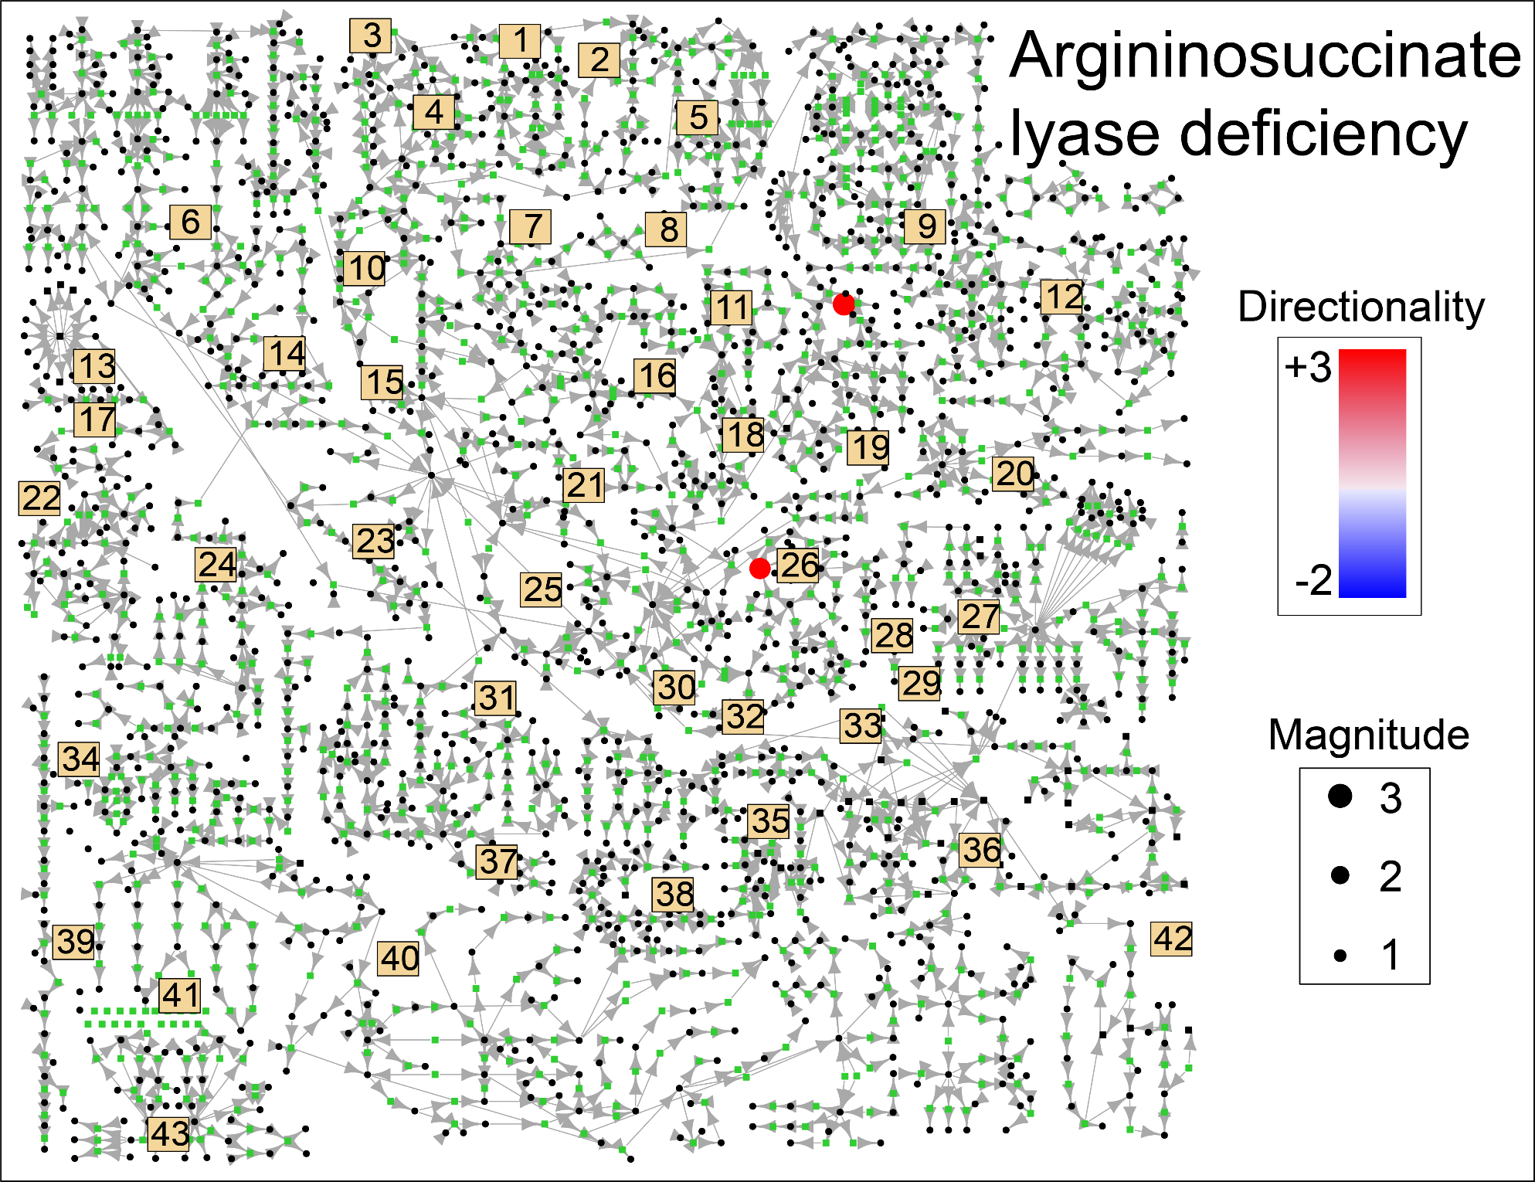
Figure S2A

Slide 3
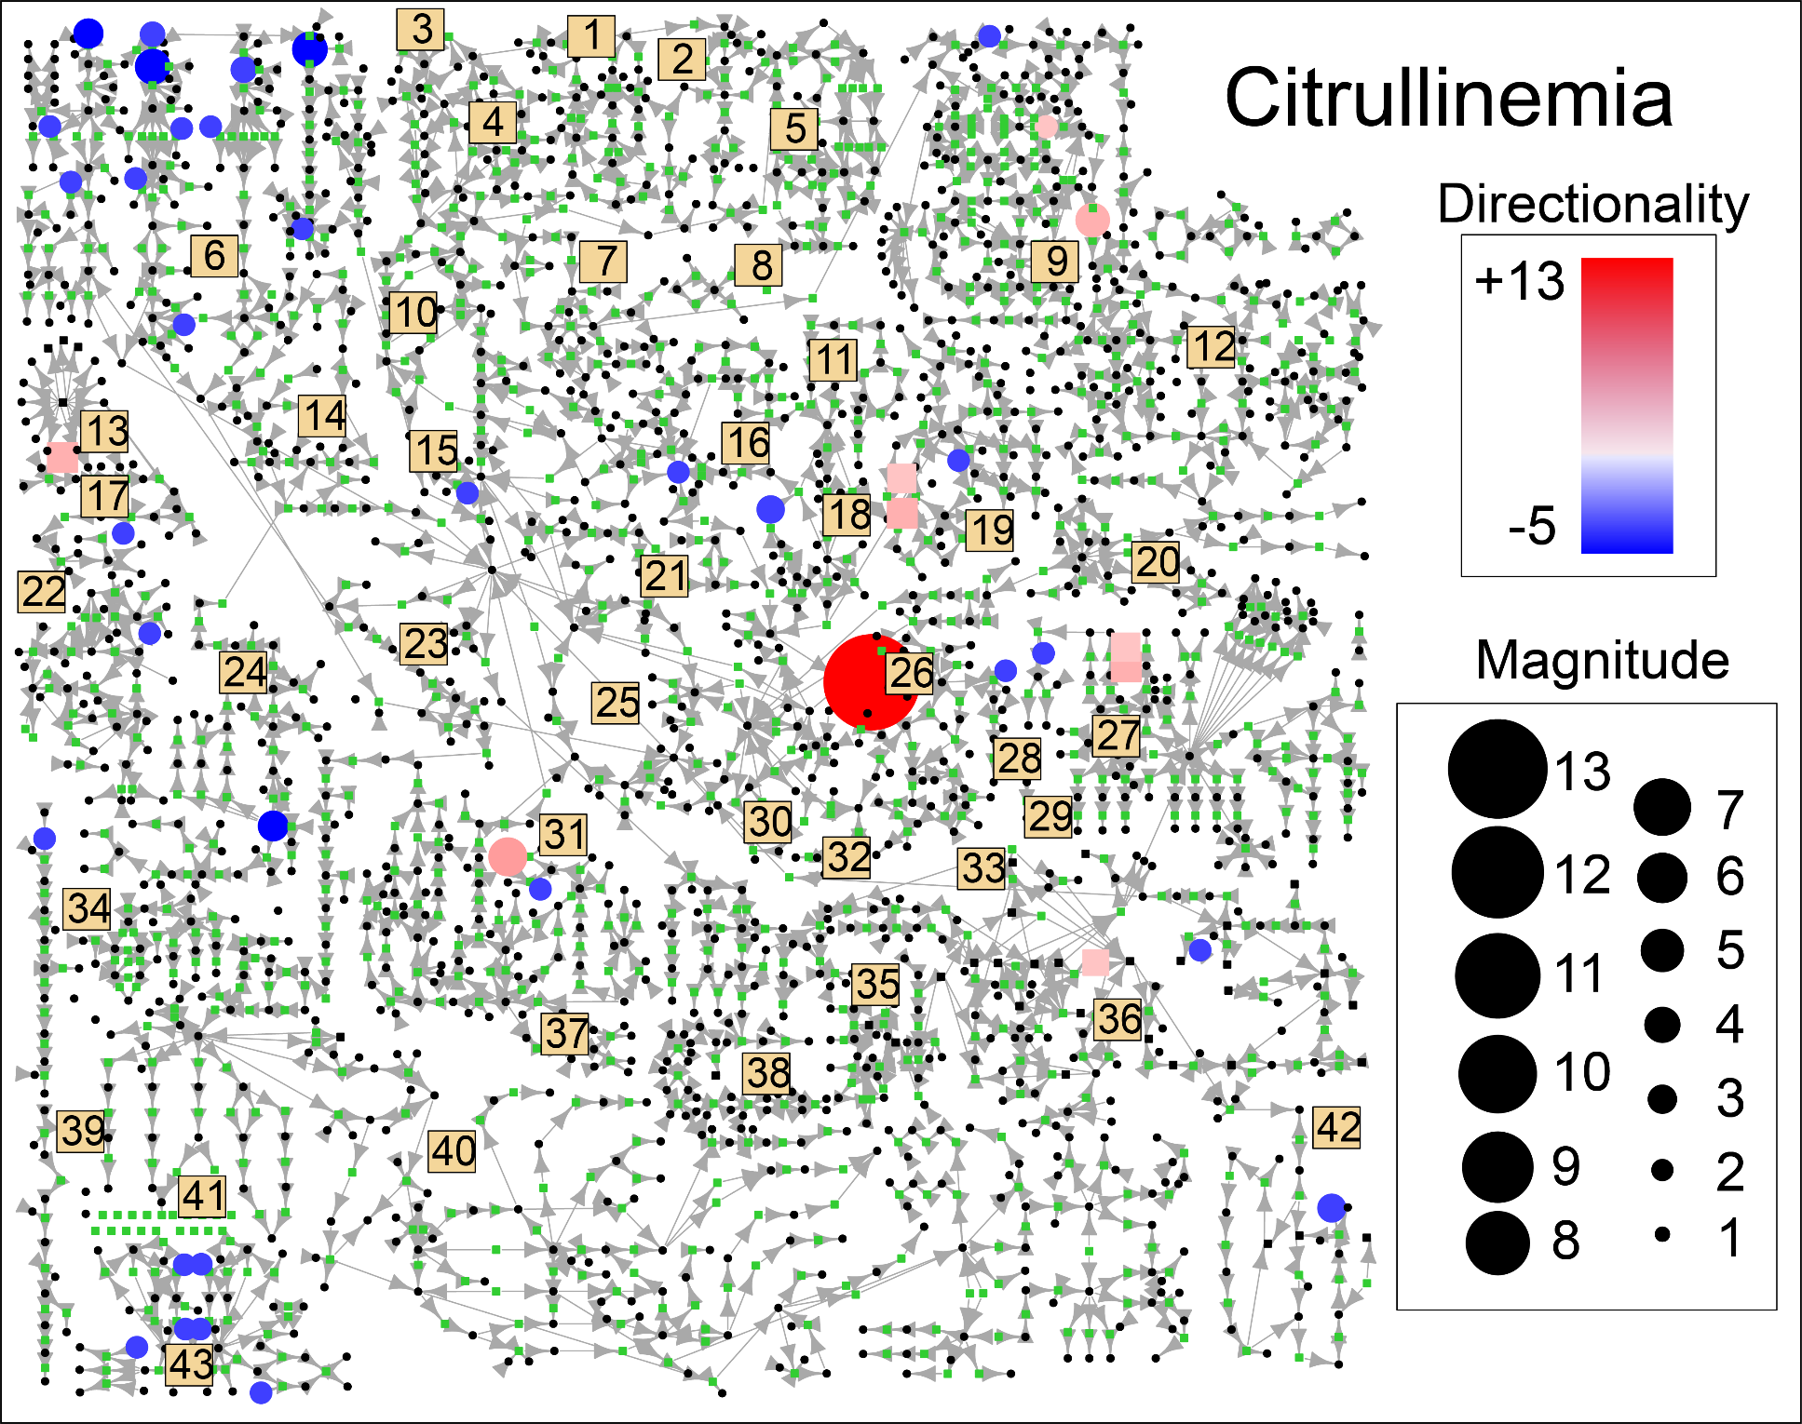
Figure S2B

Slide 4
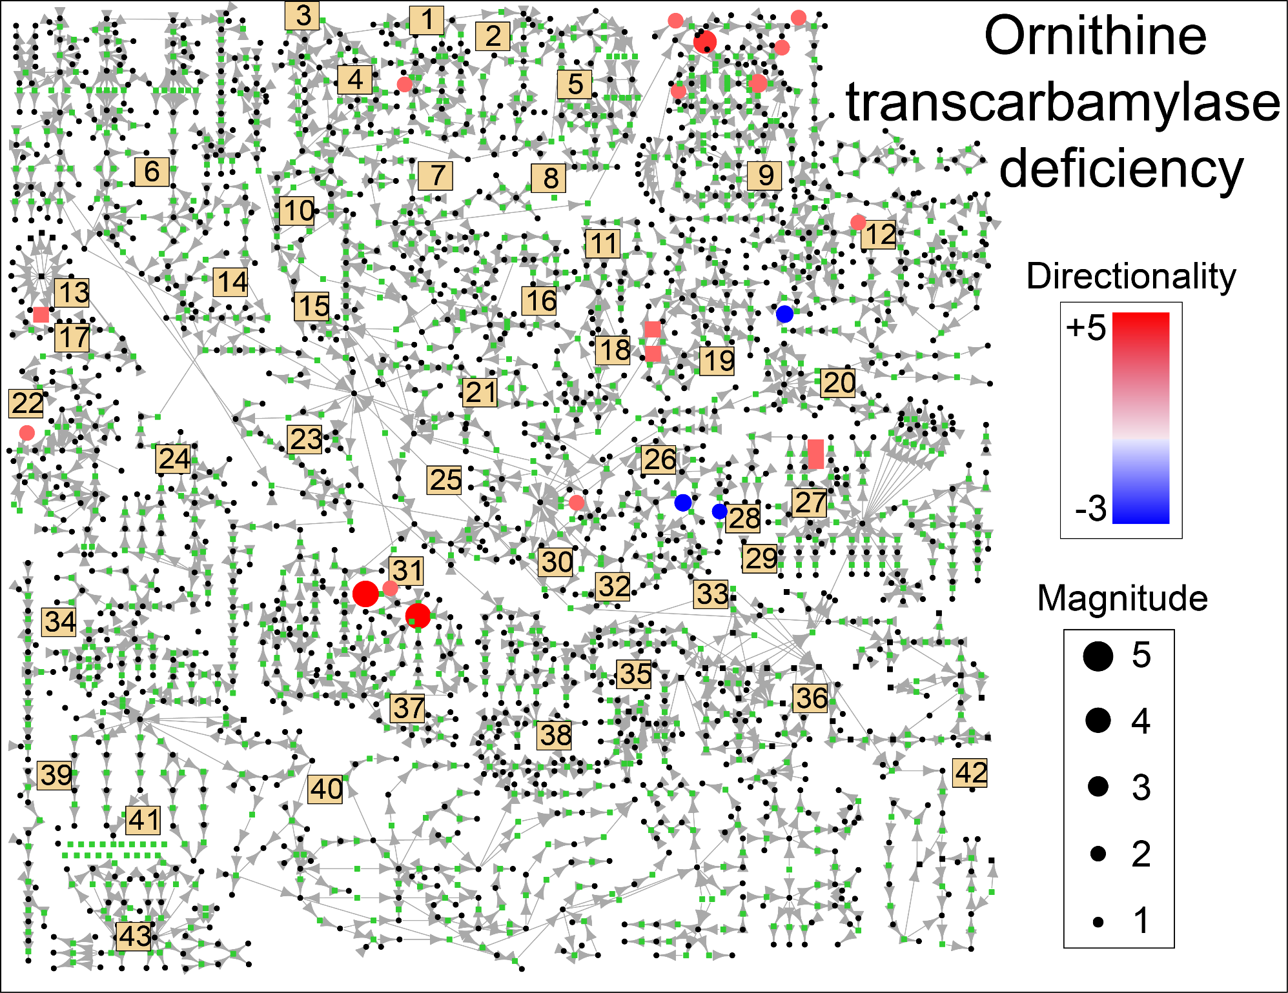
Figure S2C

Slide 5
Figure S3
B.
C.
A.
Glutamine
Orotic Acid
Urea
D.
E.
Uridine
AMP
Notes:
Can you enlarge the fonts on the X- and Y–axes? It looks like a different font than in the other figures?

Slide 6
Figure S4

Slide 7
Figure S5

Slide 8
Figure S6

Slide 9
Figure S7
A.
B.
*
*
*
*
*
*
C.
D.
*
*
*
*
*
Notes:
I corrected spelling above.
These data include all diagnoses in collective analysis?
I wonder about putting all of these data into a single graph and collor coded?

