Slide 1
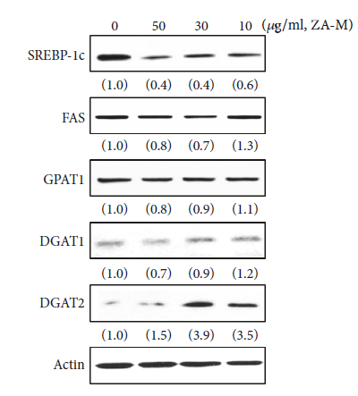
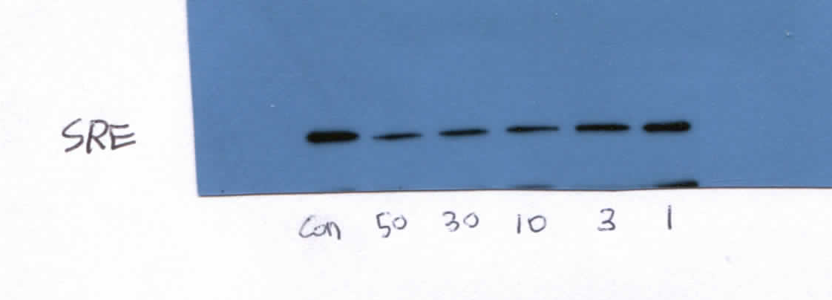
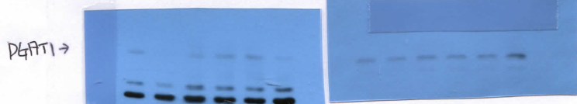
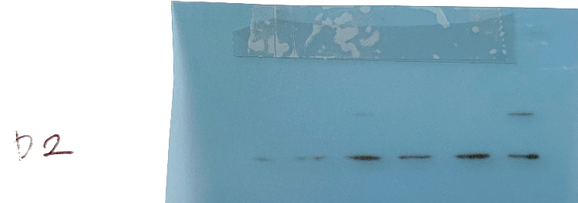
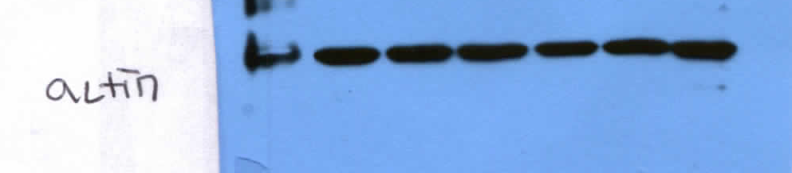
0 50 30 10 3 1 ug/ml, ZA-M
Figure 3 (A)
2014.9.23
2014.9.23
2014.9.23
2014.9.23
2014.10.8
2014.10.8

Slide 2
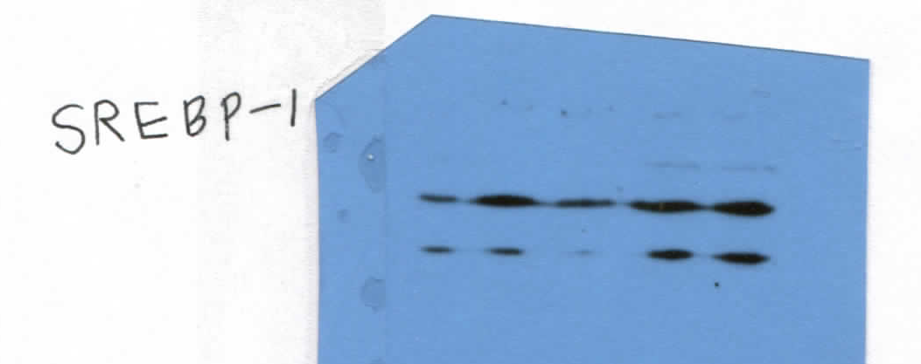
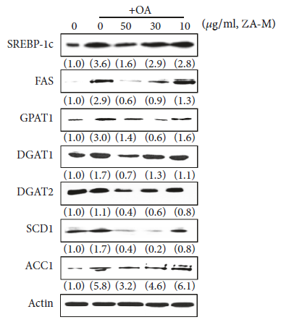
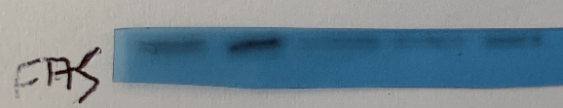
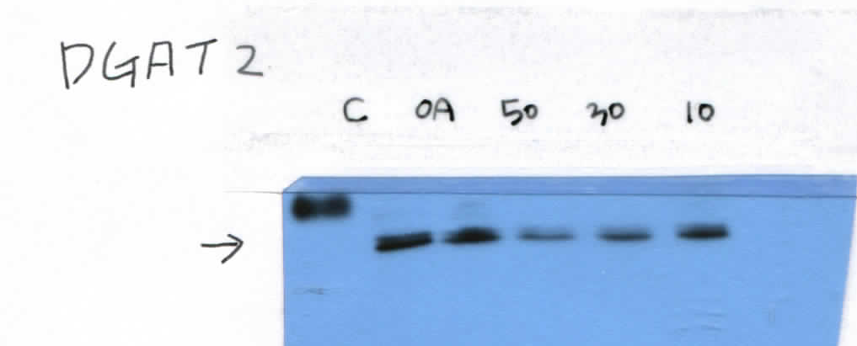


논문 figure
Figure 3 (D)
2014.9.30
2015.6.3
2014.9.30
2014.12.10
2014.9.30
2014.12.10
2014.10.8
2014.9.30

Slide 3
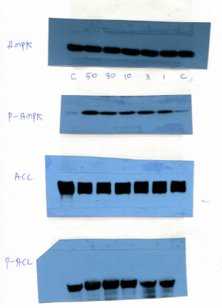
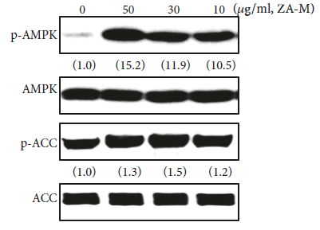
논문 figure
Figure 4 (A)
2014.7.29

Slide 4
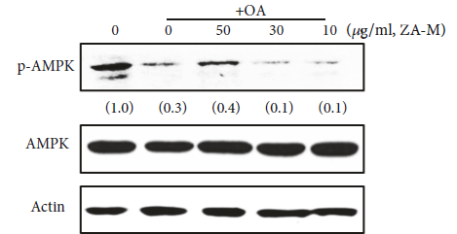

논문 figure
Figure 4 (B)
2015.1.8
2016.10.6
2014.12.5

Slide 5

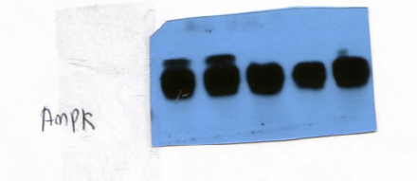
The original one
Figure 4 (B)
(B)
+ OA
0 0 50 30 10 (μg/ml, ZA-M)
p-AMPK
2016.10.6
(1.0)
(0.3)
(0.4)
(0.1)
(0.1)
AMPK
Actin
2016.10.6

