Slide 1













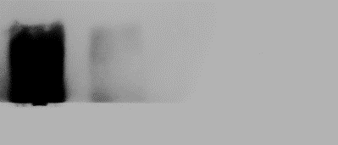






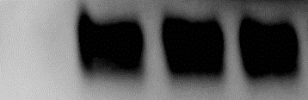

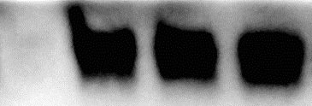





































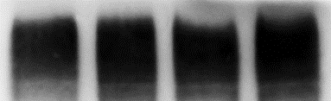
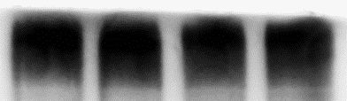
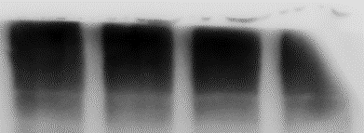
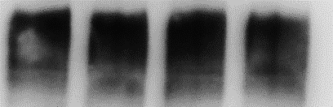
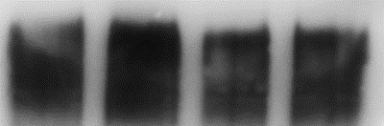
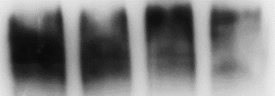












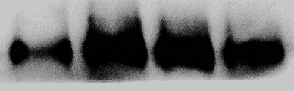
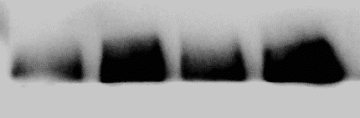

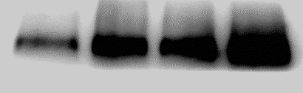

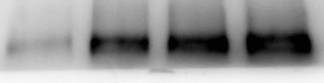












Supplemental Figure S1
SKBR3
MDA-MB-231
A
3-Cl
3,5-Br₂
3-Cl-5-OCH₃
3-Cl
3,5-Br₂
3-Cl-5-OCH₃
(μM)
0 2 5 10
0 2 5 10
0 2 5 10
0 2 5 10
0 2 5 10
0 2 5 10
EGFR
bcl2
survivin
c-PARP
c-CASP3
B
3-Cl
3,5-Br₂
3-Cl-5-OCH₃
3-Cl
3,5-Br₂
3-Cl-5-OCH₃
(μM)
0 2 5 10
0 2 5 10
0 2 5 10
0 2 5 10
0 2 5 10
0 2 5 10
p-mTOR
mTOR
p-S6RP
S6RP
p-4EBP1
4EBP1
C
3-Cl
3,5-Br₂
3-Cl-5-OCH₃
3-Cl
3,5-Br₂
3-Cl-5-OCH₃
(μM)
0 2 5 10
0 2 5 10
0 2 5 10
0 2 5 10
0 2 5 10
0 2 5 10
TXNDC5
β1-integrin
CHOP
XBP-1s
β-actin
Supplemental Figure S1. Buttressed analogs of DIM-C-pPhOH downregulates NR4A1-regulated gene products and pathways. MDA-MB-231 and SKBR3 cells were treated with different concentrations of buttressed analogs (as outlined in Fig. 3), and effects on growth promoting/survival proteins (A), mTOR pathway gene products (B), and reductant and stress gene products (C) were determined by western blot analysis.

