Slide 1
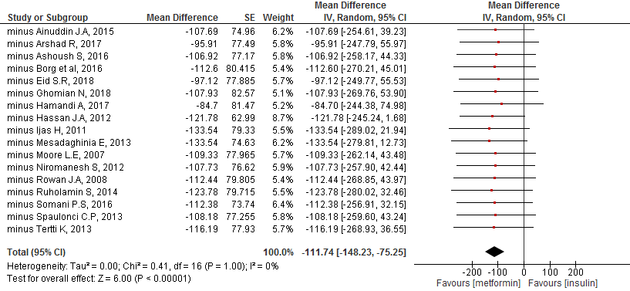
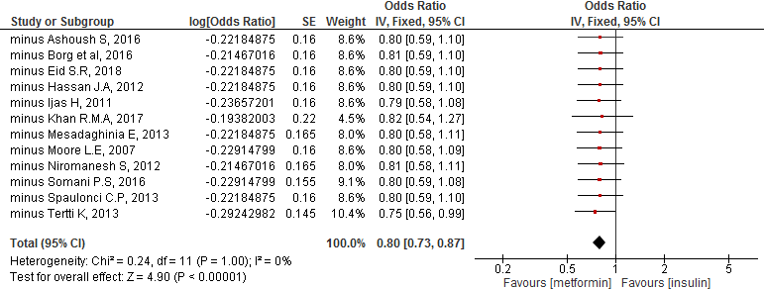
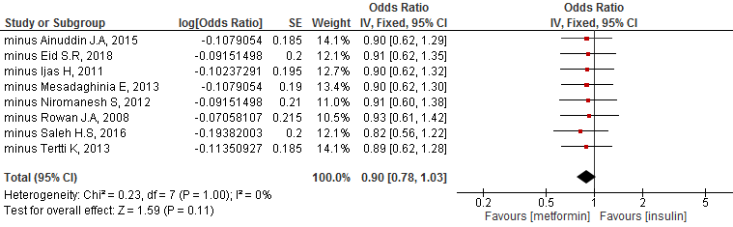
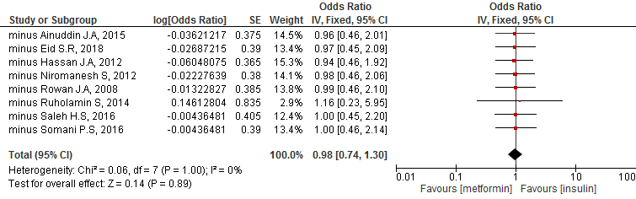
A) Leave One Out analysis: Birth weight
B) Leave One Out analysis: Macrosomia
C) Leave One Out analysis: LGA
D) Leave one out analysis: SGA
S3 Fig: Leave One Out sensitivity analysis

