Slide 1
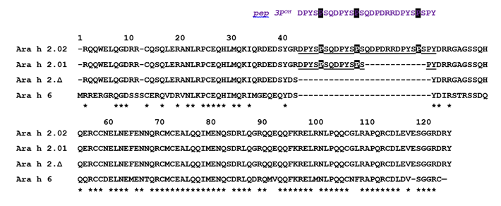
Figure E1 Sequence comparison between Ara h 2.02 (Ara h 2.0201, UniProt accession number Q6PSU2), Ara h 2.01 (Ara h 2.0101, Q6PSU2-2), the deletion variant Ara h 2.∆ and Ara h 6 (Q647G9). Numbering of Ara h 6 is shown and hydroxyprolines in the DPYSP^{OH}S motifs are shown with shaded letters. Identical residues between Ara h 2 and Ara h 6 sequences are indicated with asterisks. The peptide containing three DPYSP^{OH}S motifs pep 3P^{OH} corresponds to the domain found in Ara h 2.02 isoform.

Slide 2
Figure E2 Cross-reactivity between Ara h 2 and Ara h 6 evaluated by competitive inhibition of IgE-binding to Ara h 2 (see Methods). Competitions with Ara h 2 (in red) or with Ara h 6 (in blue) were performed with native allergens purified from raw peanut. Competitive inhibition was not performed for sera 9 and 16 (too weak IgE-binding to Ara h 2) and 5 (not enough serum).

Slide 3
Figure E3 Cross-reactivity between Ara h 2 and Ara h 6 evaluated by competitive inhibition of IgE-binding to Ara-h-6 (see Methods). Competitions with Ara h 2 (in red) or with Ara h 6 (in blue) were performed with native allergens purified from raw peanut. Competitive inhibition was not performed for sera 2, 13, 15 and 29 (too weak IgE-binding to Ara h 6) and 5 (not enough serum).

Slide 4
Figure E4. Mediator release assay with RBL SX-38 cells sensitized with immunopurified IgE antibodies from peanut-allergic patients in response to increasing concentrations of Ara h 2 (red) and Ara h 6 (blue). X-axis shows the concentration of the tested molecule and Y-axis the percentage of the reference release induced with anti-human IgE mAb LE27.

