Slide 1
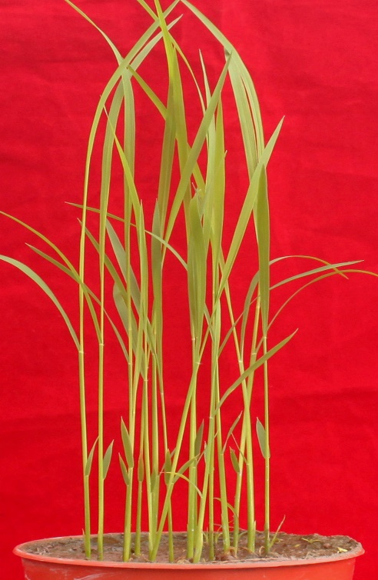
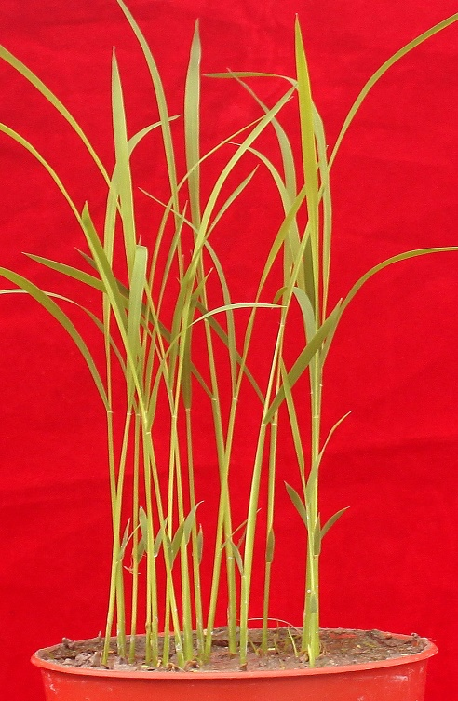
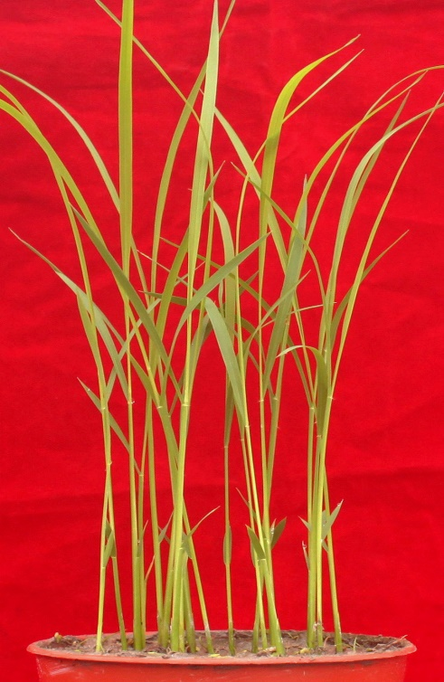
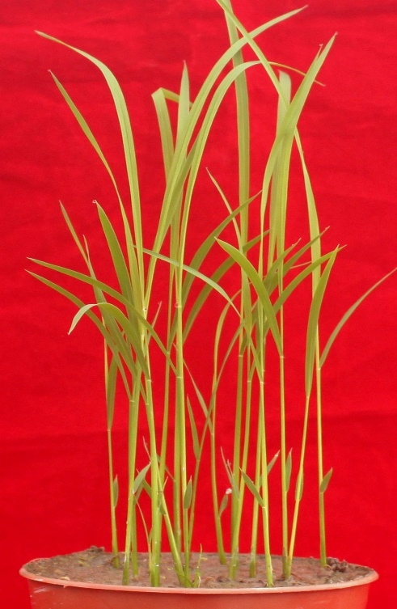
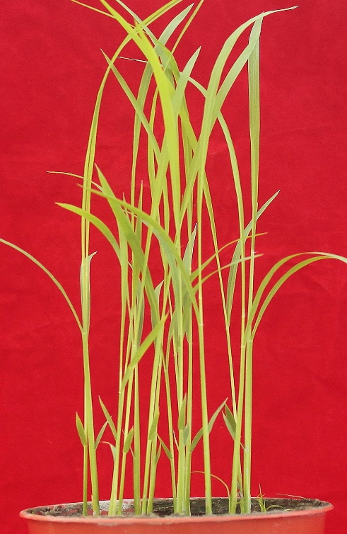
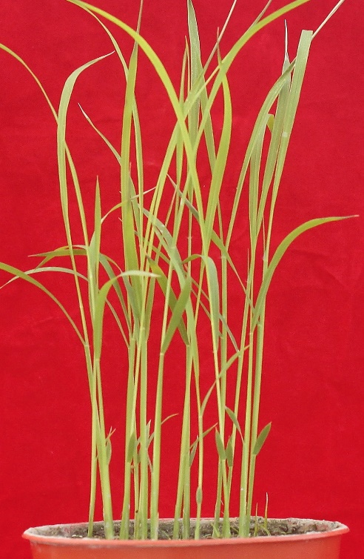
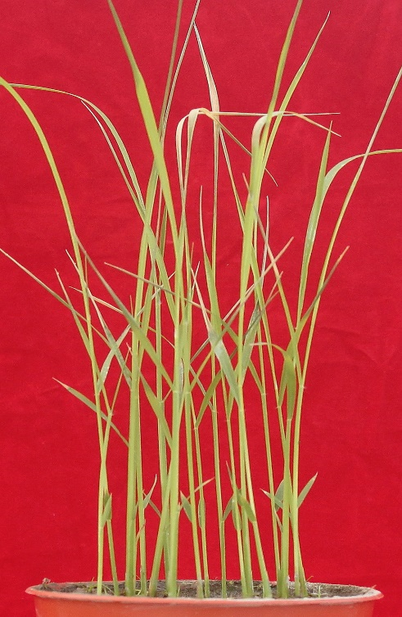
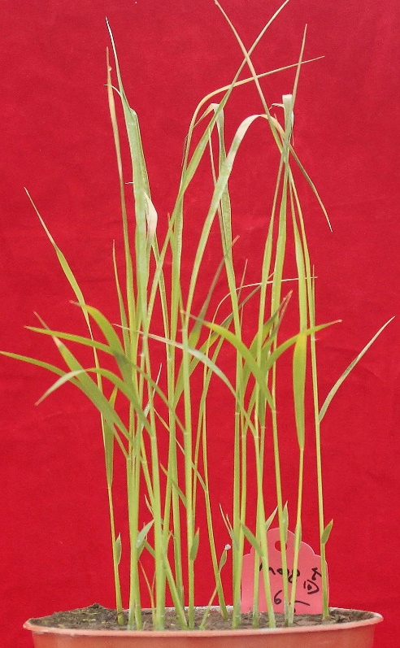
a
Buffer
MBP
MBP-MoCDIP6
MBP-MoCDIP7
b
Buffer
MBP
MBP-MoCDIP6
MBP-MoCDIP7
Additional file 2: Figure S1. Recombinant MoCDIP6 and MoCDIP7 caused wilt symptoms on rice seedlings. a rice seedlings before spraying with recombinant MoCDIP6 and MoCDIP7. b rice seedlings displayed wilt symptoms at two days after spraying with MBP-MoCDIP6 or MBP-MoCDIP7.

