Slide 1
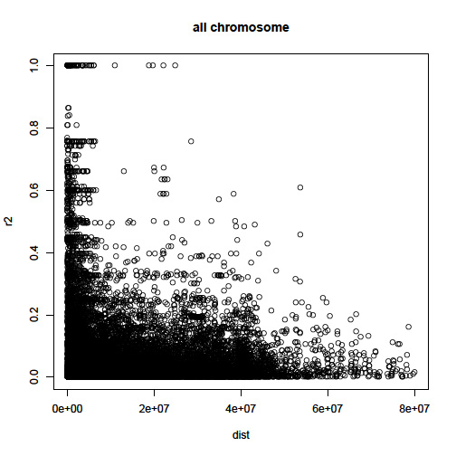
Fig. S5. The average linkage disequilibrium (LD) decays (r²) approach 0.02 when distance between SNPs was approximately 200 Kb. Distance in bp is shown on X-axis.

