Slide 1
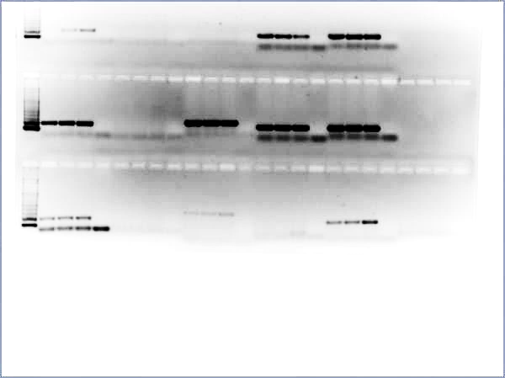
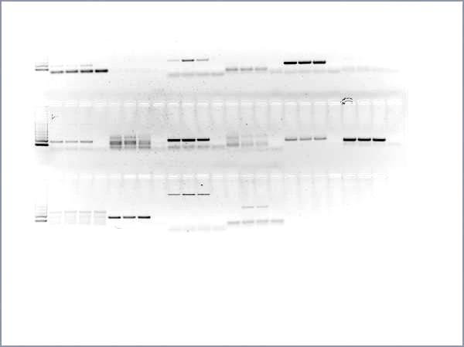
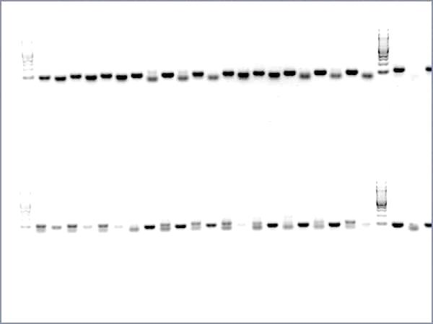

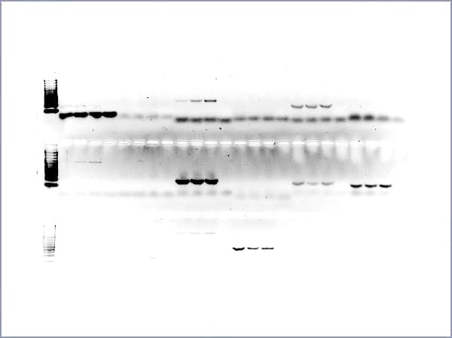
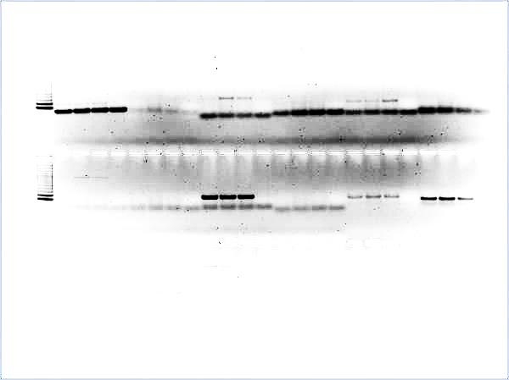
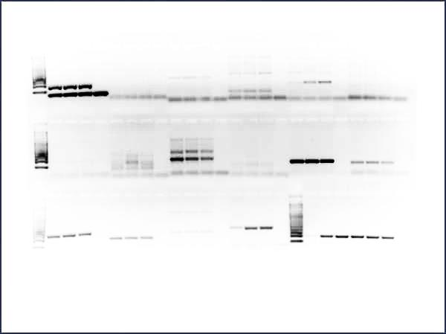
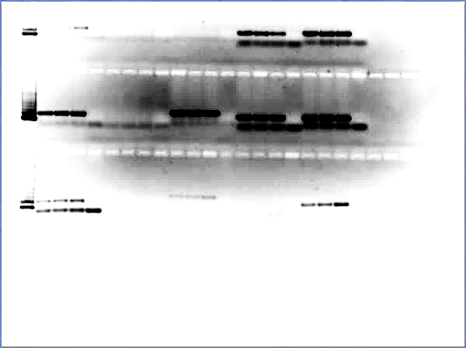


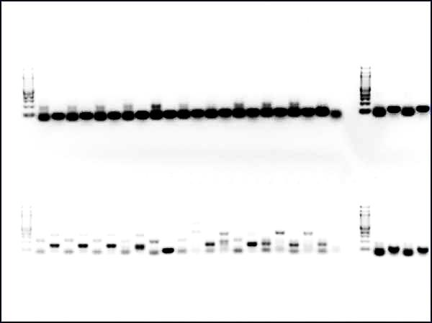
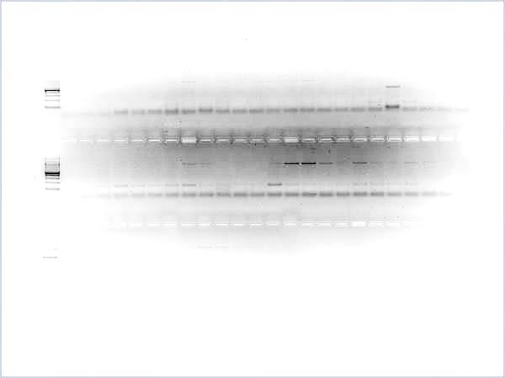
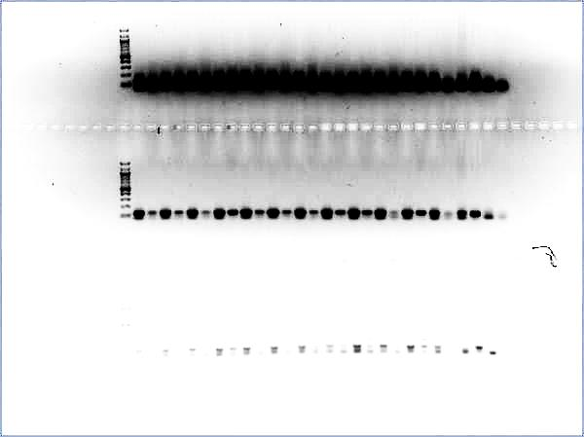
Additional file 1: Figure S1. Correlation between transcriptional expression by qRT-PCR and the promoter hypermethylation of tumor suppressor genes by MSP analysis in OSCC cell lines. Related to Figure 1A.
MGMT
sFRP2
HIC1
RT-PCR
MSP
RT-PCR
MSP
RT-PCR
MSP
5-aza-dC (uM)
U
M
5-aza-dC (uM)
U
M
5-aza-dC (uM)
U
M
0
5
10
0
5
10
0
5
10
SAS
OSC20
Ca9-22
OSC20
Timp3
SCC25
sFRP4
RT-PCR
MSP
HSC4
RT-PCR
MSP
5-aza-dC (uM)
U
M
YD10B
5-aza-dC (uM)
0
5
10
0
5
10
U
M
HSC3
SAS
HSC3
SAS
TCERG1L
YD38
OSC20
RT-PCR
MSP
5-aza-dC (uM)
U
M
sFRP5
p16
0
5
10
RT-PCR
MSP
RT-PCR
MSP
HSC3
5-aza-dC (uM)
U
M
5-aza-dC (uM)
U
M
TCERG1L
0
5
10
0
5
10
RT-PCR
MSP
OSC20
OSC20
5-aza-dC (uM)
DKO2
IVD
H₂O
YD10B
0
5
10
U
M
U
M
U
M
U
M
HN22
MGMT
YD9
sFRP4
sFRP5
sFRP2
Timp3
p16
HIC1
GATA5
TCERG1L

Slide 2
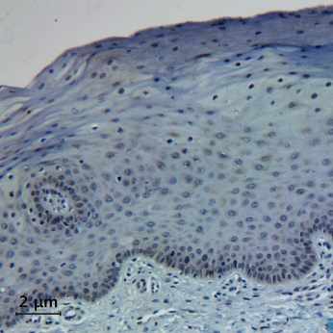
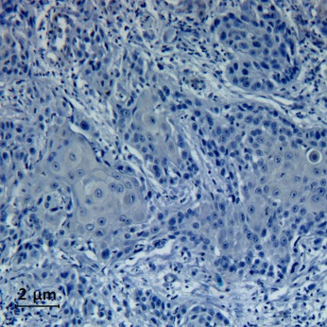
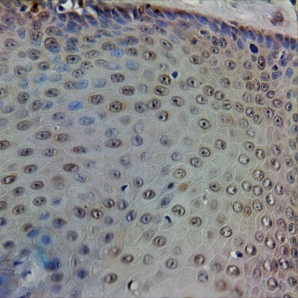
Additional file 1: Figure S2. Protein expression levels of TFPI2, SOX17, and GATA4 in additional set of primary OSCC tumors and normal oral mucosa. Related to Figure 5.
Normal oral mucosa
Primary OSCC
A
B
TFPI2
C
D
Sox17
E
F
GATA4

