Slide 1
Supplementary Table 1. Origin and description of samples sequenced
Sample origin | PENILE |  |  |  |  |  | VAGINA |  |  |  |  |  | ORAL
Description | NoS | BeS | AfUS | AfPS | H₂O₂ | H₂O₂ x15 | NoS | BeS | AfUS | AfPS | H₂O₂ | H₂O₂ x15 | Male Before | Male After | Female Before | Female After
Nº reads | 46157 | 50709 | 56985 | 193 | 49047 | 55318 | 12124 | 77398 | 57098 | 43741 | 49766 | 64474 | 47455 | 62029 | 101 | 47472
NoS, microbiota without sexual intercourse
BeS, immediately before sexual encounter
AfUS, 4 days after unprotected sexual encounter, only penetration and with ejaculation inside the vagina
AfPS, immediately after vaginal sex with condom and oral sex
H2O2, after 1 day of H2O2 treatment
15H2O2, after 15 days of intermittent H2O2 treatment

Slide 2
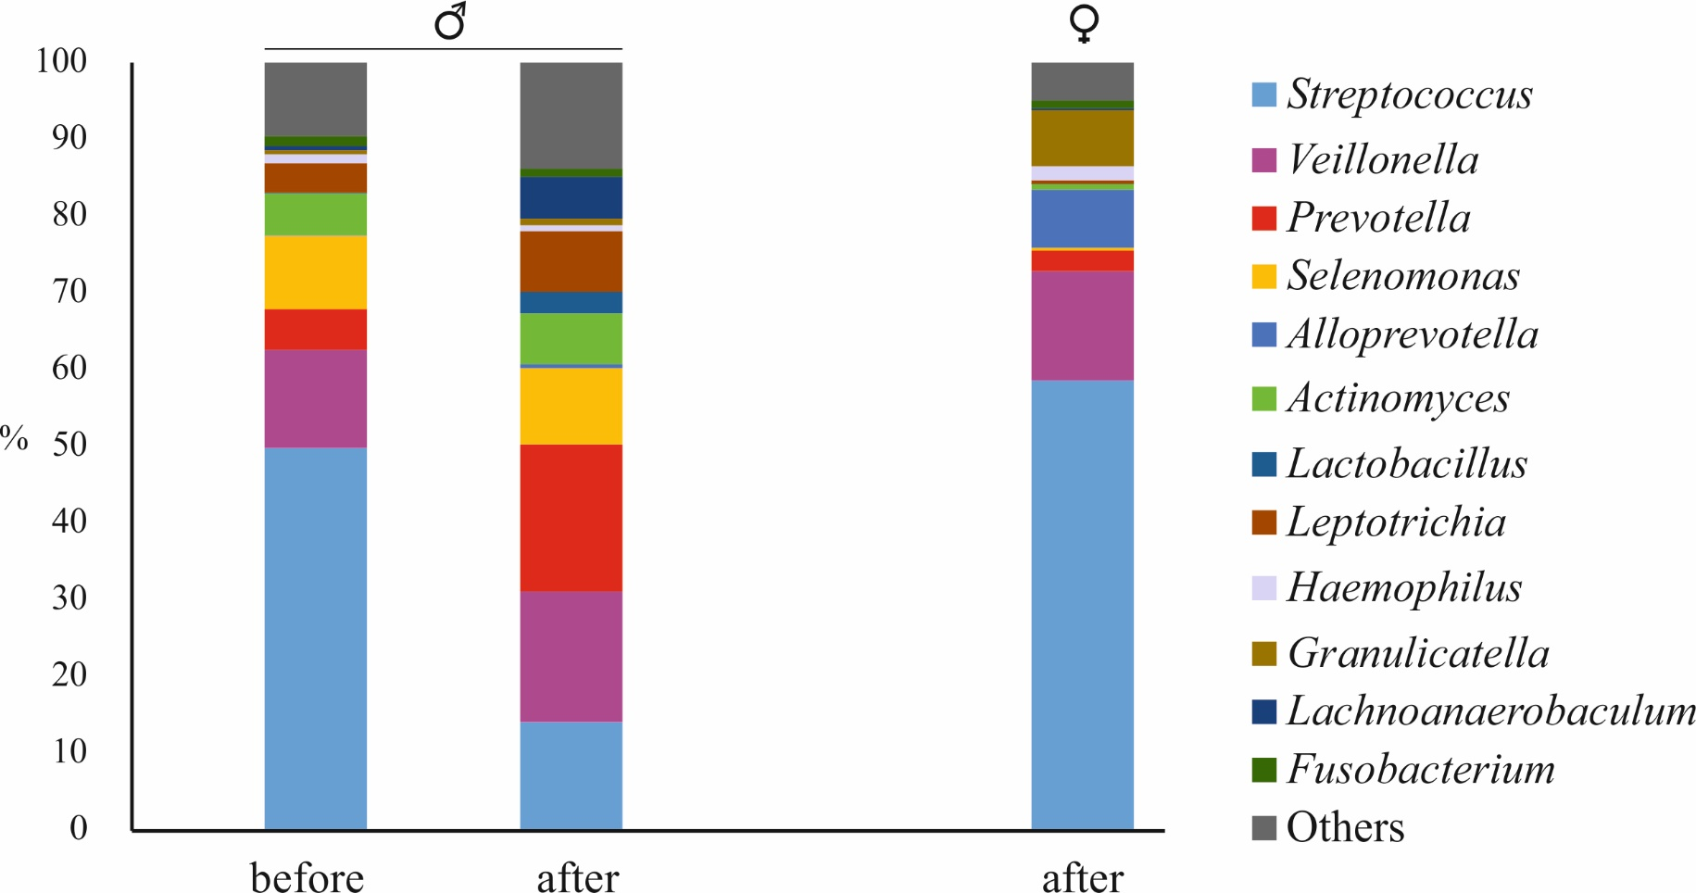
Supplementary Figure 1. Bacterial communities associated to oral swabs before and after oral sex. Male and female samples are indicated with the corresponding symbol.
Notes:
Figure 4. Bacterial communities associated to oral swabs before and after oral sex. Male and female samples are indicated with the corresponding symbol.

