Slide 1
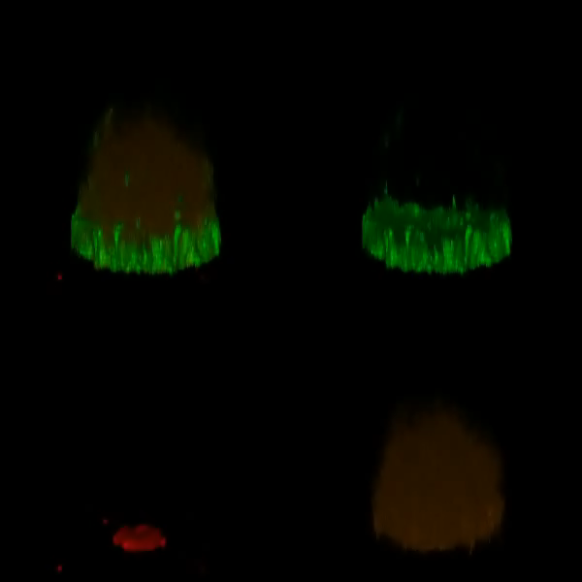
U2932-HGAL(Y106F)
HGAL
BCR
Grb2

