Slide 1
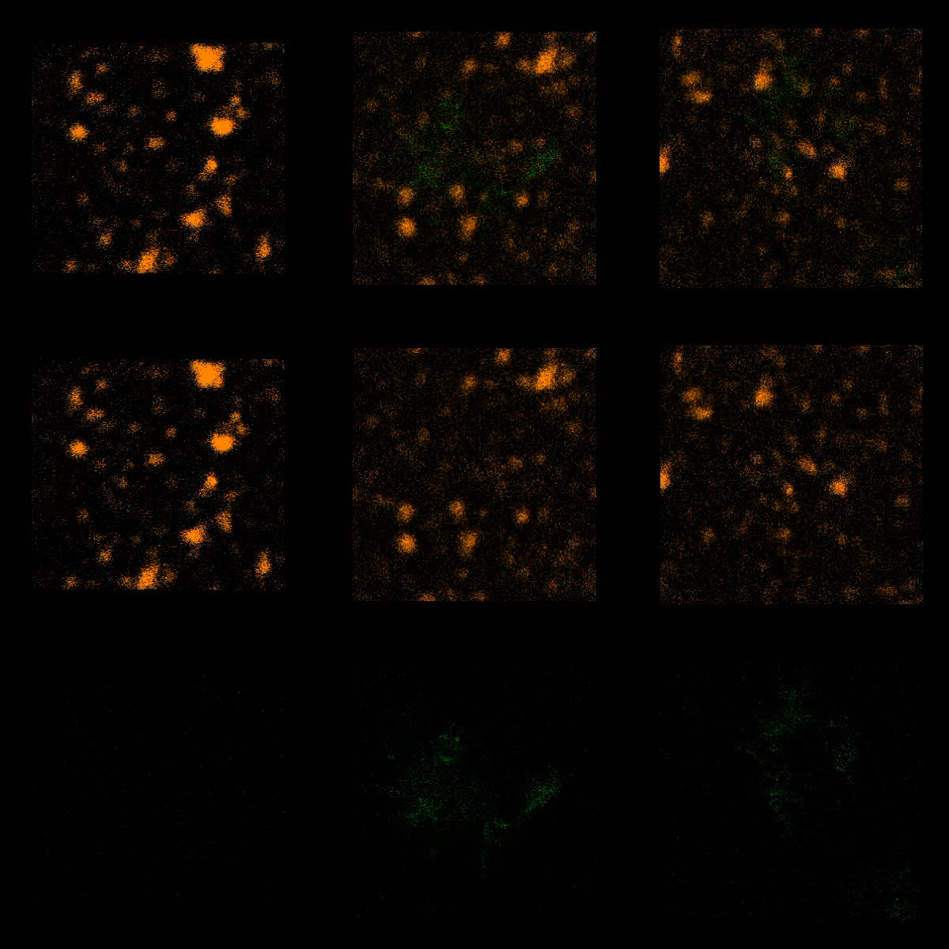
U2932-HGAL
BCR/HGAL
BCR
HGAL

