Slide 1
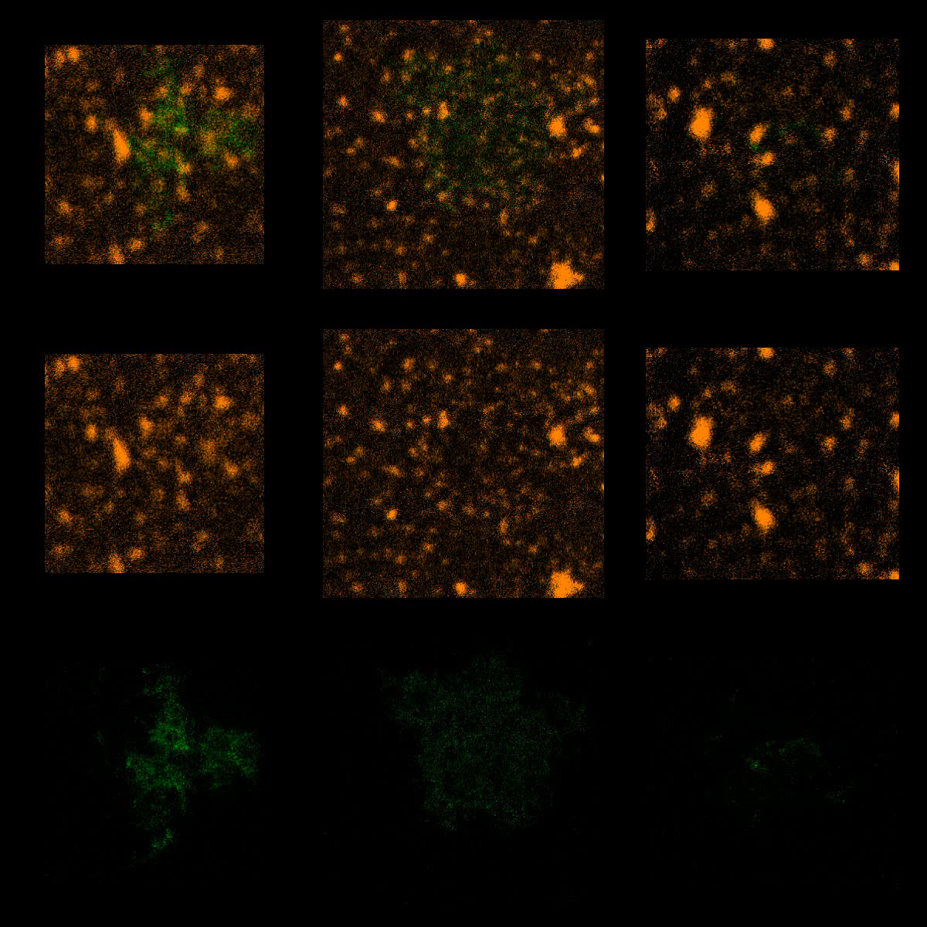
U2932-HGAL(Y106F)
BCR/HGAL
BCR
HGAL

