Slide 1
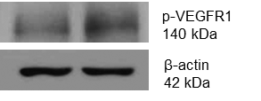
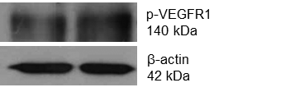
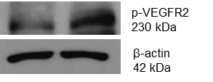
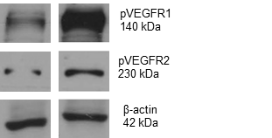
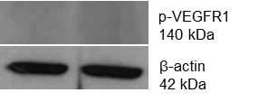
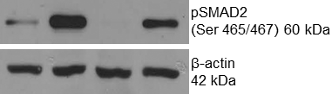
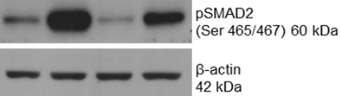
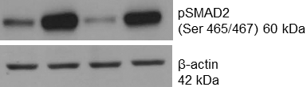
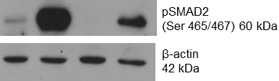
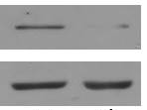
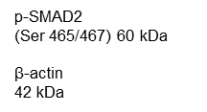
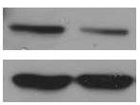
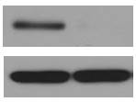
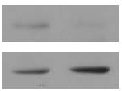
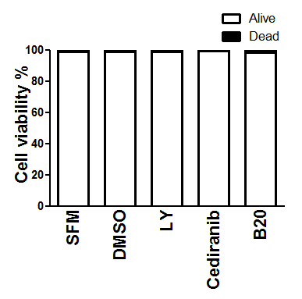
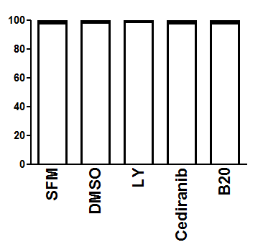

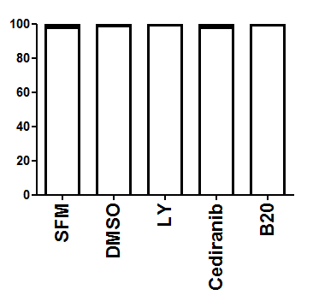
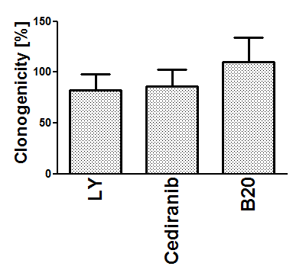
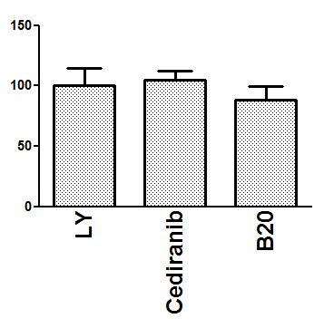
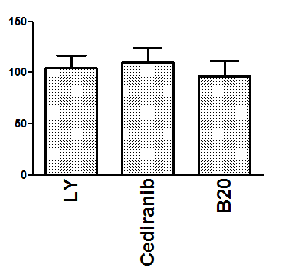
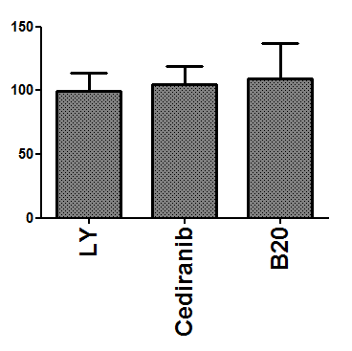
Supplementary Figure 2
A
-
+
-
+
-
+
-
+
-
+
VEGF-A
SMA-497
SMA-540
SMA-560
GL-261
1.67
2.28
1.06
1.41
0.81
1.07
0
0.04
1.04
2.45
B
0.34
0.96
SMA-497
SMA-540
SMA-560
GL-261
0.28
1.60
0.01
0.83
0.75
3.26
0.33
1.6
0.88
3.24
0.42
2.7
0.17
3.26
0.00
1.49
DMSO
LY +
TGFβ-2
DMSO
LY +
TGFβ-2
DMSO
LY +
TGFβ-2
DMSO
LY +
TGFβ-2
LY
LY
LY
LY
TGFβ-2
TGFβ-2
TGFβ-2
TGFβ-2
C
SMA-497
SMA-540
SMA-560
GL-261
0.35
0.05
0.45
0.29
0.86
0.06
0.29
0.02
SFM
SFM
SFM
SFM
HYPOXIA
HYPOXIA
HYPOXIA
HYPOXIA
D
SMA-497
SMA-540
SMA-560
GL-261
E
SMA-497
SMA-540
SMA-560
GL-261

