Slide 1
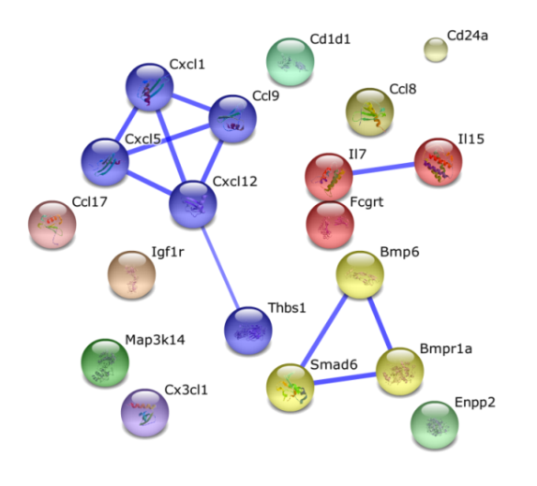
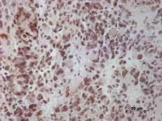
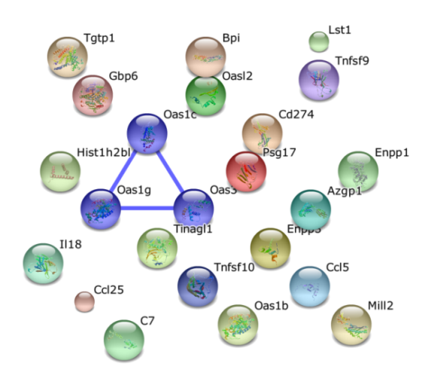
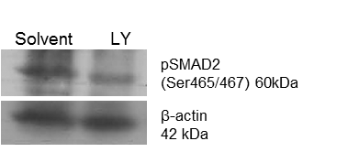
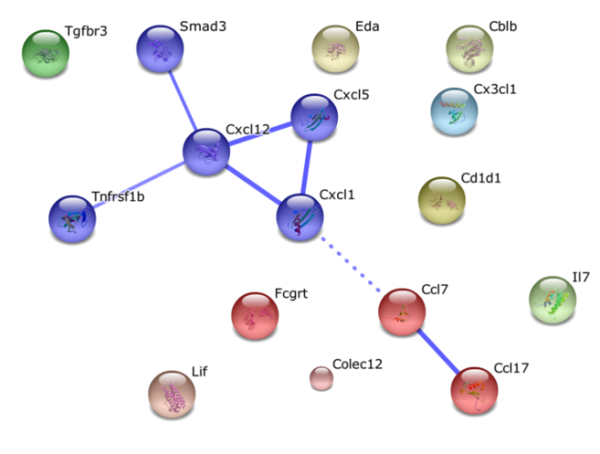
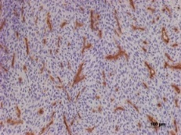
Supplementary Figure 4
early-stage
A
SMA-497
SMA-540
SMA-560
GL-261
D
Solvent
H & E
SMA-497
LY
B
Solvent
pSMAD2
E
pSMAD2
LY
0.50
0.36
GL-261
C
Solvent
CD31
LY

