Slide 1
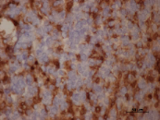
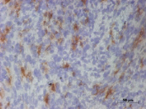
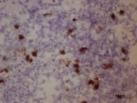
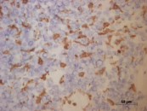
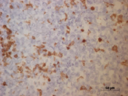
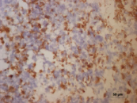
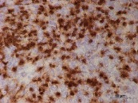
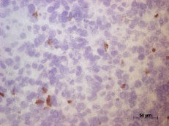
Supplementary Figure 7
early-stage
A
CD45
B
CD4
C
CD8
D
CD11b
SMA-497
GL-261
SMA-497
GL-261
SMA-497
GL-261
SMA-497
GL-261
Solvent
LY
B20
LY+B20
E
F
G
CD45
CD4
CD8
CD11b
H
Solvent
LY
end-stage
B20
LY+B20

