Slide 1
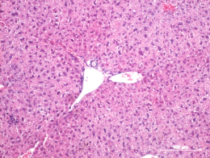
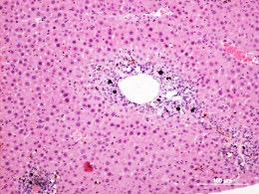
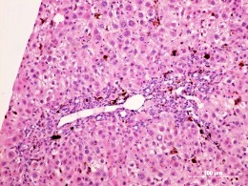
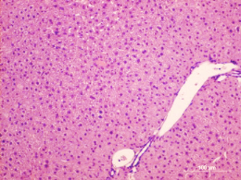
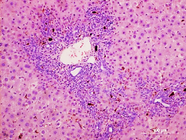
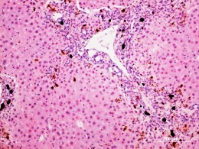
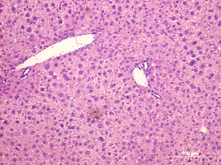
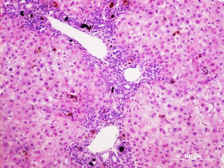
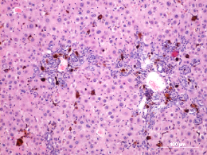
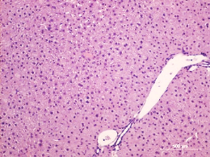
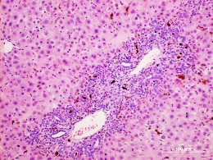
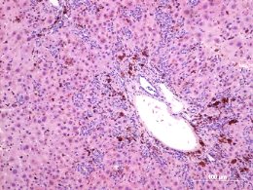
Supplementary figure 1
WT
BMP9-KO
0
2
6
DDC time (weeks)
Supplementary figure 1
Images of H&E staining in liver tissues of WT and BMP9-KO livers untreated or after 2 and 6 weeks of DDC diet. Scale bar=100 μm.

Slide 2
Supplementary figure 2
A
B
C
1.2
Alk1
8
***
120
1.0
***
100
(fold change)
6
**
0.8
80
***
0.6
4
60
(fold induction)
BRE-luciferase
Number of cells
0.4
(% of control)
mRNA levels
2
40
0.2
20
- + - +
- + - +
NT shALK1
BMP9
BMP9
NT shALK1
NT shALK1
Supplementary figure 2
BMP9 does not require ALK1 to activate Smad signaling and to induce cell loss in oval cells.
ALK1 knockdown oval cells were generated (shALK1) A. Alk1 mRNA levels were determined by qRT-PCR. B-C. NT and shALK1 oval cells were treated or not with BMP9 (5ng/ml). B. Transcriptional reporter assay. Data are mean ± S.E.M of 2 experiments (n = 6). C. Analysis of cell number after 2 days of treatment. Data are mean ± S.E.M of 2 experiments performed in triplicate. *p<0.05, **p<0.01, ***p<0.001. NT: non-target shRNA.

