Slide 1
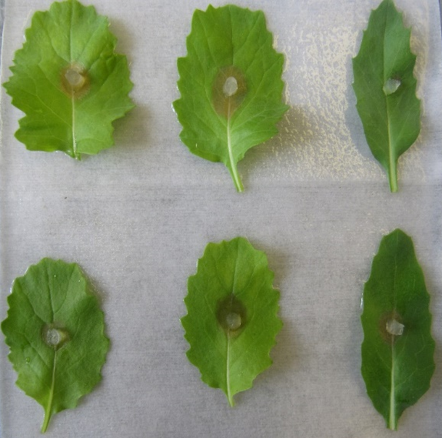
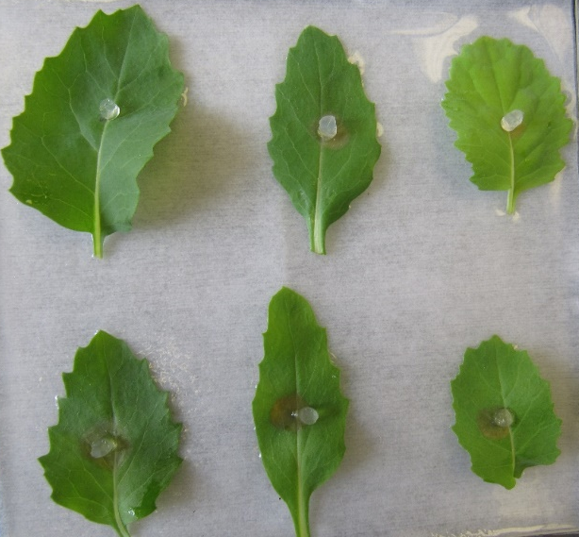
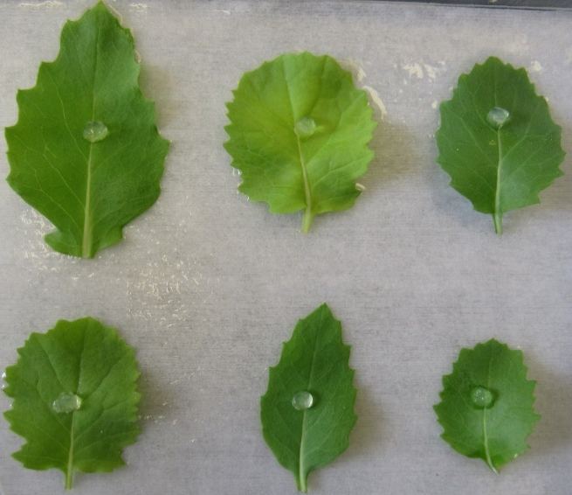
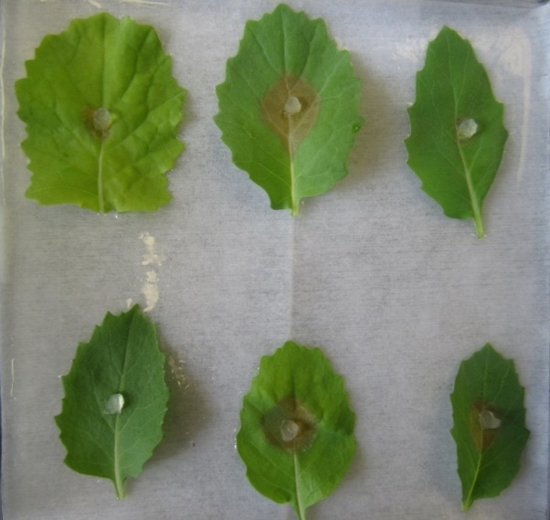
A.
B.
C.
D.
Figure S2. Effects of external RNA pesticide on inhibiting Sclerotinia sclerotiorum from causing lesions on canola leaves (A) dsRNA targeting agl-2 at 200 ng/20ul, (B) dsRNA targeting agl-2 at 400 ng/20ul, (C) dsRNA targeting agl-2 at 800 ng/20ul, as control (D) dsRNA targeting agl-4 at 800 ng/20ul as control, at 48 hours post inoculation. Statistical comparison is shown in Fig 6C.

