Slide 1
Supplemental Figure 1A-C
A
**
p=0.0008
B
**
p=0.0011
C
*
p=0.0102

Slide 2
Supplemental Figure 1D-H
D
G
p=0.1136
p=0.2393
E
H
p=0.1935
p=0.8743
F
p=0.7093

Slide 3
Supplemental Figure 2A-C
A
B
C

Slide 4
Supplemental Figure 2D-E
D
E

Slide 5
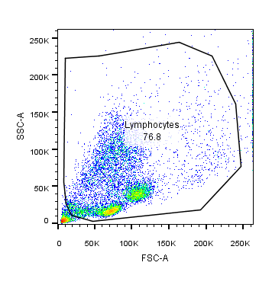
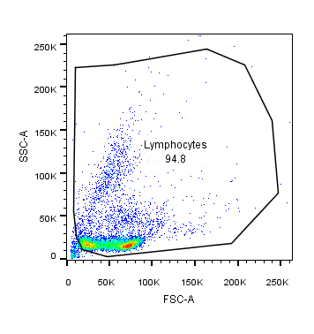
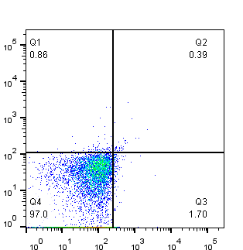
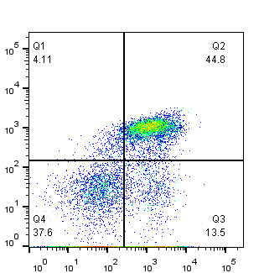
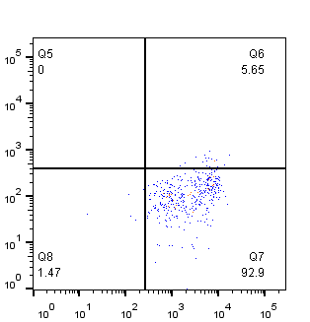
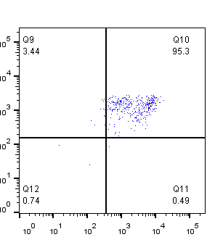
Supplemental Figure 3A
Iso
Abs
CD33-APC
HLA-DR-PECy7
Q1: → HLA-DR/CD33+
CD15-FITC
CD14-V-450
CD11b-PE

Slide 6
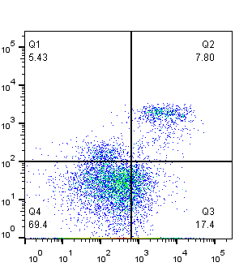
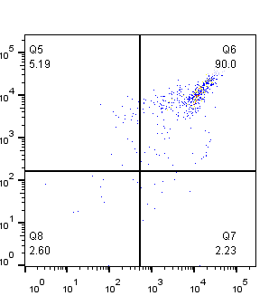
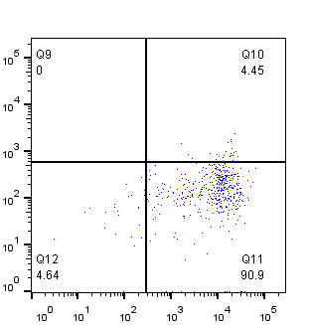
Supplemental Figure 3B
Iso
Abs
CD33-APC
HLA-DR-PECy7
Q1: → HLA-DR/CD33+
CD15-FITC
CD14-V-450
CD11b-PE

