Slide 1
Supplementary information for:
A strand-specific real-time quantitative RT-PCR assay for distinguishing the genomic and antigenomic RNAs of Rift Valley fever Phlebovirus
Breanna Tercero ¹, Kaori Terasaki^{1,2}, Keisuke Nakagawa¹,
Krishna Narayanan¹, and Shinji Makino*^{1,2,3,4,5}
Corresponding author: Shinji Makino
shmakino@utmb.edu

Slide 2
Supplementary Table S1. Unmodified primers used for reverse transcription
RVFV RNA | Target strand | Sequence (5’- 3’) | Genome position (Genomic sense)
L segment | Genome | acacaaaggcgcccaatc | 1-18ª
 | Antigenome | cacaaagaccgcccaat | 6403-6387ª
M segment | Genome | acacaaagacggtgcattaa | 1-20^{b}
 | Antigenome | cagctaatctggcaaaagac | 3844-3825^{b}
S segment | Genome | acacaaagctccctagag | 1-18^{c}
 | Antigenome | cccctagtgcttatcaag | 1680-1663^{c}
ª From Rift Valley Fever virus strain MP-12 L segment, DQ375404.1 ^{b} From Rift Valley Fever virus strain MP-12 M segment, DQ380208.1 ^{c} From Rift Valley Fever virus strain MP-12 S segment, DQ380154.1

Slide 3
Supplementary Table S2. Unmodified primers used for PCR
RVFV RNA | Target strand | Sequence (5’- 3’) | Genome position (Genomic sense)
L segment | *Genome | cctcactattacacaccattc | 3296-3316ª
 |  | atcatcagctgggaagct | 3453-3436ª
 | Antigenome | gctaggctaagaccagtaagc | 6288-6308ª
 |  | cacaaagaccgcccaat | 6403-6387ª
M segment | **Genome | ctagccgtttcacaaactggg | 2656-2676^{b}
 |  | caattgcataccctttgcctgggc | 2766-2743^{b}
 | Antigenome | atccaagcttagaaacttatgcaat | 3707-3731^{b}
 |  | cagctaatctggcaaaagac | 3844-3825^{b}
S segment | ***Genome | aaggcaaagcaactgtggag | 271-290^{c}
 |  | cagtgacaggaagccactca | 407-426^{c}
 | Antigenome | ccatagaataaggtatcctgg | 1551-1571^{c}
 |  | cccctagtgcttatcaag | 1680-1663^{c}
* Primers used are from Wilson et al., 2013 ** Primers used are from Maquart et al., 2013 *** Primers used are from Naslund et al., 2008 ª From Rift Valley Fever virus strain MP-12 L segment, DQ375404.1 ^{b} From Rift Valley Fever virus strain MP-12 M segment, DQ380208.1 ^{c} From Rift Valley Fever virus strain MP-12 S segment, DQ380154.1
F
R
F
R
F
R
F
R
F
R
F
R

Slide 4
Genome
Antigenome
L
M
S
L
M
S
Marker
1
2
3
4
5
6
7
Supplementary Figure S1. Absence of residual plasmid DNAs after DNase treatment in RNA preparations. In-vitro synthesized RNAs corresponding to genomic and antigenomic segments of L, M, and S RNAs were treated with DNase and directly subjected to PCR using unmodified PCR primer sets that specifically target genomic L (lane 1), M (lane 2), and S (lane 3) segments and PCR primer sets that specifically target antigenomic L (lane 5), M (lane 6) and S (lane 7) segments. The PCR products were analyzed by agarose gel electrophoresis. Lane 4 represents the DNA size marker.

Slide 5
A
Genomic PCR primers
L
M
S
MP-12 IC
MP-12 IC
MP-12 IC
G
AG
G
AG
G
Marker
AG
200 bp
100 bp
1
2
3
4
5
6
7
8
9
10
B
Antigenomic PCR primers
L
M
S
G
MP-12 IC
MP-12 IC
MP-12 IC
AG
G
AG
G
Marker
AG
200 bp
100 bp
1
2
3
4
5
6
7
8
9
10
Supplementary Figure S2. Modified tagged PCR primer sets do not amplify cDNAs generated by primer-independent reverse transcription. 100 ng of in-vitro synthesized RNAs corresponding to the genomic (G) and antigenomic (AG) segments of L, M, and S RNAs and intracellular RNAs from RVFV-infected cells (MP-12 IC) were used for cDNA synthesis without the use of specific RT primers. (a) After reverse transcription, cDNAs underwent PCR using primer sets with the forward PCR primer having a tagged sequence and a segment-specific reverse PCR primer designed to selectively amplify genomic L (lanes 2-4), M (lanes 5-7), and S (lanes 8-10) segments. (b) Experiments were done similar to (a) except that the samples underwent PCR using a set of forward PCR primers having a tagged sequence and a segment-specific reverse PCR primer specific for antigenomic L (lanes 2-4), M (lanes 5-7), and S (lanes 8-10) segments. Lane 1 in (a) and (b) represents the DNA size marker, and the location of the 100 and 200 base pair (bp) bands of the marker are indicated by arrows. The PCR products were analyzed by agarose gel electrophoresis.

Slide 6
Supplementary Table S3. Tagged primers used for reverse transcription
RVFV RNA | Target strand | Sequence (5’- 3’) | Genome position (Genomic sense)
L segment | Genome | GGCCGTCATGGTGGCGAATAgcccaatcatggattctat | 11-29ª
 | Antigenome | GGCCGTCATGGTGGCGAATAcaaagaccgcccaatattg | 6401-6383ª
M segment | Genome | GGCCGTCATGGTGGCGAATActaacccagagatgattg | 124-141^{b}
 | Antigenome | GGCCGTCATGGTGGCGAATActggcaaaagacgattacg | 3836-3818^{b}
S segment | Genome | GGCCGTCATGGTGGCGAATAcactattacaataatggac | 26-41^{c}
 | Antigenome | GGCCGTCATGGTGGCGAATAgtatatcatggattactt | 1663-1646^{c}
ª From Rift Valley Fever virus strain MP-12 L segment, DQ375404.1 ^{b} From Rift Valley Fever virus strain MP-12 M segment, DQ380208.1 ^{c} From Rift Valley Fever virus strain MP-12 S segment, DQ380154.1 Tagged RT primers were used for strand-specific reverse transcription. The Tag sequence is in capital letters and underlined.

Slide 7
Supplementary Table S4. Primers used for PCR
RVFV RNA | Target strand | Sequence (5’-3’) | Genome position (Genomic sense)
L segment | Genome | ccagattgaagtctatgg | 169-152ª
 | Antigenome | gctaggctaagaccagtaagc | 6288-6308ª
M segment | Genome | caagccatcagcagcaatg | 278-260^{b}
 | Antigenome | atccaagcttagaaacttatgcaat | 3836-3818^{b}
S segment | *Genome | aactctacgggcatcaaacc | 152-133^{c}
 | Antigenome | ccatagaataaggtatcctgg | 1551-1571^{c}
Tag |  | **GGCCGTCATGGTGGCGAATA
* Primer used is from Brennan et al., 2014 **Tag sequence is adapted from Brennan et al., 2014 ª From Rift Valley Fever virus strain MP-12 L segment, DQ375404.1 ^{b} From Rift Valley Fever virus strain MP-12 M segment, DQ380208.1 ^{c} From Rift Valley Fever virus strain MP-12 S segment, DQ380154.1
R
R
R
R
R
R
F

Slide 8
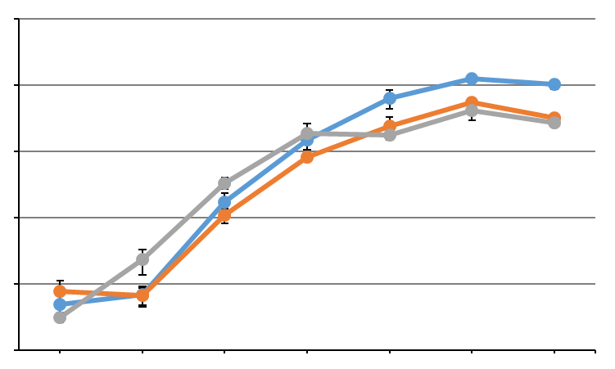
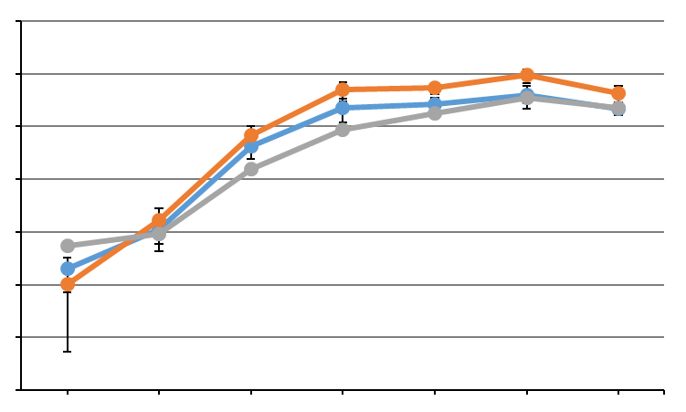
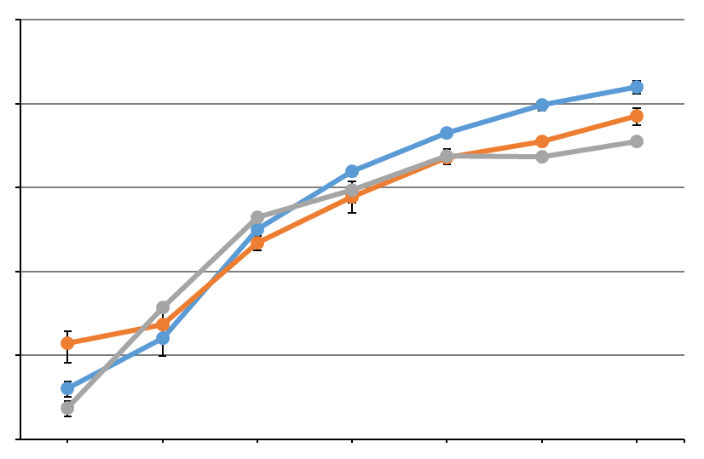
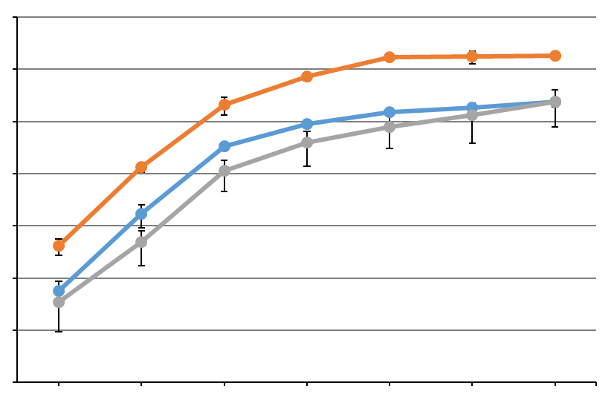
A
Genome
B
Antigenome
9
Vero E6
8
Vero E6
8
7
7
6
5
6
L
4
L
5
M
3
M
4
S
2
S
2
4
6
8
12
16
20
1
2
4
6
8
12
16
20
Copy number (log₁₀)
Copy number (log₁₀)
9
Huh7
8
Huh7
8
7
7
6
5
6
L
4
L
5
M
3
M
4
S
2
S
2
4
6
8
12
16
20
1
2
4
6
8
12
16
20
Hours post-infection
Hours post-infection
Supplementary Figure S3. Comparison of accumulation kinetics of L, M and S segments in RVFV-infected cells. Alternate representation of the data shown in Fig.8 for the accumulation kinetics of a) all three genomic segments and b) all three antigenomic segments. Blue, red and grey lines represent L segment, M segment and S segment, respectively.

