Slide 1
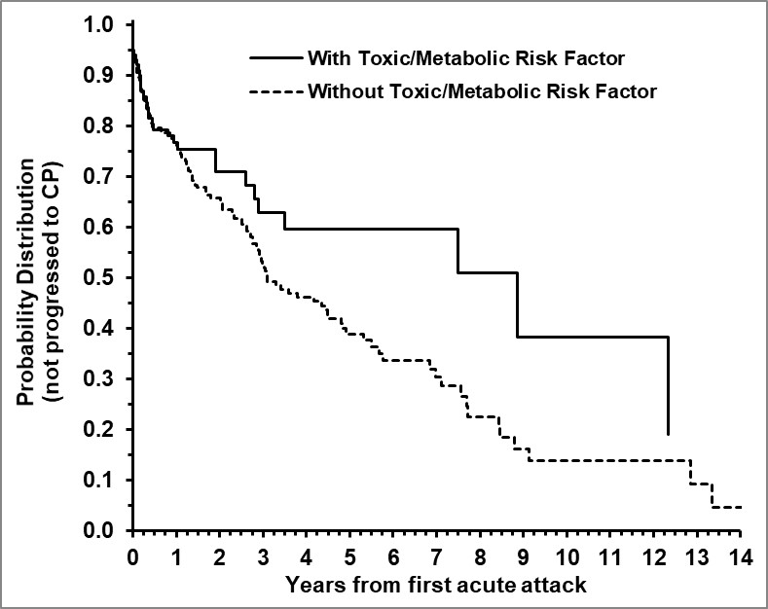
Figure S1. Toxic Metabolic Risk Factors on Disease Progression

