Slide 1
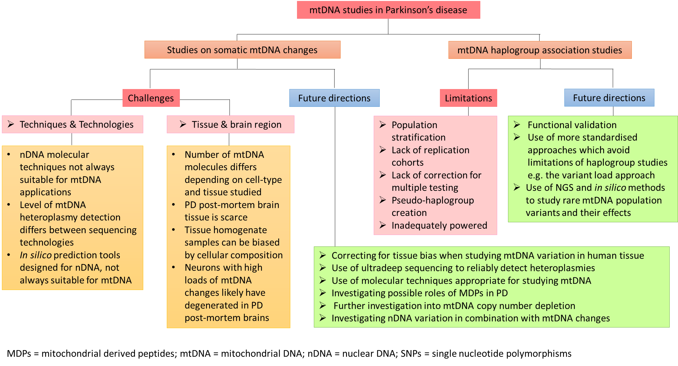
Supplementary Figure 1. Flow diagram summarizing the limitations and challenges of published studies investigating mtDNA variation in Parkinson’s disease as well as directions for future studies in this field.
MDPs = mitochondrial derived peptides; mtDNA = mitochondrial DNA; nDNA = nuclear DNA; NGS = next-generation sequencing; PD = Parkinson’s disease; SNPs = single nucleotide polymorphisms

