Slide 1
Supplemental Figures
Supplemental Figure 1. The detailed time line of the euthanization of study animals
Supplemental Figure 2. Volcano plot of miRNA expression in replication cohort (GSE95070). Plotted along the x-axis is the mean of log2 fold-change, along the y-axis the negative logarithm of the log2 p values. Lightblue demonstrates the miRNAs with significant p value (p < 0.05), and red denotes these significant miRNAs validated by the replication cohort. The horizontal line represents the threshold of significant p value.
Supplemental Figure 3. The results of qRT-PCR for technical replication
Supplemental Figure 4. WGCNA module-based analysis for genes and miRNAs expression data of GSE73507. The hierarchical clustering dendrogram is shown for 13,241 mRNAs and 546 miRNAs expressed and highly connected genes. Each line demonstrates a specific gene. Genes were clustered based on a dissimilarity measure (1-TOM). The branches are related to modules of highly interconnected gene groups. Below the dendrogram of each gene group is a color to indicate its module color. As the result, 25 co-expression module were constructed and painted with different colors.
Supplemental Figure 5. KEGG pathway enrichment analyses for mmu-miR-190a-3p highly related genes in red module. The red vertical line indicates the threshold of the significant pathway enrichment p value after FDR correction. Dark blue color of horizontal bars represents the significantly enriched pathway, and the light blue color represents the non-significantly enriched pathway.

Slide 2
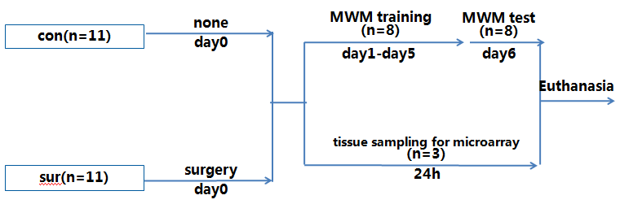
Supplemental Figure 1

Slide 3
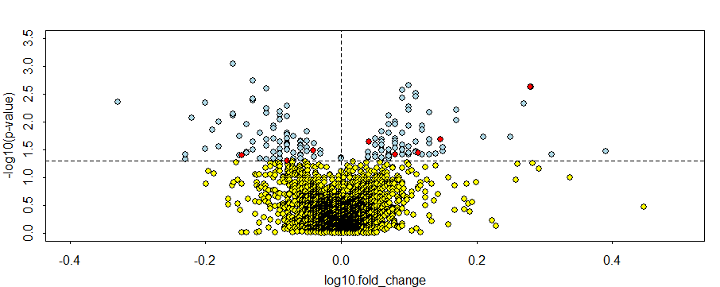
Supplemental Figure 2

Slide 4
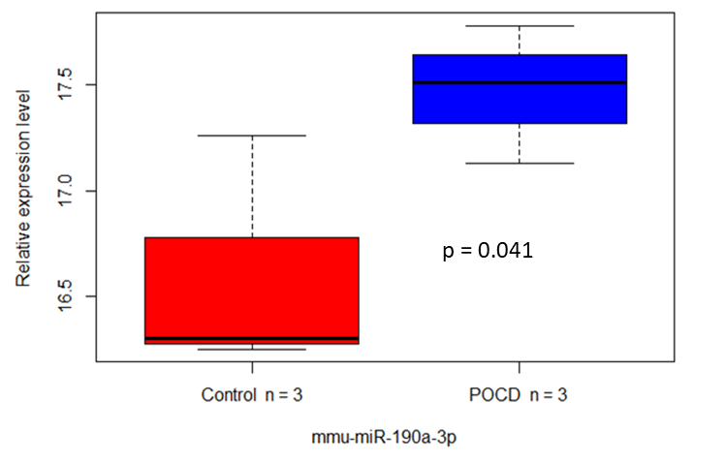
Supplemental Figure 3

Slide 5
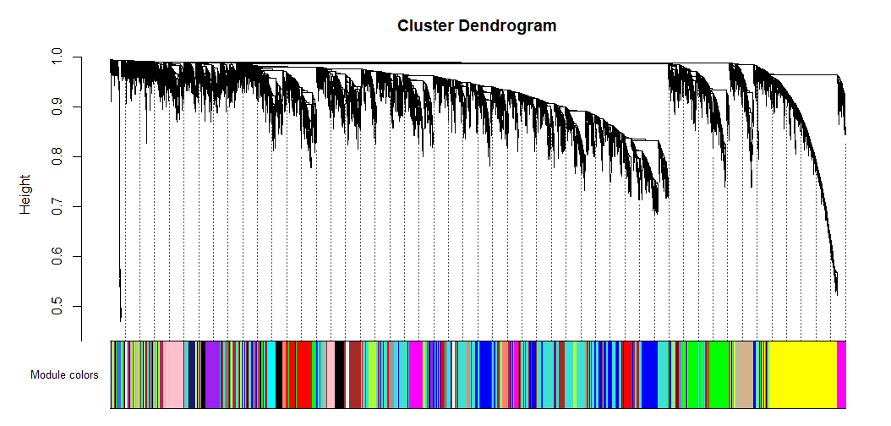
Supplemental Figure 4

Slide 6
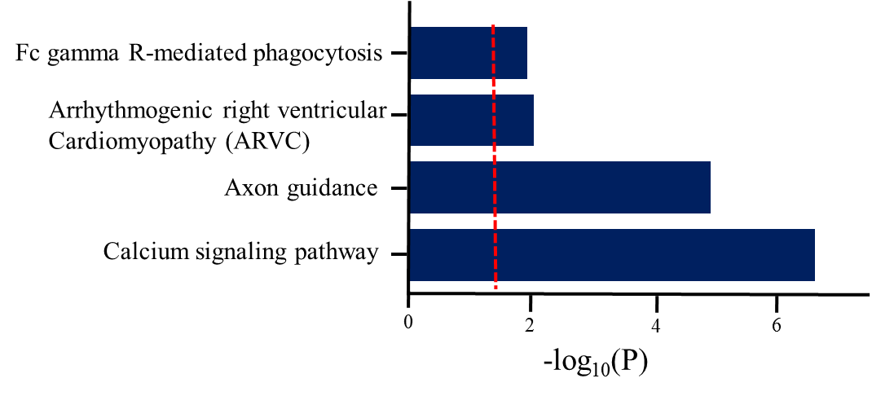
Supplemental Figure 5

