Slide 1
On-line Supplemental Figure 1. Overlap among different types of separation/loss

Slide 2
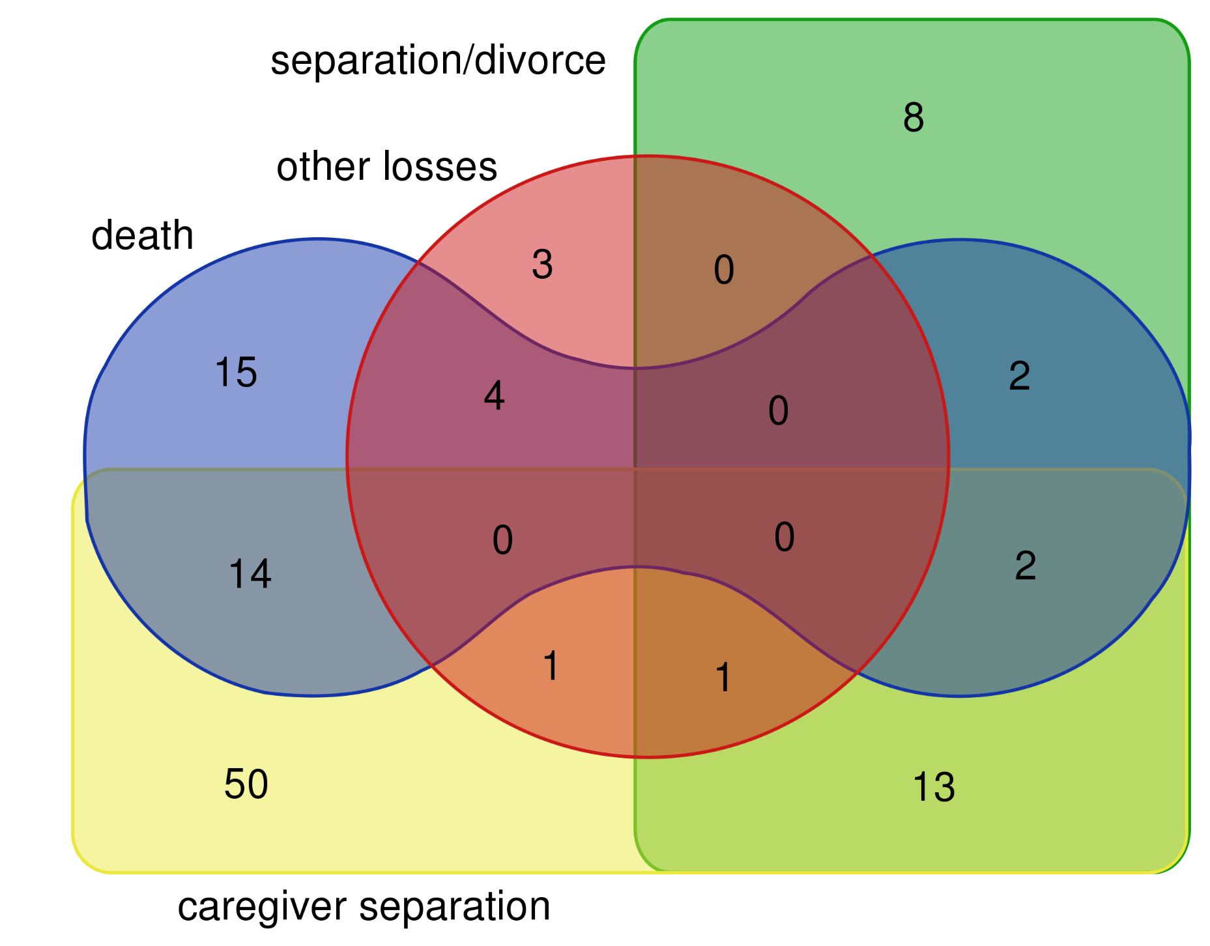

Slide 3
On-line Supplemental Figure 2. Overlap among loss, violence, and non-interpersonal trauma

Slide 4
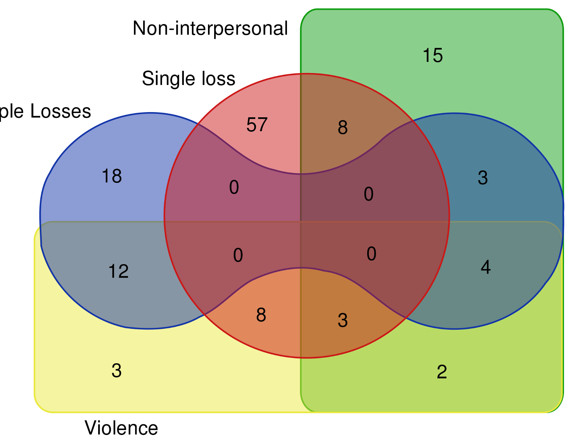
Multiple losses

Slide 5
On-line Supplemental Figure 3. Overlap among loss and violence

Slide 6
