Slide 1
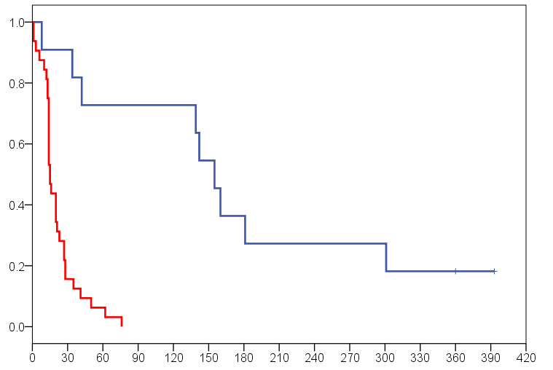
Figure S1
irAE discontinuation (n=11)
Non-irAE discontinuation (n=32)
irAE discontinuation (n=11)
Non-irAE discontinuation (n=32)
Median (months)
5.2 (95%CI, 4.4-5.9) vs 0.5 (95%CI, 0.44-0.56)
HR 0.09 (95%CI, 0.02-0.27)
P<0.001
Period from discontinuation to the next therapy
or decision for BSC
0
3
6
9
12
Months

